Slide 1

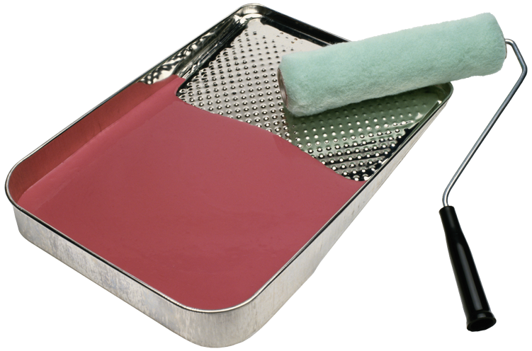



NINE TYPES OF ADAPTATIONS
SUGGESTIONS FOR DIFFERENTIATING
INSTRUCTION FOR SPECIAL NEEDS STUDENTS

Slide 2
Common Core Standards
A must for all students
Students with special needs-including ESL, LD, gifted, and other students needing support- may benefit in achieving the CCS by individualized help using some of the following strategies or procedures.

Slide 3


1. SIZE
Adapt the number of items the learner is expected to learn or complete
Less is often more
In-class or homework assignments
Ex: Reduce the number of science terms the learner must learn at any one time.

Slide 4



2. TIME
Adapt the time allotted or allowed for learning, task completion, or testing**
Ex: Pace learning differently by increasing or decreasing time for some learners—create an individualized timeline for completing a long-term project or homework assignment.
Ex: Allow extra time for testing. (IEP)

Slide 5

3. LEVEL of SUPPORT
Increase the amount of personal assistance with a specific learner.
Assign a peer tutor
Small group or partner tasks
Pre-teach/Teach/Re-teach Method
Ex: One-on-one help before or after school or class

Slide 6



4. Input
Adapt and modify the way instruction is delivered.
Ex: Use visual aids, slideshows, overhead, charts, graphs
Ex: Hands on activities
Ex: Concrete examples
Ex: Cooperative groups-peer teaching
Ex: Provide notes page, graphic organizers
(partially completed); modify textbook
Ex: Consider multiple intelligences, learning styles when planning instruction

Slide 7


5. Participation
Adapt the extent to which the learner is actively involved in tasks, discussions.
Ex: Think-Pair-Share
Ex: Pre-assign question/response
Ex: Involve as an assistant
Ex: Provide adequate think time
Ex: Non-verbal responses, private responses
Ex: Choice to work alone or partner

Slide 8
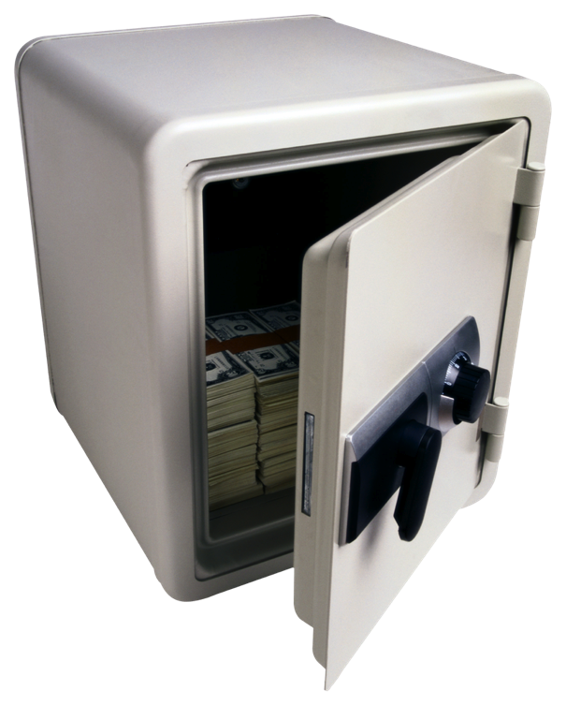
6. Difficulty
Adapt the skill level, problem type, or modify procedures (rules) the learner must follow.
Ex: Simplify task directions
Ex: Provide step-by-step procedures
Ex: Allow use of calculator
Ex: Scale-back procedures
Ex: Adapt rules to insure success for some learners

Slide 9


7. Output
Adapt how a learner may respond to instruction or complete tasks.
Ex: Allow verbal responses rather than in writing
Ex: Allow use of hands-on materials to show that learner has acquired the knowledge
Ex: Use technology
Ex: Choices
Ex: Alternative testing—more frequent, but shorter tests on specific items; retest options

Slide 10


8. Alternate Goals
Modify outcomes or goals while using the same materials, standards.
Ex: Allow a learner to identify the location of the states, while others must also identify the capitals.

Slide 11

9. Substitute Curriculum
Provide different instruction and materials to meet a learner’s individual goals.
EX: Use prompts and cues
Ex: Provide step-by-step written/icon procedures or directions
Ex: Provide readers with similar
texts, but at the readers independent
level.

