Slide 1


HOW TO ACE AN INTERVIEW
Presented by
Notes:
Minimalist Grey Brand Guideline Presentation

Slide 2


SOMETHING TO REMEMBER:
All of our dreams can come true-
if we have the courage to pursue them.
- WALT DISNEY

Slide 3



THE INTERVIEW PROCESS
PRE-INTERVIEW
POST-INTERVIEW
INTERVIEW

Slide 4


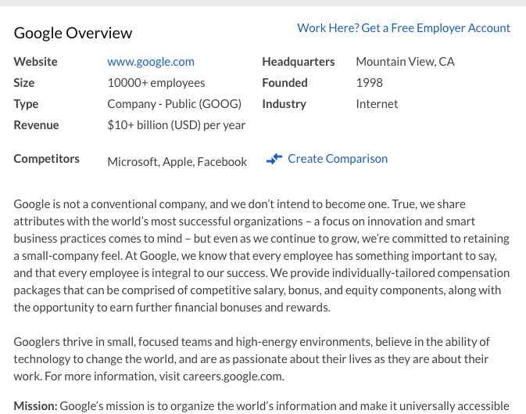
RESEARCH
HISTORICAL AND FINANCIAL BACKGROUND
  Origins-founding principles & mission and vision of the company
  How well is the company doing financially?
MACRO (THE BIG PICTURE)
  How well is the company doing in its respective industry?
MICRO (MORE SPECIFIC)
  What is it like working for the company?
  Number of employees
  Employee rating
    Glassdoor
    Indeed
PRE-INTERVIEW

Slide 5

PREPARATION
FAMILIARIZE YOURSELF WITH VIDEO CHAT PLATFORMS
Google Meet, Zoom, Microsoft Teams, etc.
PREPARE YOUR TECHNOLOGY
Test your technology the day before. You may consider doing a test run with a friend so they can provide feedback about the quality of your video and sound.
PREPARE YOUR BACKGROUND
Add a professional virtual background if your computer allows.
If not, tidy your space or choose a blank wall.
PRE-INTERVIEW

Slide 6


FIRST IMPRESSION
SKILLS:
Dress for Success!
REASONS
  More presentable and professional.
  When you are dressed your best, you tend to feel more confident.
CUT
  Shirts and attire should be modest
  No slits in the front of skirts/dresses
PRINT
  Minimal print to solid (no print) is best
COLOR
  Dark Blue
  Black
  Gray
PRE-INTERVIEW

Slide 7
How to Answer the
"TELL ME ABOUT YOURSELF"
Question
WORK EXPERIENCE
EDUCATION
KEY STRENGTHS
FUTURE
  Begin with your year in school, major (and minor), and how you became interested in the field.
  Skills you have learned through school projects.
  Mention on campus membership/s and organizations (especially if in a leadership position).
  Discuss your current position, if you are currently working.
  Mention past jobs.
  Focus on transferable skills that would be valuable to employers in the field, professional accomplishments, or recognition you received.
  Based on your research of the organization, mention two key strengths of yours that match the requirements of the organization.
  End with why you are interested in working for the organization.
  State that you look forward to learning more about how you might be able to contribute your skills, talents, and experience in the future.
INTERVIEW

Slide 8

The CARR Technique
CONTEXT
  Describe a specific event or situation.
  Give enough detail & context for the interviewer to understand.
  Draw from campus, work, or community experiences
ACTION
  Describe the action that you took to address the situation.
  If you are describing a group project, focus on your role.
RESULT
  What did you accomplish?
  If not success, what did you learn?
RELATE
  How does this relate to the position you're applying for?
INTERVIEW

Slide 9


ASKING THE RIGHT QUESTIONS
The interview is a two-way communication process
Asking meaningful questions will demonstrate that your interest extends beyond seeking employment.
What types of questions should you ask?
Please describe an average day on the job?
What is the next step in the hiring process?
If you freeze, ask questions about what you would like to know about the job
INTERVIEW

Slide 10

Interview Summary
EXPAND
SHARE
KNOW
PREPARE
  Expand on key items listed on your resume/cover letter.
  Be sure to reference related, past experiences that fit the requirements of the position.
  Share your CARR stories that showcase past experiences.
  Know your strengths & weaknesses.
  Show how you have overcome at least
ONE weakness.
  Prepare a closing statement & questions.
INTERVIEW

Slide 11



AFTER THE INTERVIEW
Thank
you!
SEND A THANK YOU NOTE OR EMAIL TO THE INTERVIEWER/S TO THANK THEM FOR THEIR TIME
  Only 20% of candidates do this.
  Send a letter or email to each person who interviewed you.
  Use this letter to add info you thought of later that will advance you as a candidate of choice.
POST-INTERVIEW

Slide 12
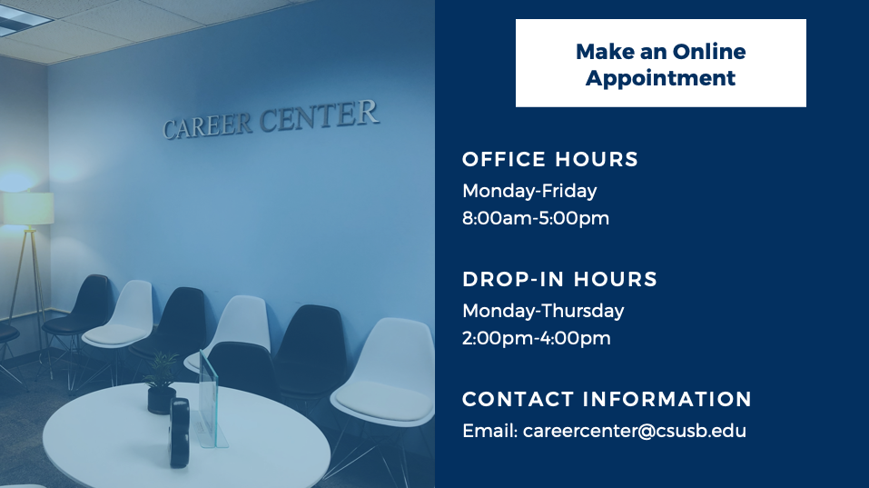
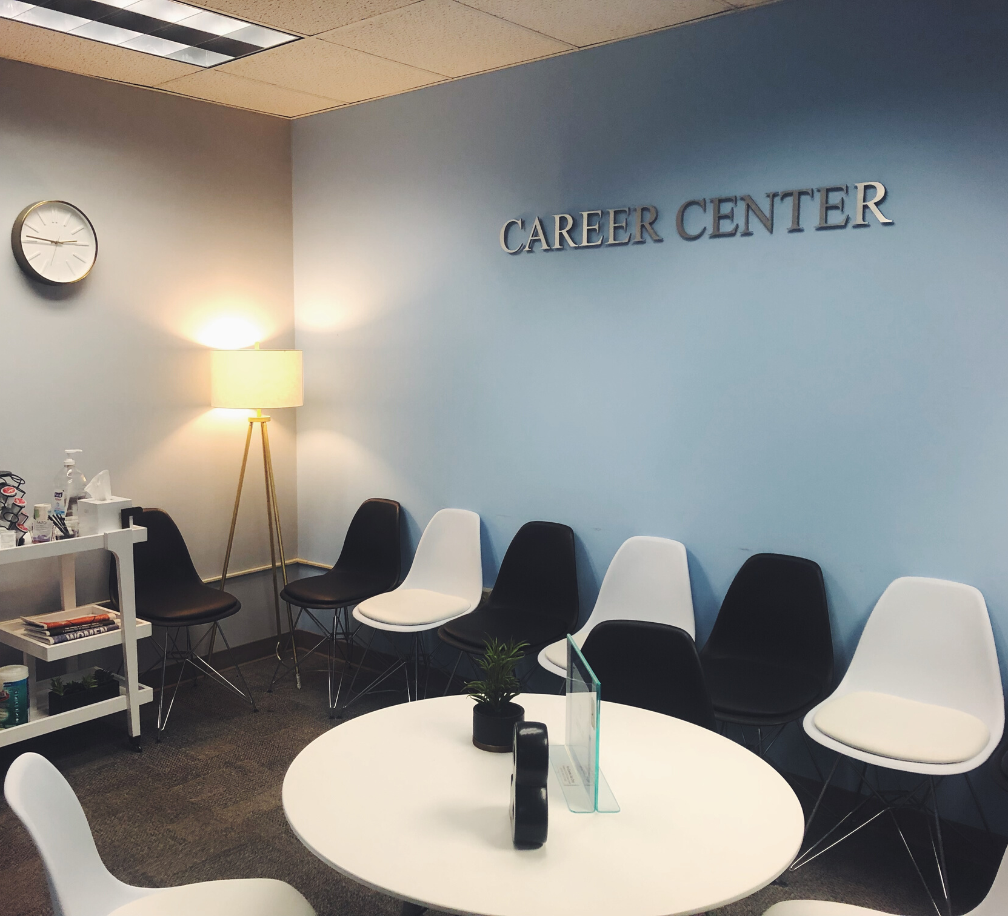
MAKE AN ONLINE APPOINTMENT
OFFICE HOURS
Monday-Friday
8:00am-5:00pm
DROP-IN HOURS
Monday-Thursday
2:00pm-4:00pm
CONTACT INFORMATION
Email: careercenter@csusb.edu

Slide 13

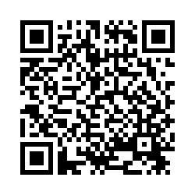
Thank you for joining us!
Questions?

