Slide 1
Presenter: Twillea Evans-Carthen University Ombuds Officer, Director, Ombuds Services
“How to Work Effectively from Home: One Size Does Not Fit All”

Slide 3
Objectives
Understanding “Stay-at-Home” Directives
Review Company Policy
Strategies for Working at Home
Communication Tips
Exercise Self-Care

Slide 4
Understanding “Stay-at-Home” Directives
Gov. Gavin Newsom ordered Californians to “stay at home effective March 19, 2020.
Mandatory restrictions in the fight against Coronavirus COVID-19.

Slide 5
Review Company Telecommuting Policy

Slide 6
Strategies for Effectively Working from Home
Designate home workspace to set-up office.
Keep to a regular work schedule.
Dress like you are at work.
Create a “Things to Do List” to remain productive and hold self-accountable.
Collaborate with colleagues and supervisor via Zoom video conferencing.
Build in time for other commitments.
Childcare
Tutor/Emergency Teacher
Eldercare

Slide 7
Communication Tips
Establish Boundaries
Active Listening
Non-verbal Communication
Use “I” Statements
Remain Calm
Control Tongue and Tone
Confront the situation not the person including kids and parents.
Other

Slide 8
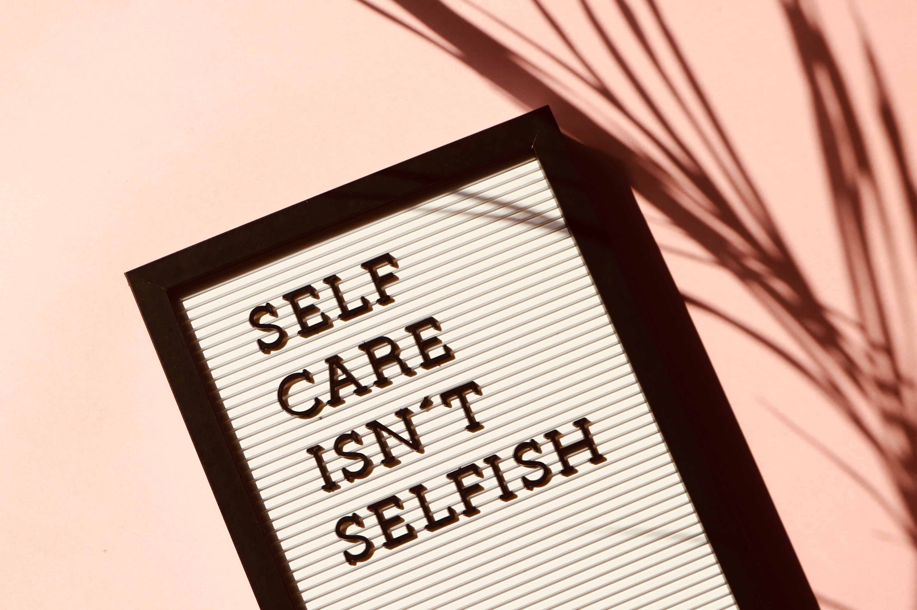
Exercise Self-Care
Mind
Music
Take Breaks
Body
Exercise
Sleep
Eat Healthy
Drink Water
Spirit
Stay connected with others via Zoom videoconferencing, telephone, other
Exercise Self-Control

Slide 9
Questions

Slide 10
Contact Information
Twillea Evans-Carthen
University Ombuds Officer, Director of Ombuds Services
California State University, San Bernardino
5500 University Parkway
San Bernardino, CA 92407
tcarthen@csusb.edu
(909) 537-5635

