Slide 1
How to Complete the CITI Training for External Researchers, Evaluators, and Volunteers

Slide 2
Requirements and recommendations to complete the CITI training.
Computer (fully charged or plugged in)
Pencil and paper to take notes
Ability to save the final completion certificate
3-5 hours to complete the full training
You may complete the training in multiple sessions

Slide 3
Requirements and recommendations to complete the CITI training cont.
MUST complete all modules.
MUST pass all module quizzes with 100% to pass the training (5-10 questions each). You are able to retake the quizzes if you do not pass.
Final test uses same questions as the previous quizzes, but rearranges the questions to ensure your paying attention.
After completing all modules, you will receive a certificate. Please print and/or save the completion report and certificate to your computer or device.

Slide 4
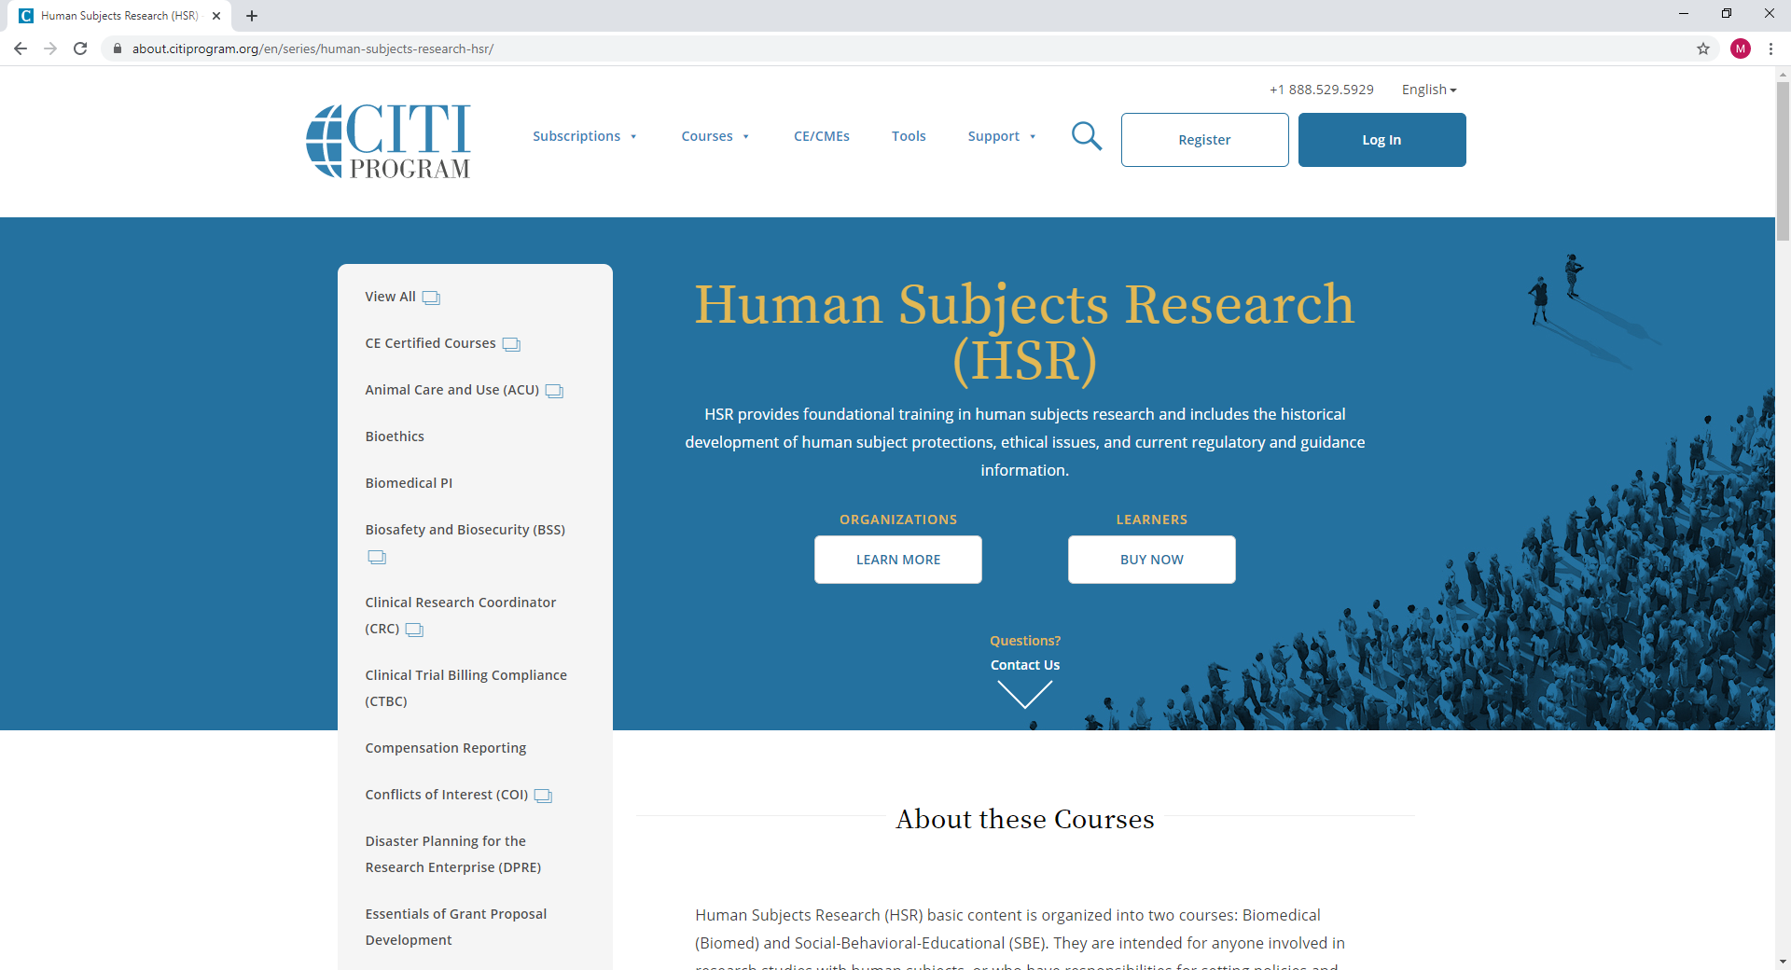
Step 1: Go to the CITI Human Subjects Training website:
https://about.citiprogram.org/en/series/human-subjects-research-hsr/
Step 2: Select Register:

Slide 5
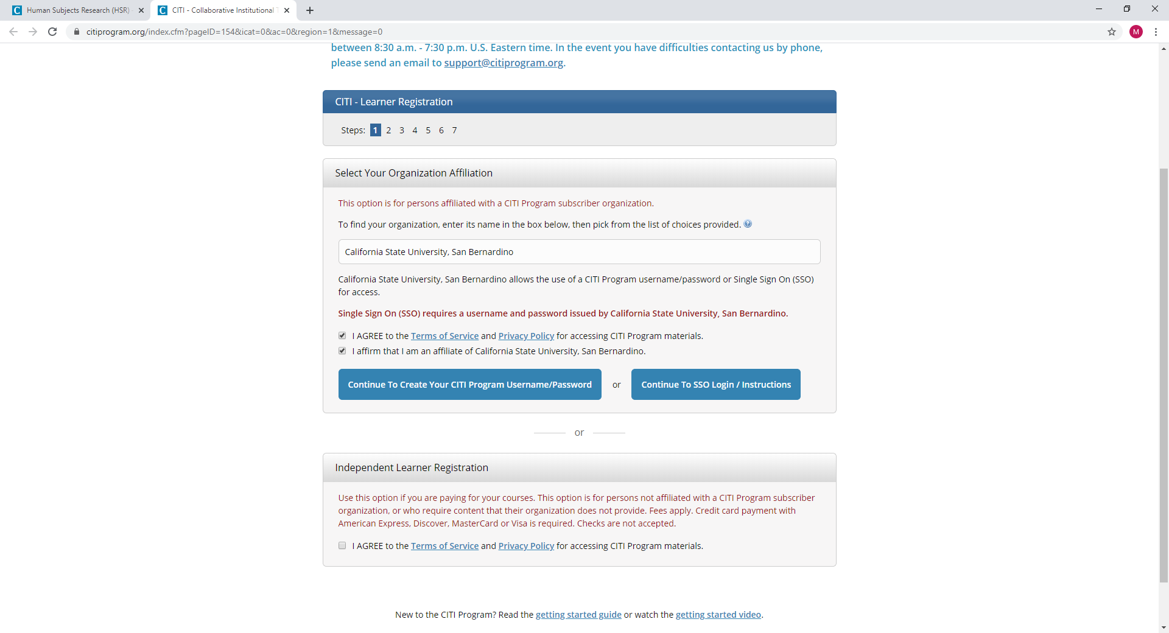
Step 5: A new screen will appear and should look like the picture below.
Step 6: Type in California State University, San Bernardino. ‘
Select California State University, San Bernardino only. Do not select the one with SSO.
Step 7: See Red Arrows to make the appropriate selections.

Slide 6
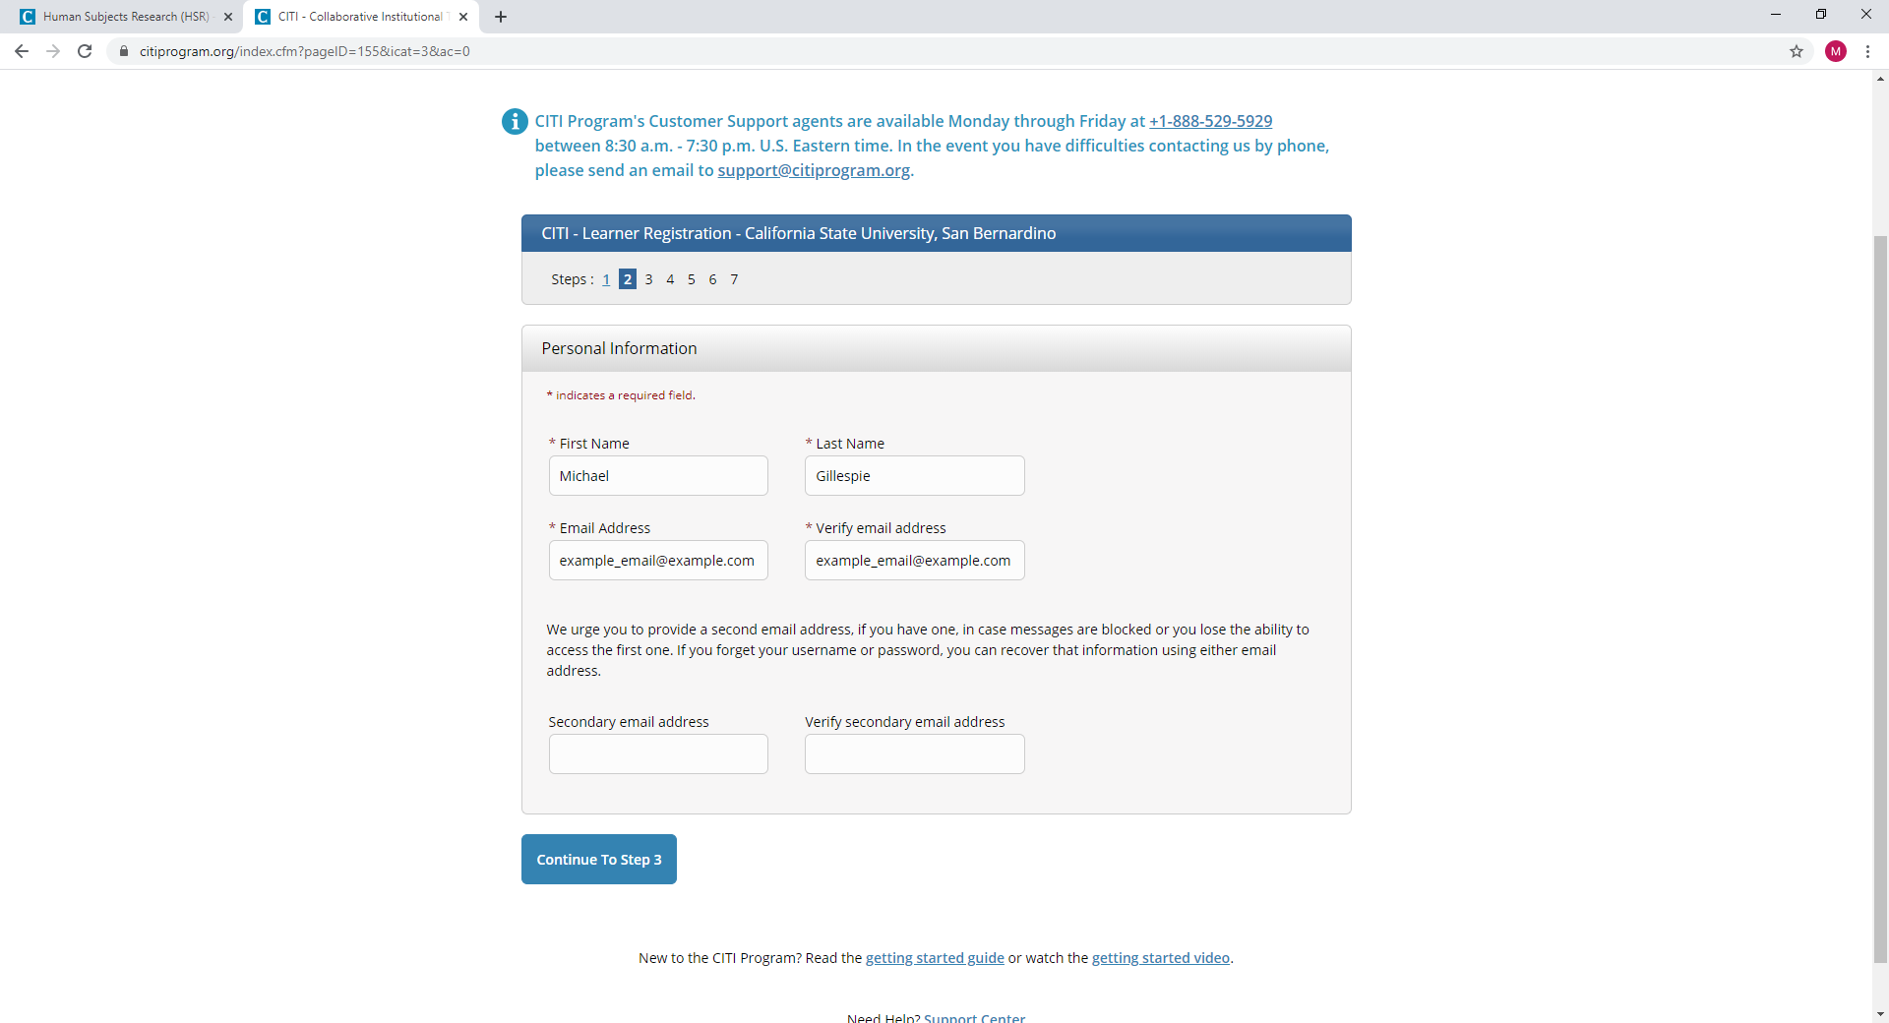
Step 7: Enter your name and email address.
Step 8: You can enter a secondary email if you wish to.
Step 9: Select Continue to Step 3.

Slide 7
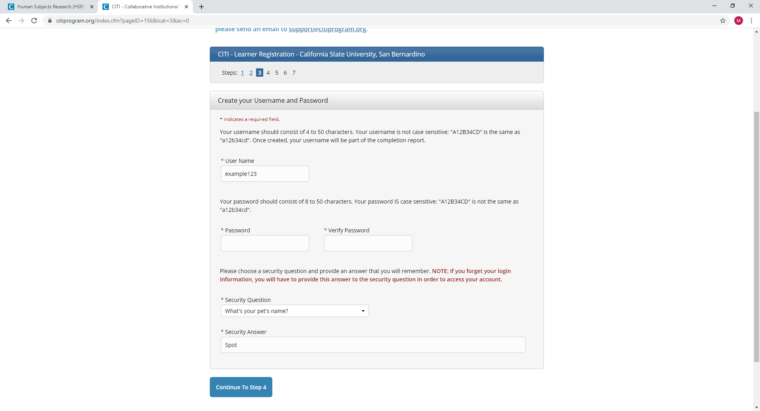
Step 10: Create a username, password, and security question.
Step 11: Select Continue to Step 4.

Slide 8
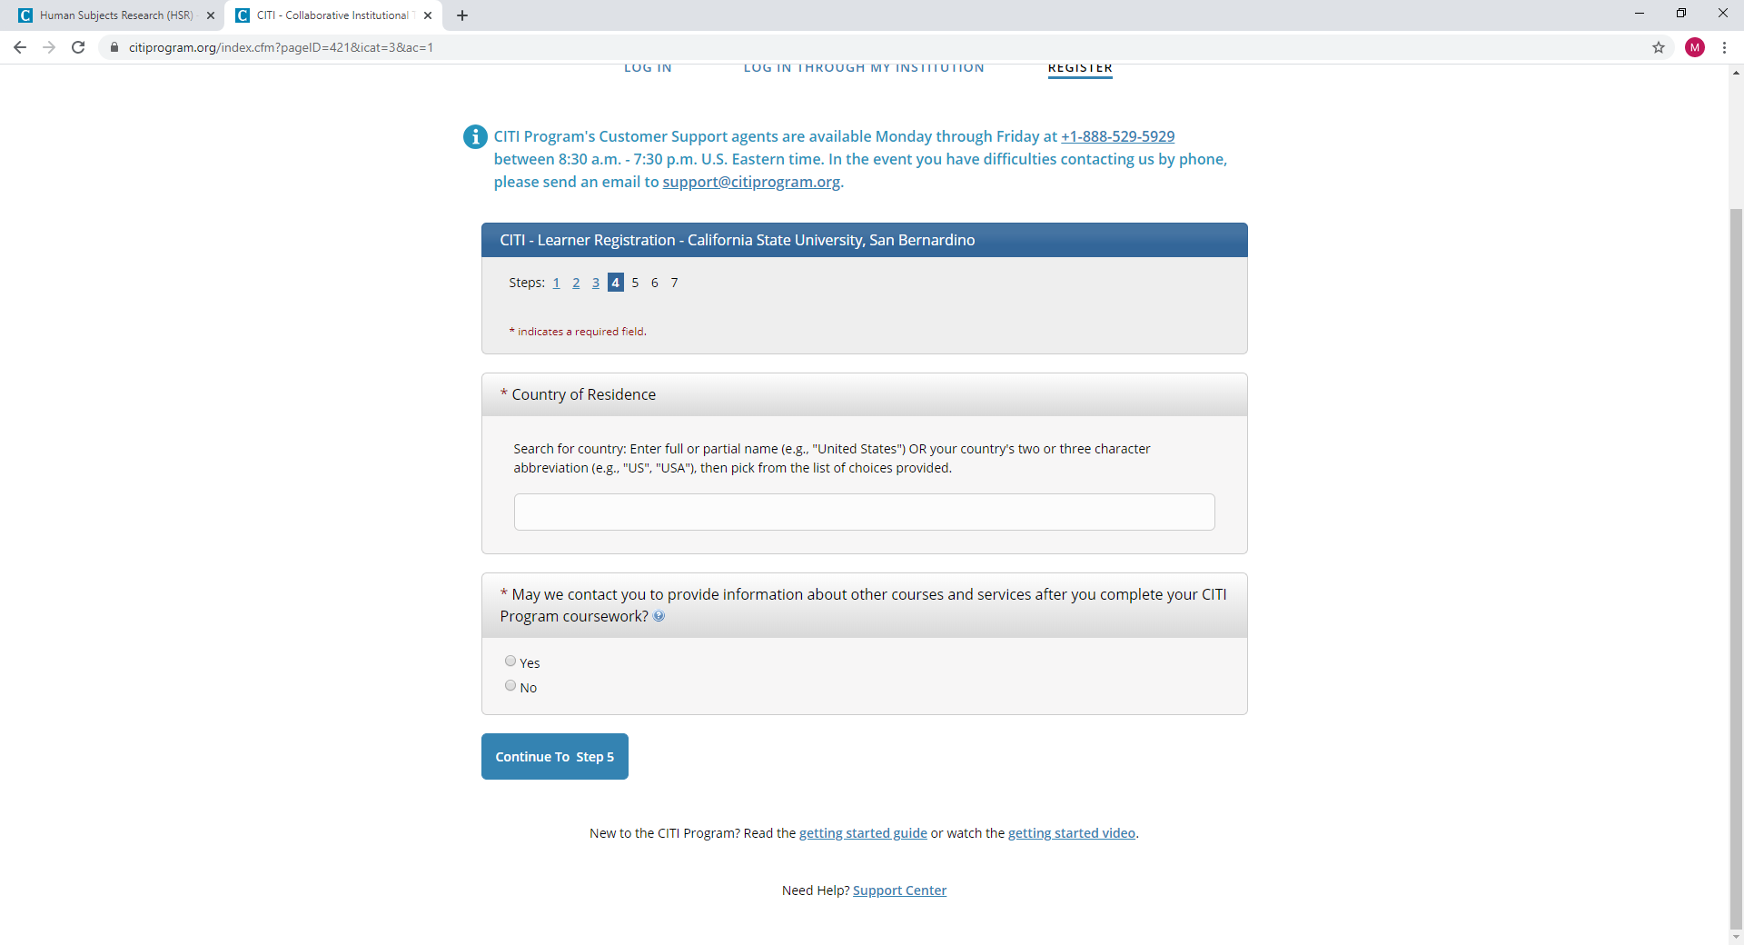
Step 12: Select “Country of Residence”
Step 13: Select Yes or No.

Slide 9
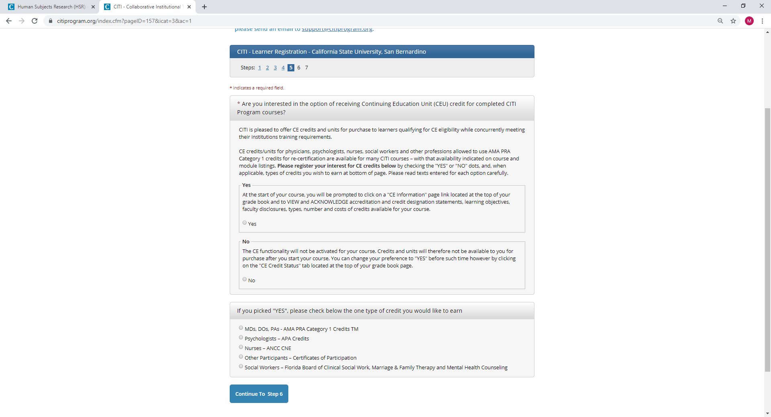
Step 14: If you would like to receive CE credits select the appropriate categories. These CE credits are not affiliated with CSUSB course credits, etc.
Step 15: Select Continue to Step 6.

Slide 10
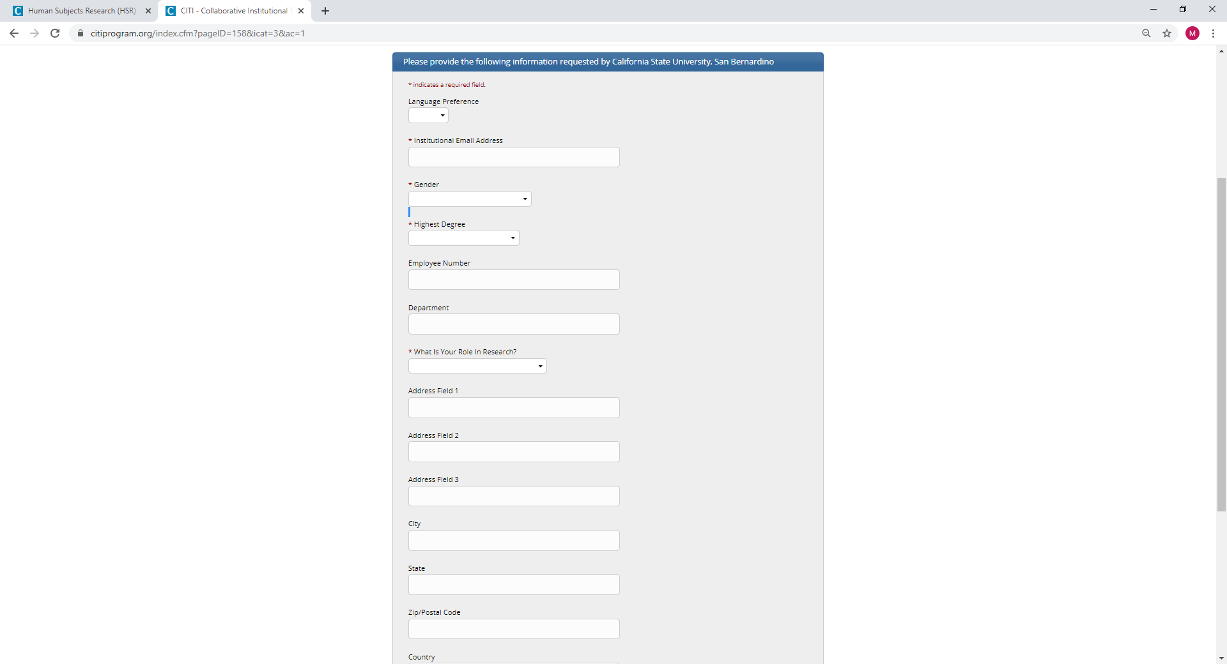
Step 17: Fill in the information on this page. Some of the information fields are required by CITI. You need to fill those marked with an asterisk (*) to proceed.
Step 18: Select Continue to Step 7.

Slide 11
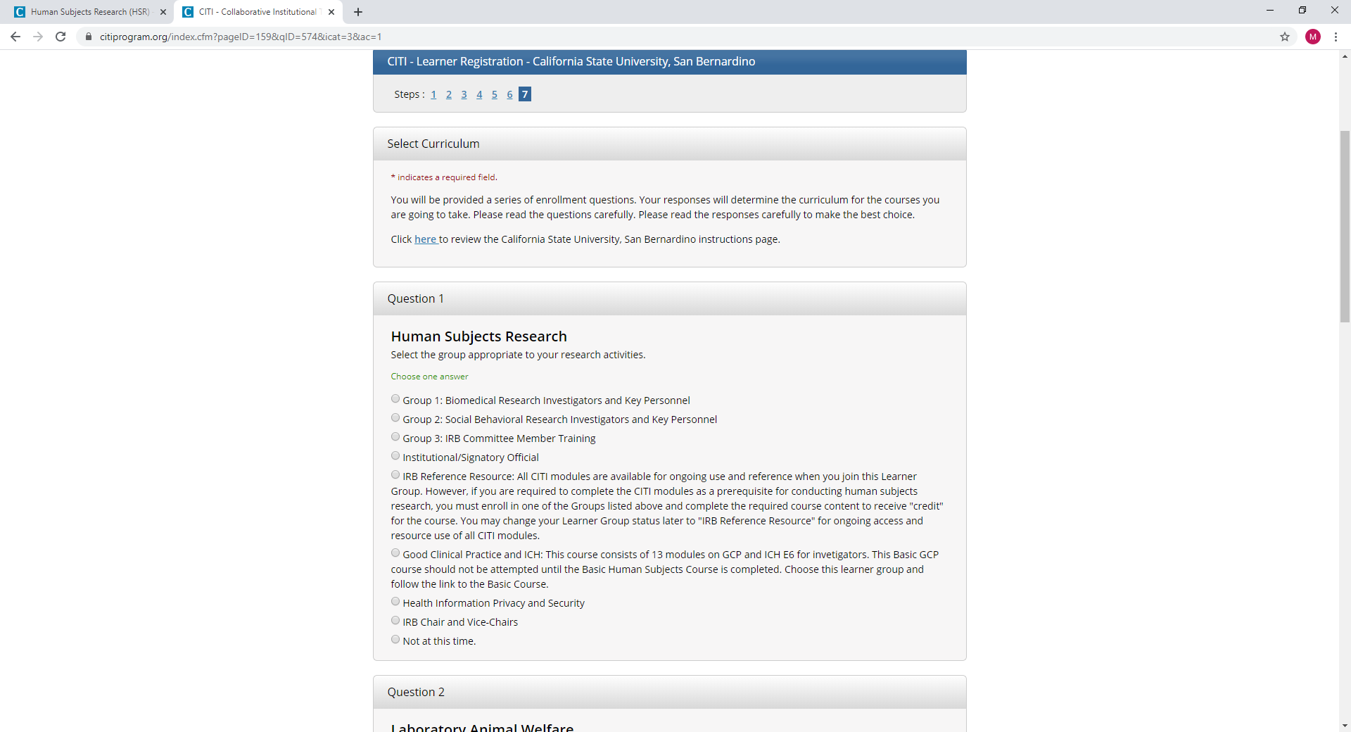
Step 19:
Select Group 1 Biomedical Research Investigators and Key Personnel if your in the Natural Sciences (e.g., biology, chemistry, health science, etc).
Select Group 2 Social Behavioral Research Investigators and Key Personnel if your in the Social Sciences (e.g., psychology, social work, sociology, etc).
Select Group 3 if you are an IRB Member. This group is for IRB members only.

Slide 12
Step 20: Answering questions 2 through 5.
Question 2: Ignore question 2 if your not working with animal subjects. If your working with animal subjects students should consult with their faculty adviser on which modules to complete. Otherwise do not select any box in question 2.
Question 3: If your required to complete the Conflict of Interest mini-course select Yes.
Note: This course is normally completed for CSUSB faculty researchers required to take Conflict of Interest (COI) training for federal grant related requirements and policies.
Question 4: Select No.
Question 5: If you are required to take the Responsible Conduct of Research (RCR) courses because you are on a National Institutes of Health (NIH), National Science Foundation (NSF), U.S. Agricultural Department (USDA), or another federal or state agency that requires RCR training please select the appropriate course related to your field and complete this training as well.
If you are not required to take RCR courses select Not at this Time.
Step 21: Select Complete Registration

Slide 13
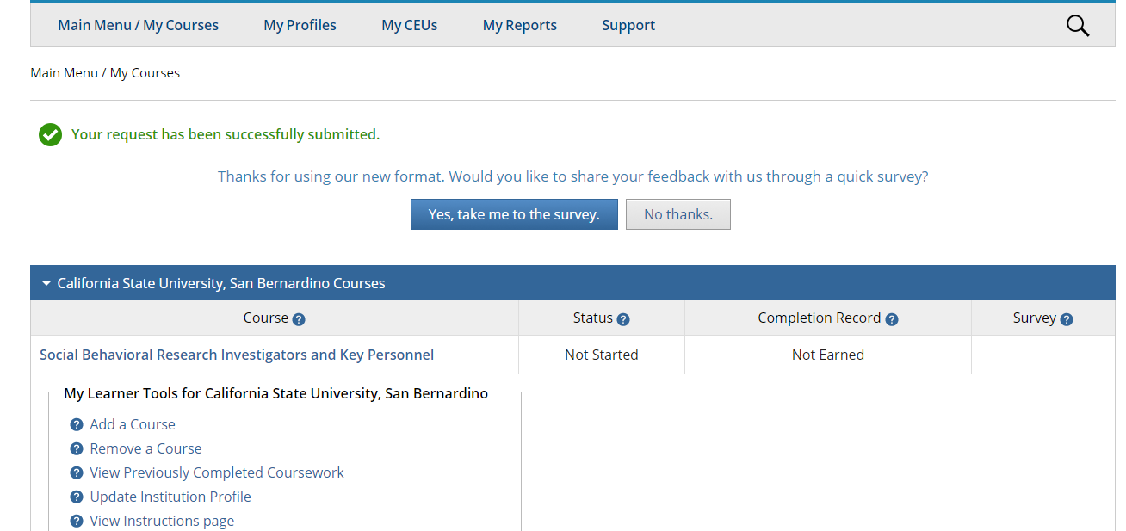
Step 22: You may receive a question that asks if you would like to leave feedback. You have to choice to select Yes or No thanks.

Slide 14
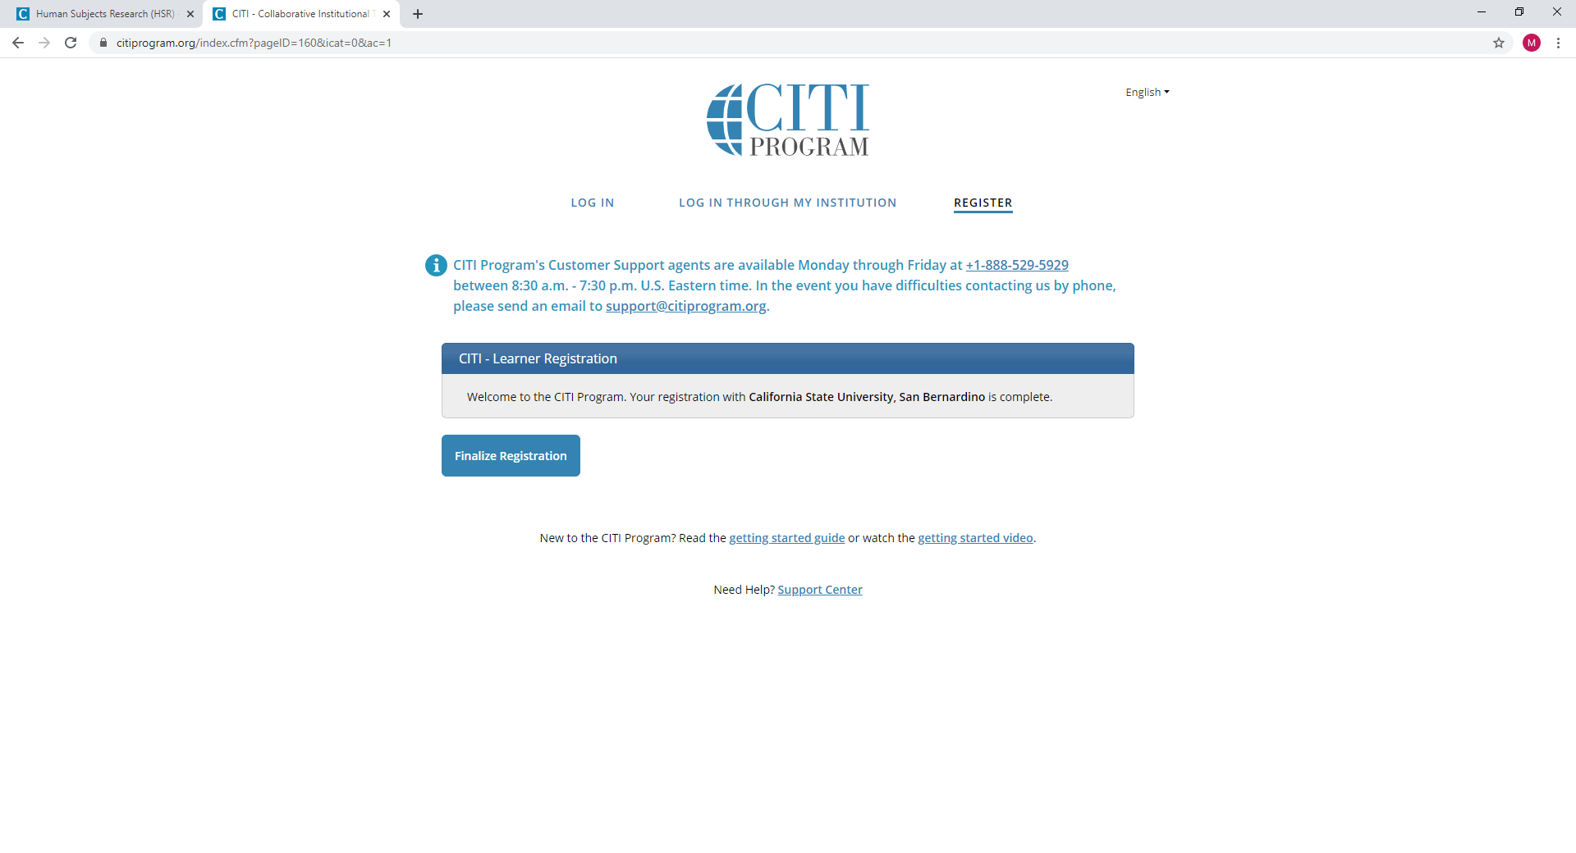
Step 23: Select Finalize Registration

Slide 15
Step 24: Select View Courses

Slide 16
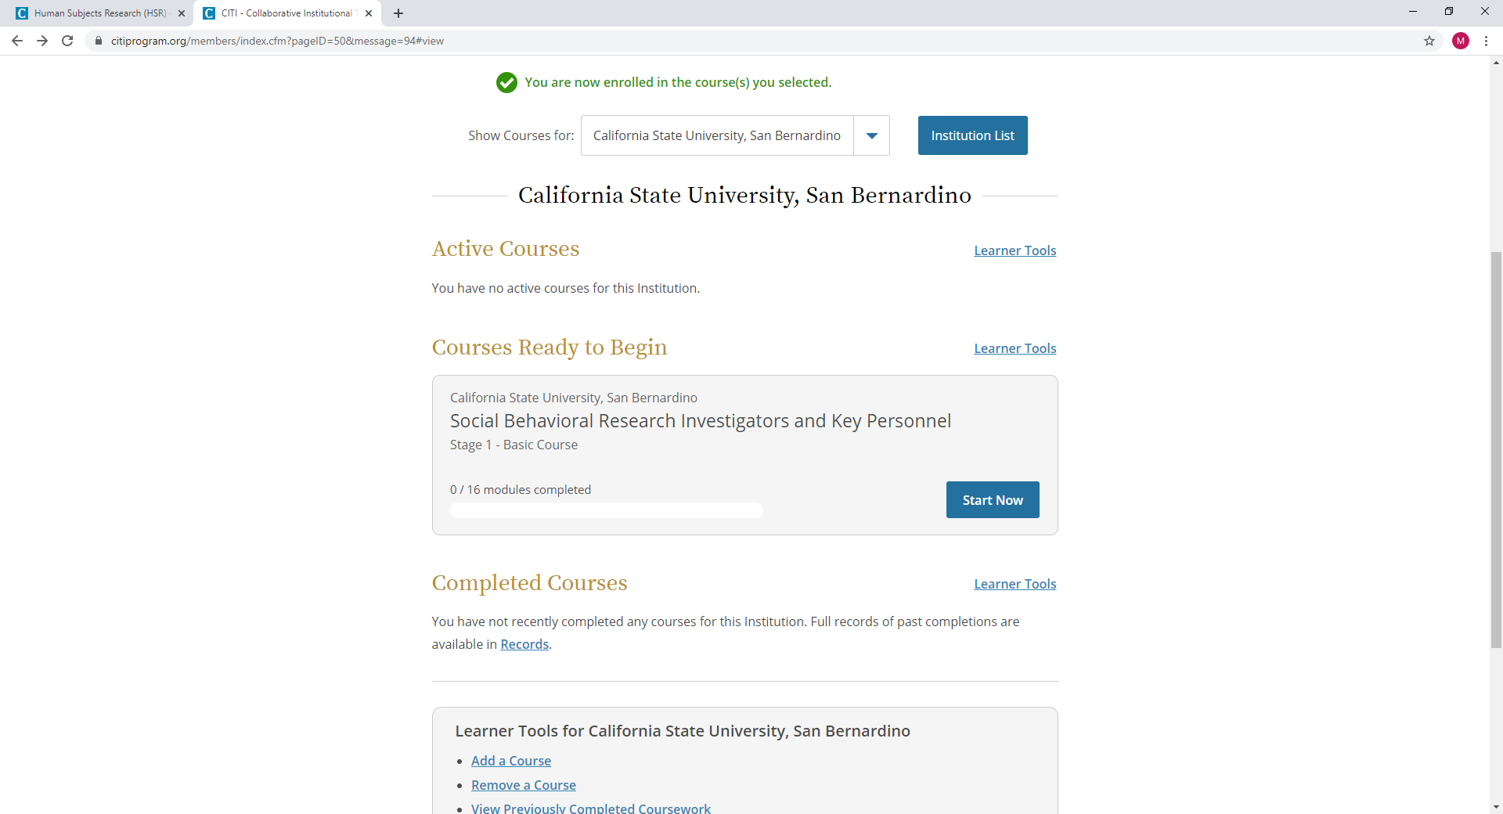
Step 25: You will see a screen indicating the course you selected in Step 19. (See example below).
Step 26: Select Start Now

Slide 17
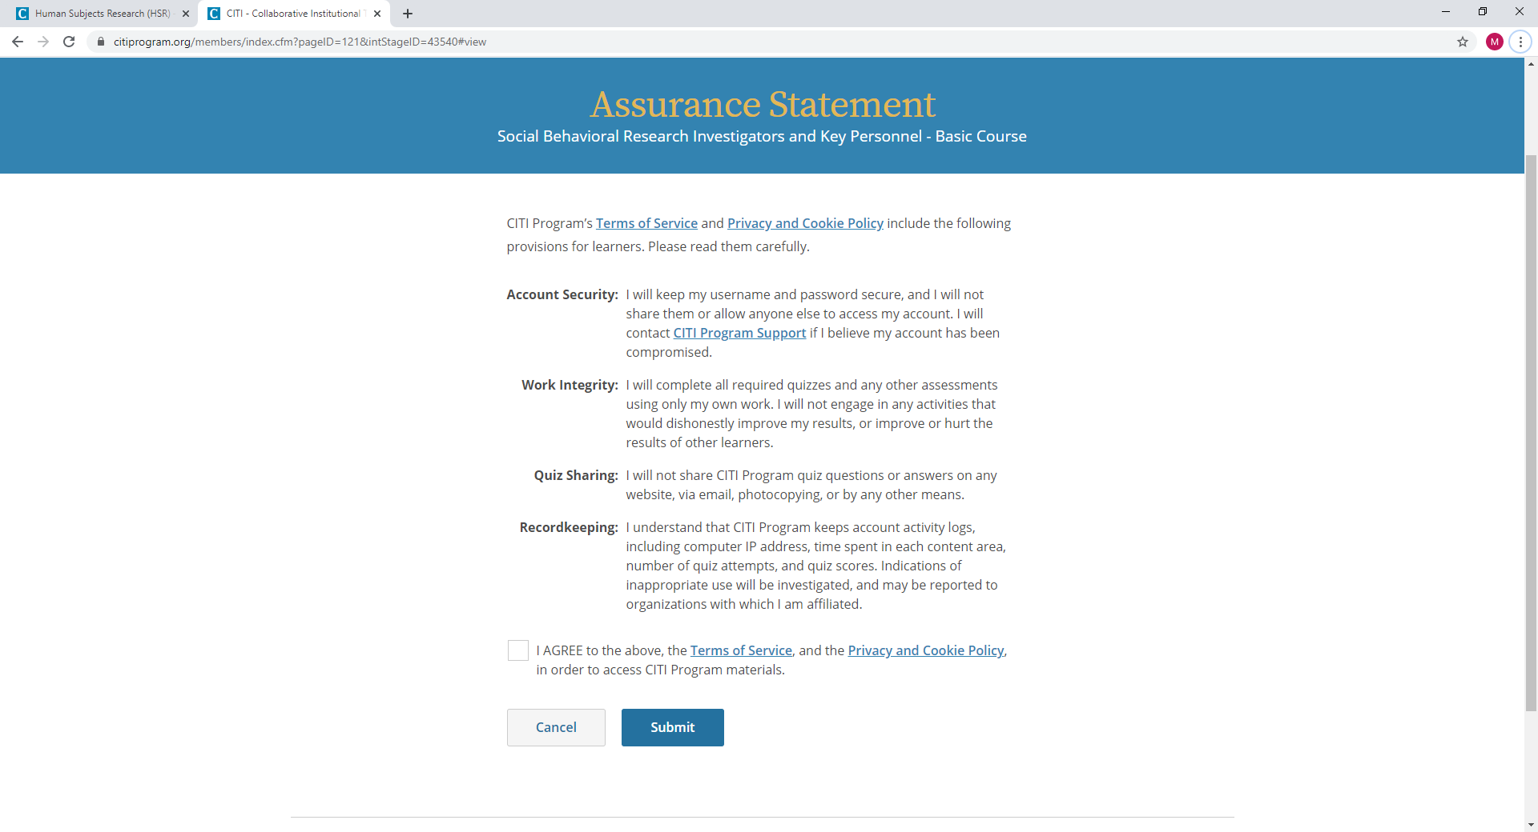
Step 27: You must complete the Integrity Assurance Statement before proceeding by selecting the “Complete the Integrity Assurance Statement before beginning the course” option and select Submit.

Slide 18
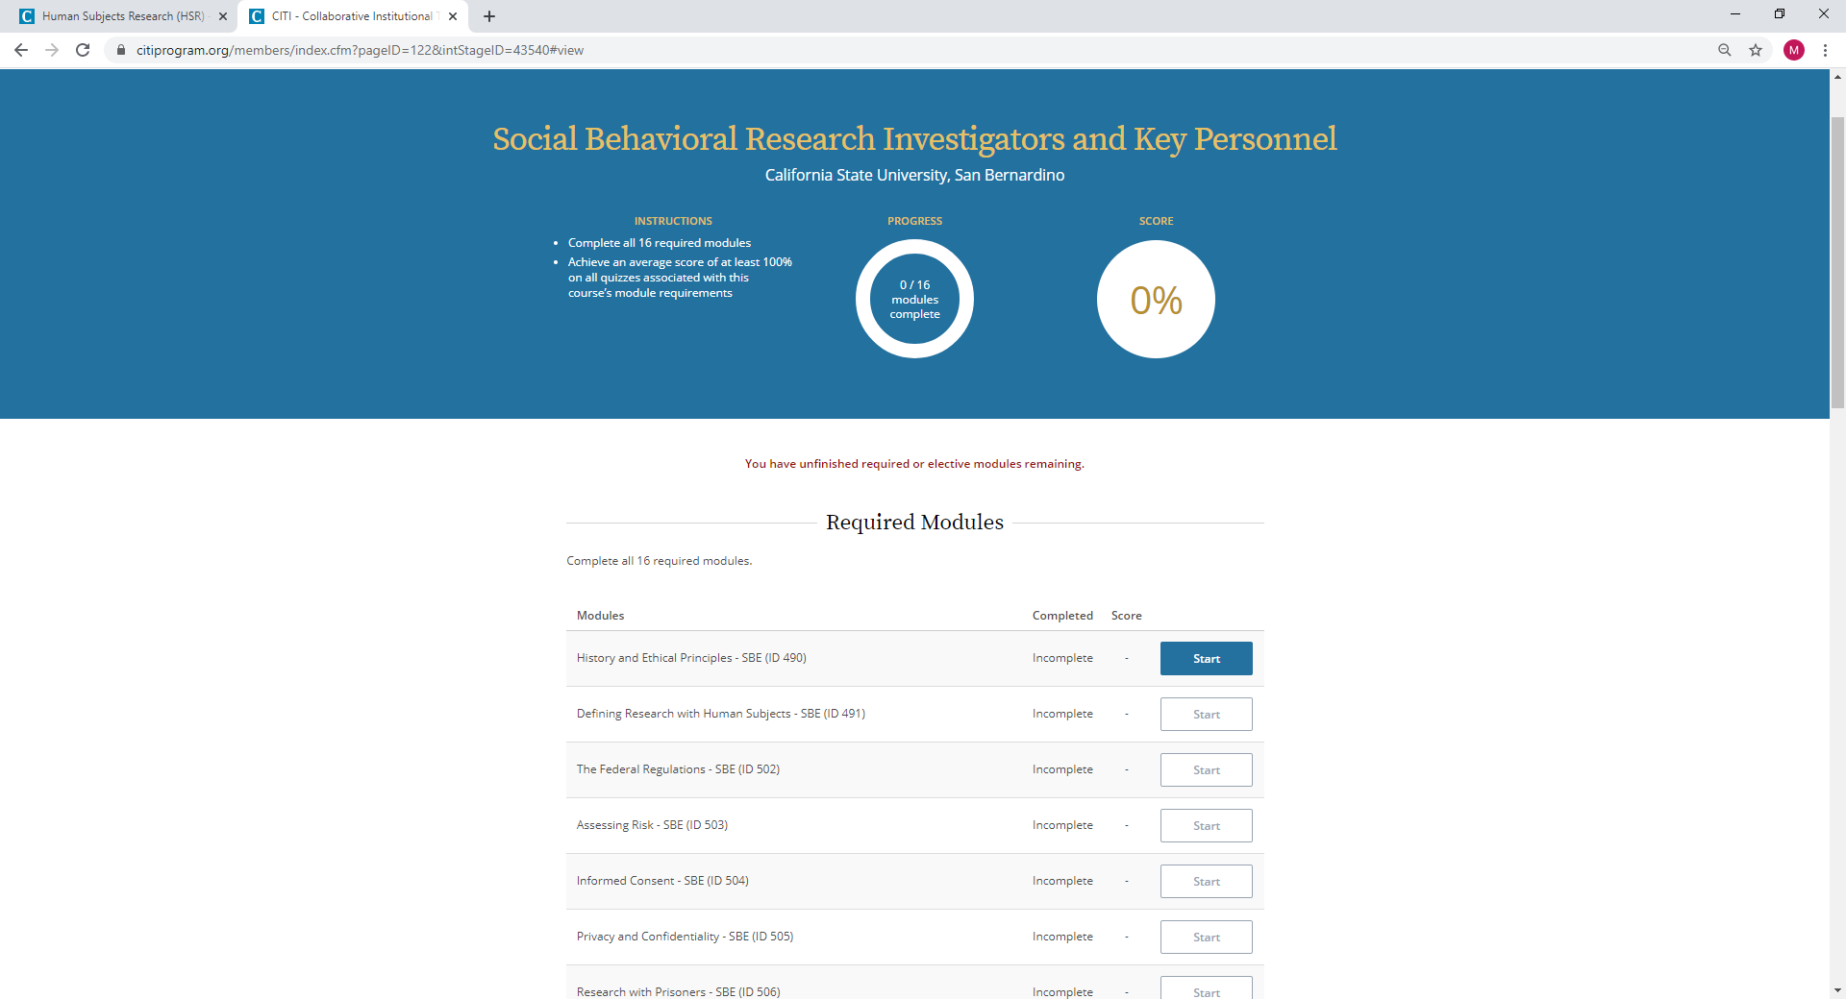
Step 28: There are 16 modules to complete. Start with the first one and proceed until you finished. You do not have to complete all modules in one session and can login back into the system to complete the modules as needed.

Slide 19
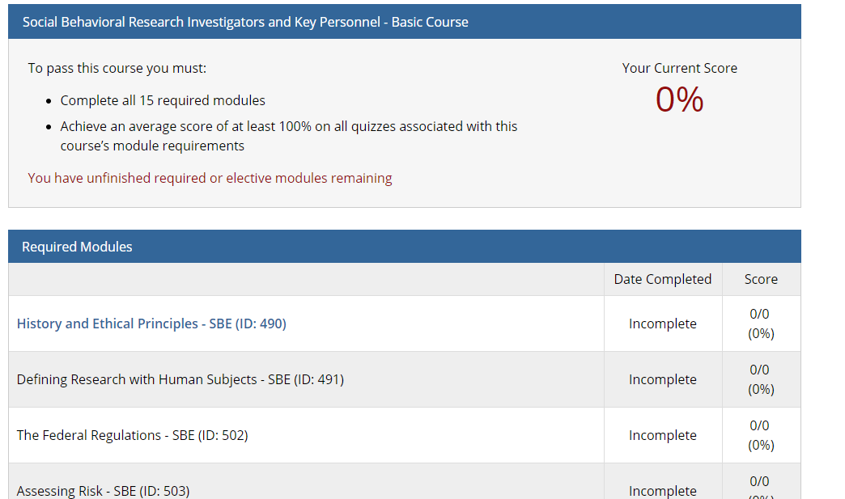
Step 29: After selecting the submit button, you will see the screen on the right.
To begin the training select the blue titles under the “Required Modules”.
Complete all the listed modules.
After completing all modules, you will receive a certificate/completion report. Save the certificate/report and upload it with your IRB application into the attachments section of the online Cayuse IRB application system.
You must receive a combined passing score of 100% to print your CITI certificate and/or completion report.

