Slide 1
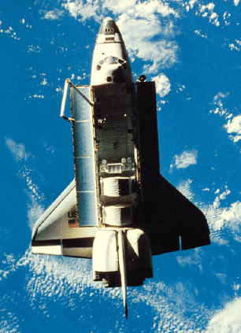
Is
Is
Teaching
English
Rocket
Science
????

Slide 2
Hand
How would you teach this?
An Example Of
Word Generalization

Slide 3
What do you visualize when you see (hear) the word “hand”?

Slide 4
Hand…. Do you think about…..
Assistance?
A person hired to give assistance?
A pledge of betrothal?
To give or pass?
The measurement of a horse’s size?

Slide 5
Or, do you think of…
An assortment of playing cards held by one player?

Slide 6
Hands up?

Slide 7
Have one’s hands full… A hand full…

Slide 8
To give or pass? Hand in… Hand out… Hand off…
Hand over?

Slide 9
Hand-over-fist?

Slide 10
Get out of hand? Get the upper hand?
Have a hand in…
In good hands…
On hand…
On the other hand…
Try one’s hand…
Hand me down…
Hand over…
Hand it to one…

Slide 11
Hand to hand? Hand to mouth?
Hands off…
Hand me down…
Hand down*
Hands down…*
Give a big hand…
An old hand…
First hand…
Hand made…

Slide 12
Or, do you think just “hand”?

Slide 13
Is Teaching English Rocket Science ?

Slide 14
“OUGH”
How do you say
“ough”
?

Slide 15
“Ough” can be pronounced in eight different ways.
The following sentence contains them all:
A rough-coated, dough-faced ploughman strode through the streets of Scarborough, coughing and hiccoughing thoughtfully.

Slide 16
Maybe teaching English is rocket science ??????

