Slide 1
RESUME 101

Slide 2
AGENDA
Purpose of a Resume
Resume Writing Guidelines & Formats
Resume Components
Writing Bullet Point Statements

Slide 3
PURPOSE OF A RESUME
Marketing document to promote you for an interview
Summarizes your history, which is excellent preparation for interviews
Identifies who you are and what skills, education, and experience you offer to employer

Slide 4
Question 1
Resumes should only be one page
True or False?

Slide 5
RESUME WRITING GUIDELINES
Basics
½ to 1 inch margins
Font style: no more than 2
No typographical or grammatical errors
Limit font sizes and colors
Easy to read, clutter free, most important content at top
Notes:
If you have trouble getting your content on one page, try a slightly smaller font style or size.
Sometimes you can enter a half-size, such as 10.5, 11.5, etc.
Note that font sizes are not the same in each font style e.g. Arial 12 is much larger than Times 12
Length depends on experience and type of position applying for (CV academic, research, teaching)
For most Master’s degree candidates, it is typical to have a one page resume.
Having a two page resume may send a signal that you’re “overqualified” or otherwise not fitting the mold of a typical candidate for entry to mid-level jobs.
Normally two page resumes are acceptable if you are advanced in your career, have years of experience, or have a PhD.
For BA/BS, MA/MS, and MBA candidates, a one-page resume is the norm.

Slide 6
RESUME WRITING GUIDELINES
Highlight most relevant skills and experiences
General Rules
Should be written in third person (no “I”, “Me”, or “My”)
Do not include personal information or picture (in U.S.)

Slide 7
Question 2
I can use the same resume for all the positions I apply for.
True or False?

Slide 8
RESUME COMPONENTS
Most Essential
Additional and Optional
Related/Relevant Coursework
Professional Affiliations (Associations)
Honors/Awards
Special Training
Study Abroad
Certifications
Class Projects
Professional Summary or Summary of Qualifications
Header
Education
Experience
Skills

Slide 9
Question 3
You should include your high school education.
True or False?

Slide 10
EDUCATION
Education is always listed first for current/recent students
List degrees in REVERSE chronological order (most current first)
Write out your full degree name
Do not list your high school diploma (unless you are applying for a job at that high school or are a first year)
Add GPA when appropriate

Slide 11
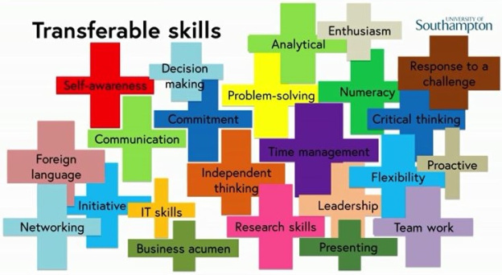
SKILLS
List skills in order of proficiency and/or relevance to your field of study/job.
For example:
Read, write and speak [insert language]
Choose one - Familiar with, Intermediate or Proficient in Microsoft Word, Excel PowerPoint and Outlook

Slide 12
EXPERIENCE
Experience can come in many forms.
Most experience is good experience to add to your resume!
Include the following information:
Position Title
Company/organization Name
City & State of Company/organization
Dates Worked (Month/Year)
3-4 bullet points focused on your accomplishments, not your duties and tailored to the position

Slide 13
EXPERIENCE
POSSIBLE SECTION HEADINGS:
Related Experience
Other Work Experience
Research Experience
Leadership Experience
Volunteer Experience
Customer Service Experience
Sales Experience
Community Engagement Experience

Slide 14
What if I don’t have related employment?
Focus on your skills you have learned
Add your academic projects
Include examples of your transferable skills

Slide 15
RESUME BULLET POINT STATEMENTS
Bullet point statement?
What a bullet point is NOT
Describes your accomplishments in relation to the job description
Shows the difference you made in your position
Describes your skills in an applicable way
NOT a job description
NOT a vague list of skills
NOT a list of duties
Notes:
Used under experience sections

Slide 16
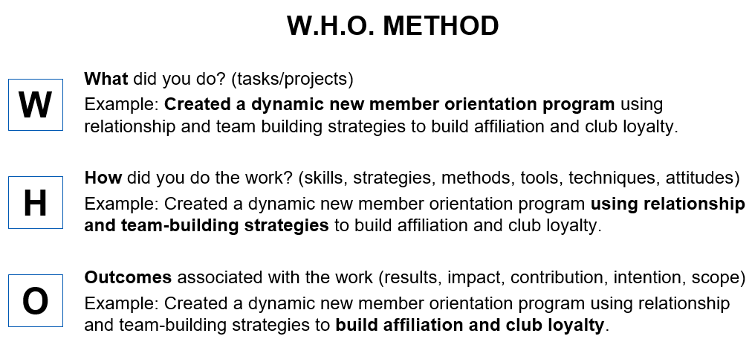
ARTICULATING YOUR EXPERIENCES

Slide 17
DETAILED EXAMPLES
Before | After
Responsible for campers | Coordinated activities and field trips for 30 children ages 6-12 to improve camper morale
Operated cash register | Provided prompt and friendly service to patrons averaging $1000 in daily sales
Met sales goals | Achieved highest annual sales in department, totaling $25,000 gross compared to $19,000 average
Got students to join organization | Persuaded students, through in-class presentations, to join campus organization, resulting in 7 new members

Slide 18
How do I get related experience to add to my resume?
Volunteer
On-campus job
Student organizations
Internships

Slide 19
What is Applicant Tracking System (ATS)?
Software that enables recruiters to wade through an ocean of resumes to find the perfect candidates that match the job requirements. It filters applications based on skills, education, experience, or anything that is a requirement for an open role.

Slide 20
COVER LETTER GUIDE
What is a Cover Letter?
Demonstrates to the prospective employer why you are interested in the company or position you are applying to
Provides an effective summary of your skills, experiences and why it would benefit the company
Suggests areas where your skills and attributes would benefit the employer

Slide 21
COVER LETTER GUIDE
Use the job description to choose key skills and responsibilities to highlight in your cover letter.
Focus your cover letter on the 3-4 most important skills.
For this position, what are some of the top skills:
Exercise Therapist-Full Time
Are you looking for a fulfilling career where you can make a positive impact on others’ lives? If you love interacting with people, enjoy working in a high energy team environment and have a genuine passion for connecting with people, this is the place for you.
We are looking for someone motivated by the challenge to expand his or her ability to help others in achieving an active, pain-free lifestyle. You will use your experience and knowledge of anatomy, kinesiology, exercise instruction, pain/injury management, and communication skills.
Our therapists critically think & are actively curious in each appointment to provide the highest level of service. Every client is unique and so is their corrective exercise solution. We look at the whole body to get to the root of the problem. This is what makes Egoscue different from traditional athletic training or physical therapy.
You must have a strong work ethic, be highly coachable, detail-oriented and be an effective, open communicator.
Job Requirements: A 4 year degree in a health related field (such as athletic training, kinesiology, etc.) is required. The ideal candidate must have the ability to both work independently as well as in a collaborative setting.

Slide 22
COVER LETTER GUIDE
Use the job description to choose key skills and responsibilities to highlight in your cover letter.
Focus your cover letter on the 3-4 most important skills.
For this position, what are some of the top skills:
Exercise Therapist-Full Time
Are you looking for a fulfilling career where you can make a positive impact on others’ lives? If you love interacting with people, enjoy working in a high energy team environment and have a genuine passion for connecting with people, this is the place for you.
We are looking for someone motivated by the challenge to expand his or her ability to help others in achieving an active, pain-free lifestyle. You will use your experience and knowledge of anatomy, kinesiology, exercise instruction, pain/injury management, and communication skills.
Our therapists critically think & are actively curious in each appointment to provide the highest level of service. Every client is unique and so is their corrective exercise solution. We look at the whole body to get to the root of the problem. This is what makes Egoscue different from traditional athletic training or physical therapy.
You must have a strong work ethic, be highly coachable, detail-oriented and be an effective, open communicator.
Job Requirements: A 4 year degree in a health related field (such as athletic training, kinesiology, etc.) is required. The ideal candidate must have the ability to both work independently as well as in a collaborative setting.

Slide 23
COVER LETTER GUIDE
Key Components of a Cover Letter?
Header: Use same header from your resume
Date: Use the date you are sending it, not the draft date
Employer Information
Salutation: Dear _____ (Contact person’s last name with Mr./Ms., Hiring Manager, Hiring Committee, etc.)
Introduction/Opening
Body: Middle 1-2 paragraphs
Closing

Slide 24
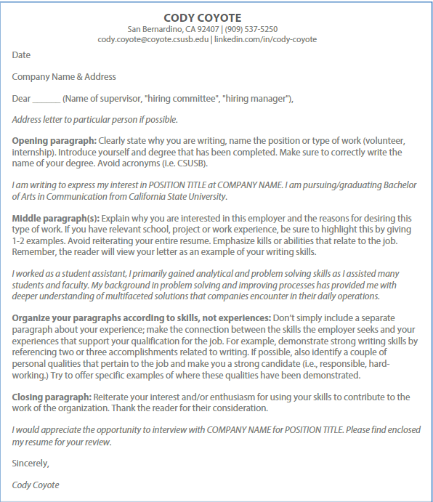

Slide 25
Come Visit Us!
 | Main Campus | Palm Desert Campus
Location | SMSU 108 / 112 | Indian Wells Center 111
Day/Hours | Monday - Friday 8am - 5pm | Monday - Friday 8am - 5pm
Phone | (909) 537-5250 | (909) 537-8236
Email | careercenter@csusb.edu | PDCCareerCenter@csusb.edu
Website | www.csusb.edu/career-center | pdc.csusb.edu/current-students/career-service

Slide 26
Check out our website for additional resources and steps to make an appointment!
https://www.csusb.edu/career-center

Slide 27
Appointments

Slide 28
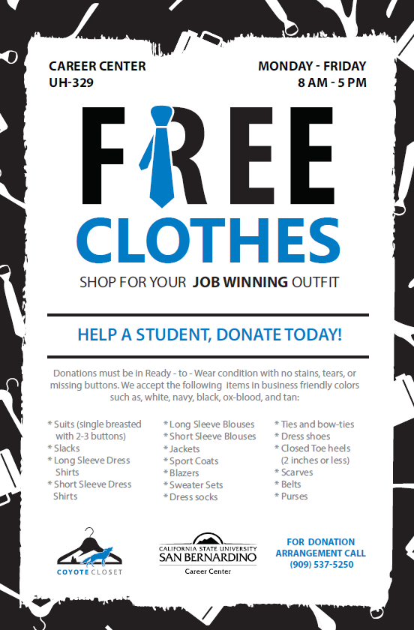
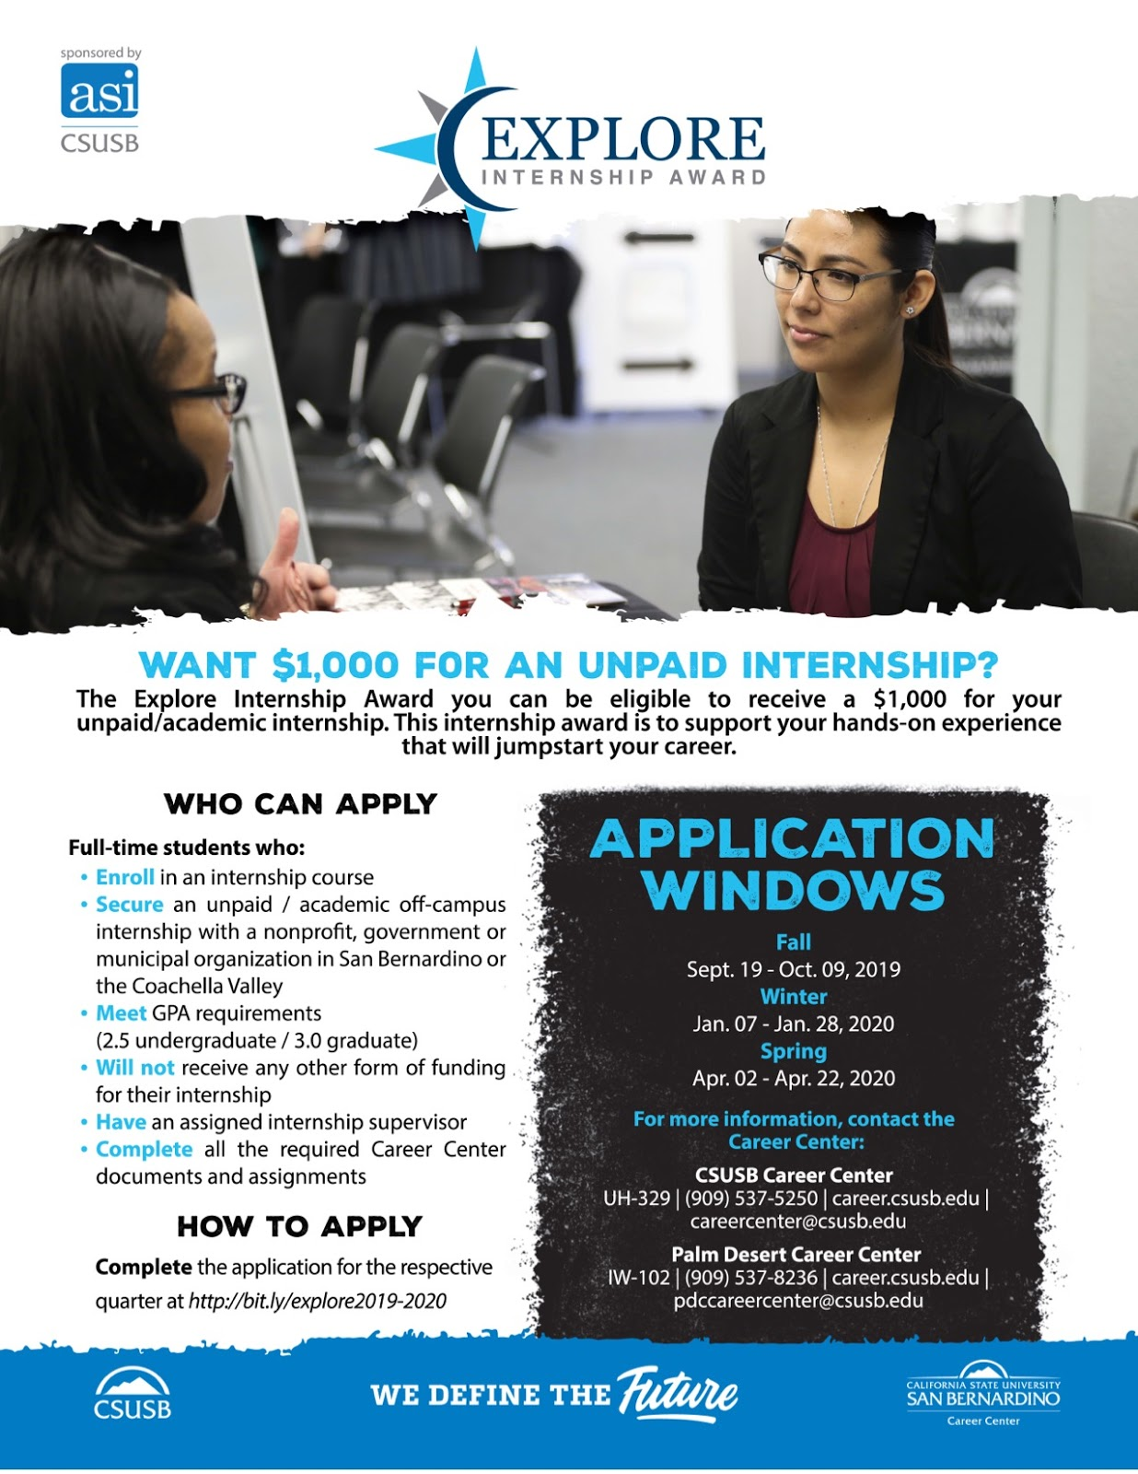
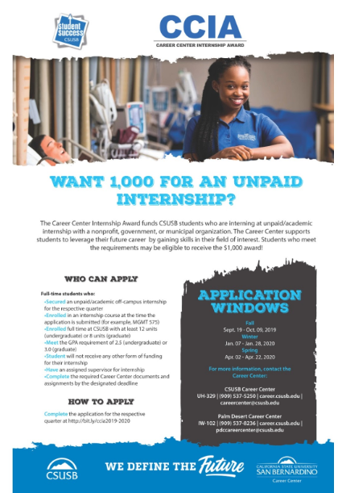

Slide 29
Here is the link to our survey if you would like to provide feedback on this presentation.
https://bit.ly/30mSWCc
THANK YOU!

