Slide 1
Create an international expense report

Slide 2
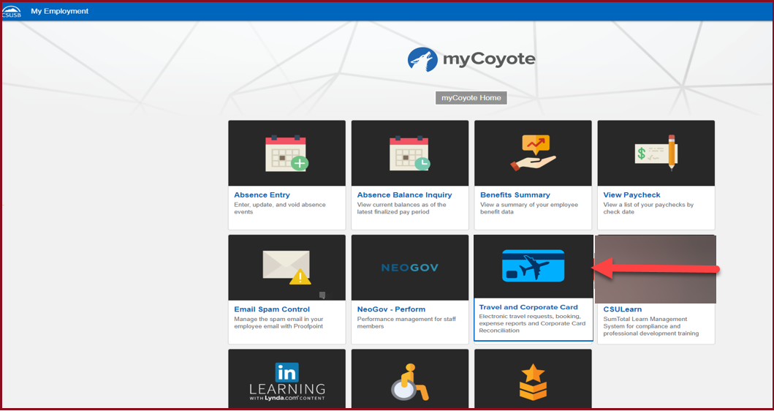
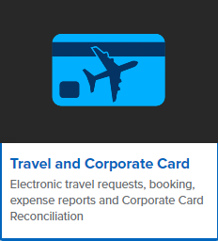
On the single sign on page, type in your mycoyote ID and password, hit enter and then either choose My Employment or, Administrative Systems and click on the Travel and Corporate card Icon as shown below:

Slide 3
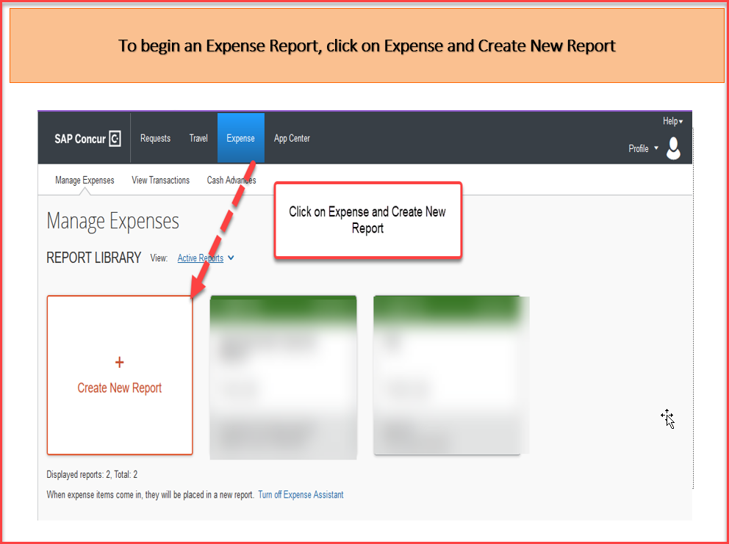

Slide 4
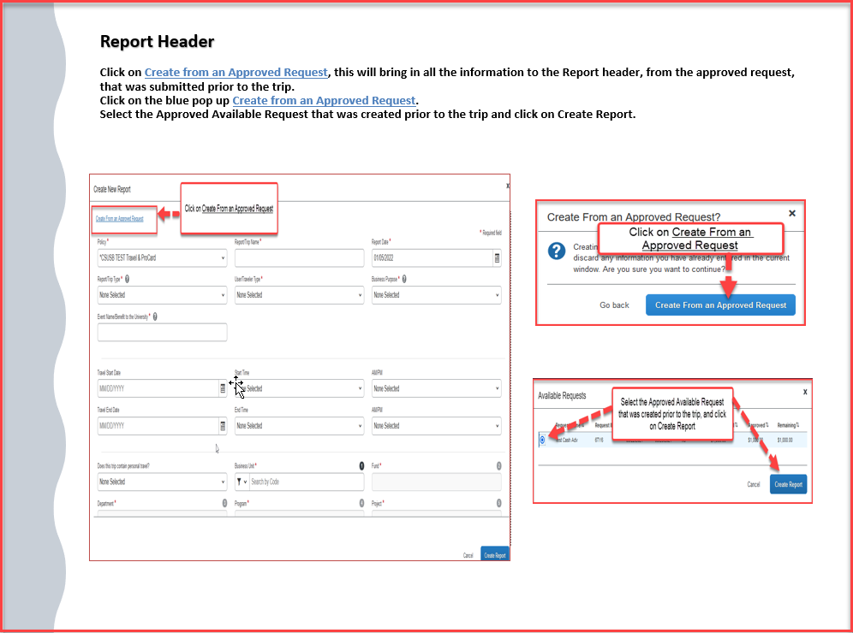

Slide 5
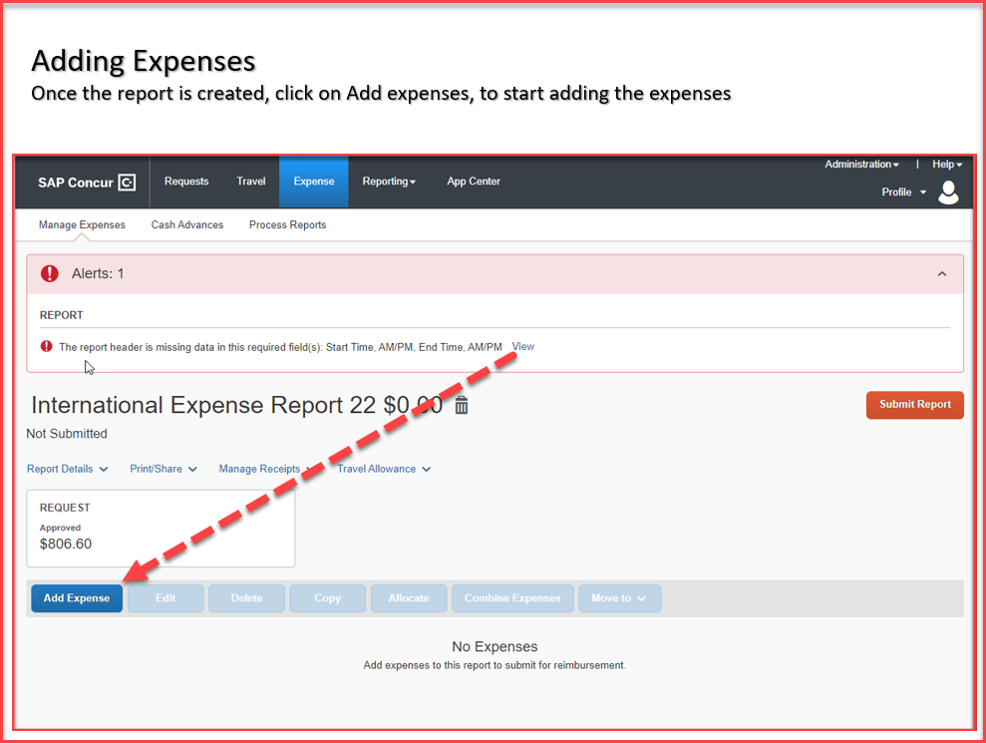

Slide 6
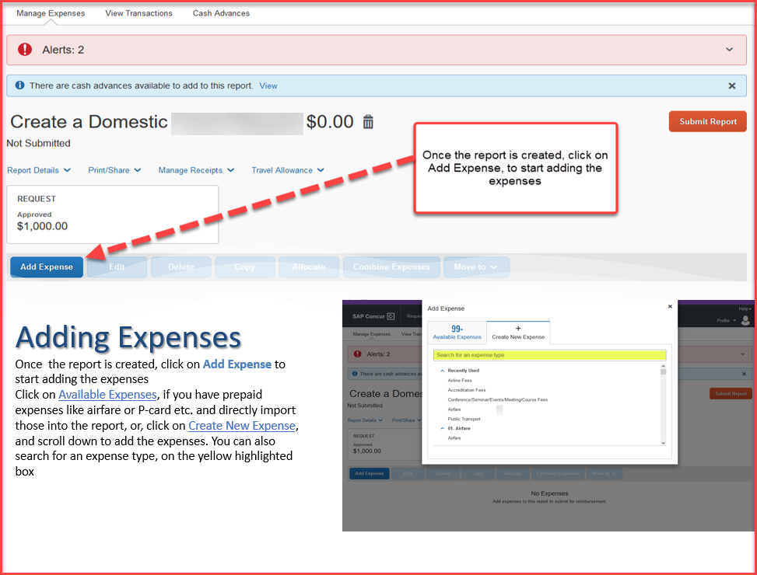

Slide 7
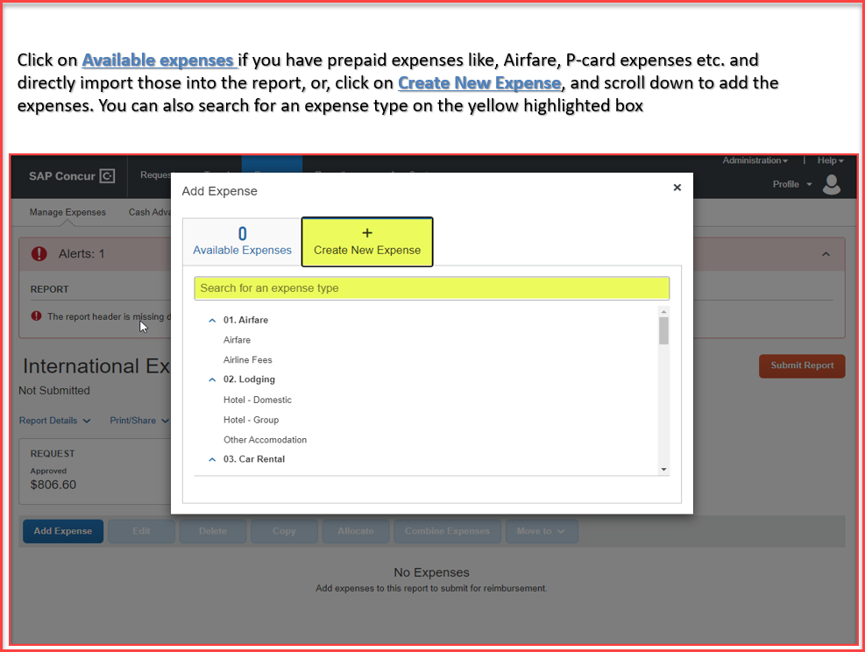

Slide 8
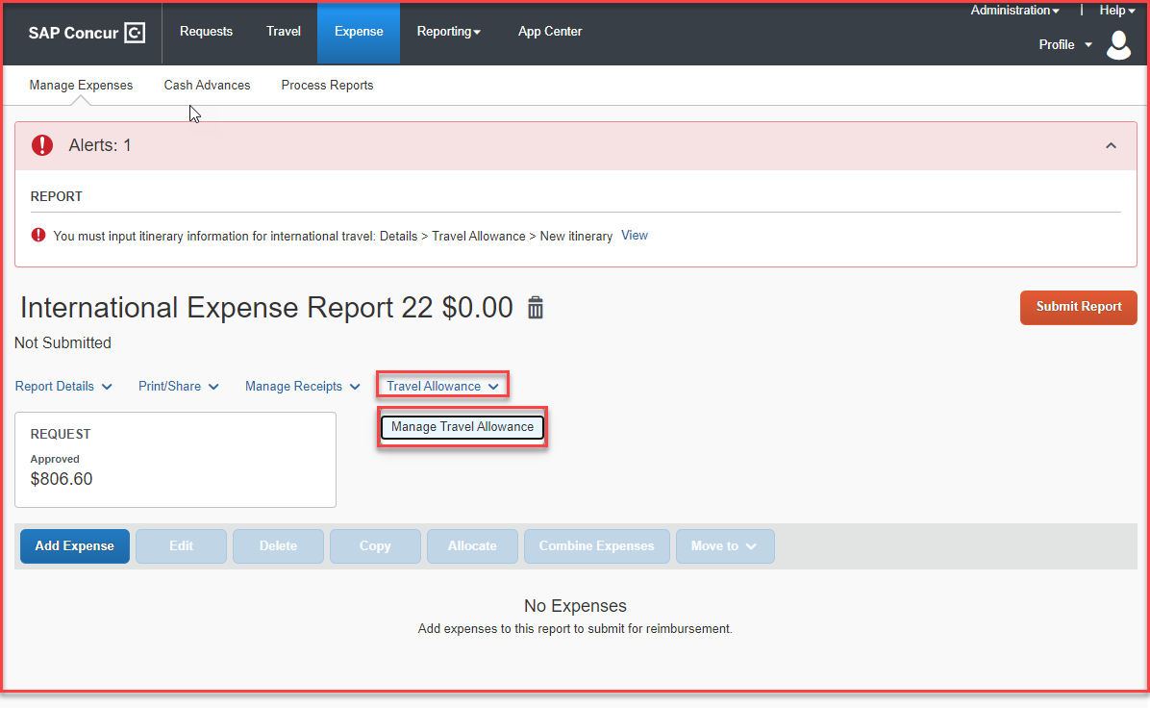
All international trips will need an itinerary to be added – The itinerary is where you will add your departure city, date and time, and your arrival city, date and time. Click on Travel Allowance> Manage Travel Allowance to start creating the itinerary. Then click on Create New Itinerary as shown below.

Slide 9
Add your departure city, date and time and your arrival city, date and time, click save and then enter your return departure city, date and time and your return arrival city, date and time. Then click next and your itinerary will be assigned to your expense report. Click next again to move to “Expenses & Adjustments”.

Slide 10
This is the Expenses & Adjustments grid. The amount listed on the right is the allowance that includes lodging and meals/incidentals. If a meal is provided, click the box and that amount will be deducted from the daily allowance. If you want to exclude an entire day’s allowance, click the box to the left under exclude . When finished click on Create Expenses.

Slide 11
The expense report is populated with the daily meal allowance (includes incidentals) and the lodging allowance for the days included in your itinerary. If you need to delete EITHER a lodging allowance OR meal allowance for a specific day you can delete the row by clicking in the box to the left of the date and click the blue delete button that will illuminate. No receipts are needed for lodging or meals per diem. Now, you can enter your other expenses as needed.

Slide 12
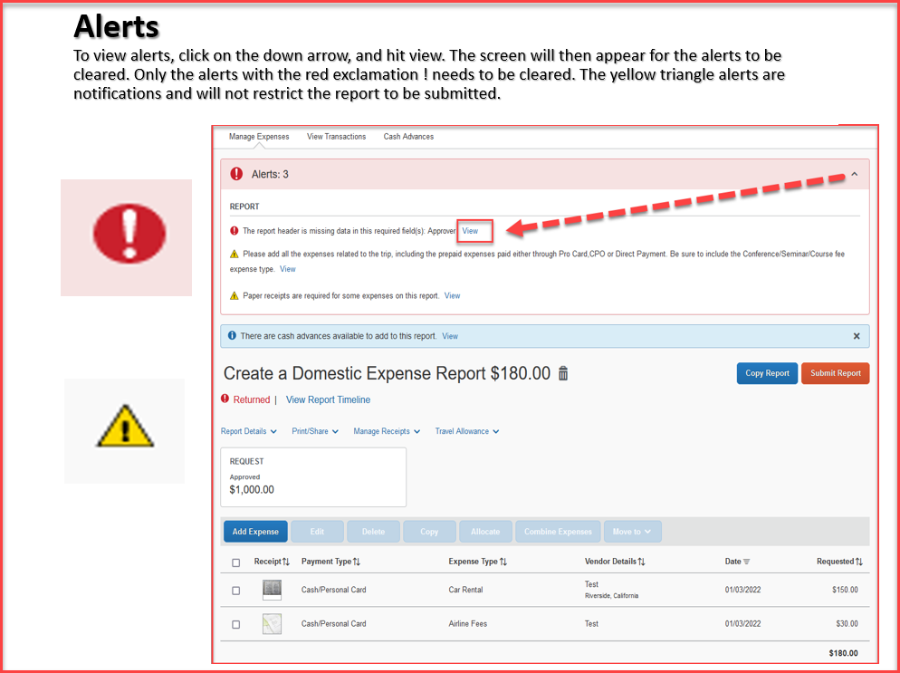

Slide 13
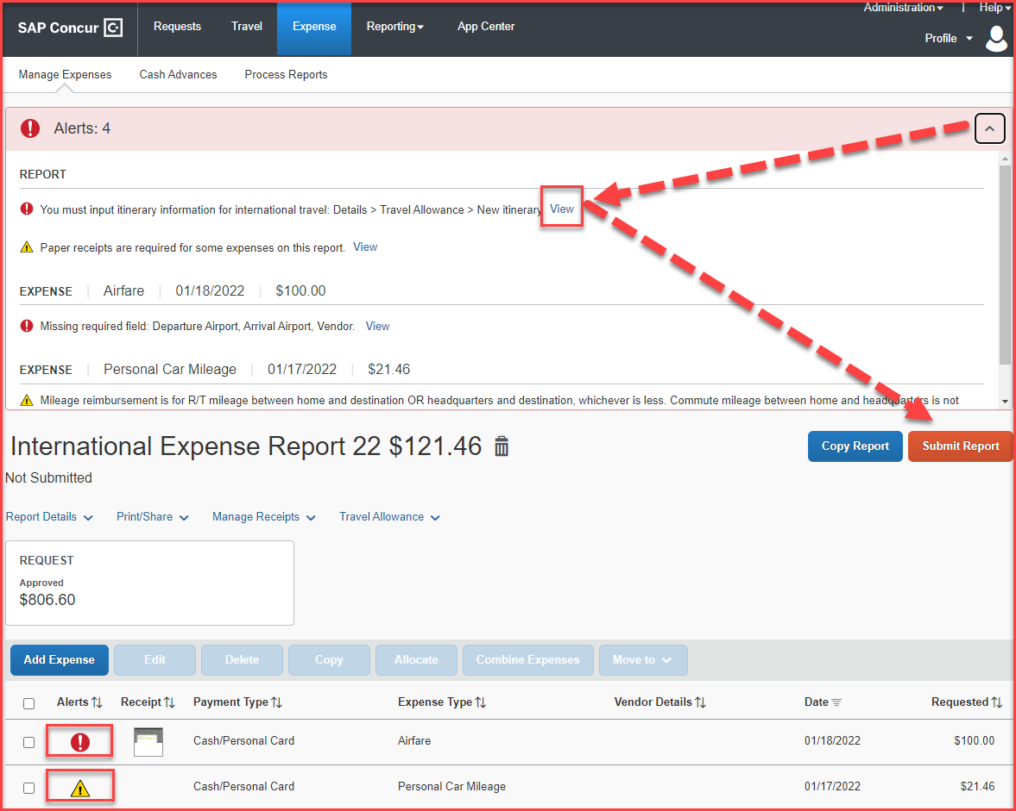
When all expenses have been entered and all the red alerts are cleared, you are now ready to submit the report!
The amounts entered in segments for airfare, domestic hotel and rental car will appear here as estimated expenses in addition to the ones entered from the expenses tab.

Slide 14
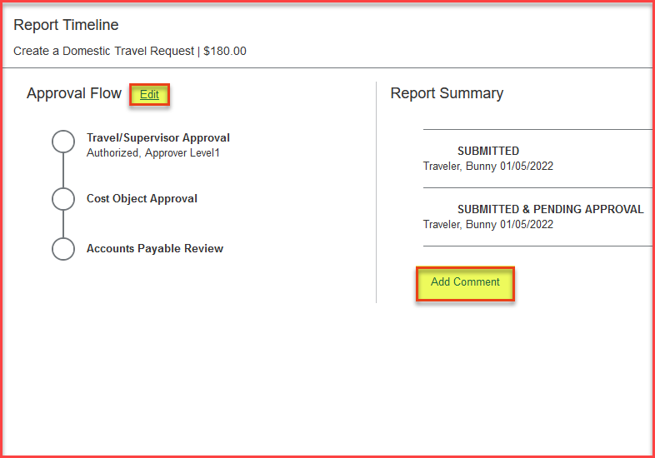
Expense Report Workflow Steps
Travel/Supervisor Approval --- This approver is the employee’s default manager
Cost Object Approval – The budget approver, or the approver listed in DACS for that department
Accounts Payable Review – The accounts payable travel processor
Please note: each approvers have 9 days to approve a Report, failing which the Report gets timed out, and the user will have to resubmit the Report
The employee can also add additional approvers by clicking on the Edit option next to Approval Flow and add a comment as well. All these changes can be done, only before the report is submitted.

Slide 15
THANK YOU!
If further information or assistance is needed, please do not hesitate to contact Accounts Payable/Travel at 909-537-3158
Notes:
Updated August, 2017 CL

