Slide 1
Overtime work Hours meal allowance reimbursement expense report

Slide 2
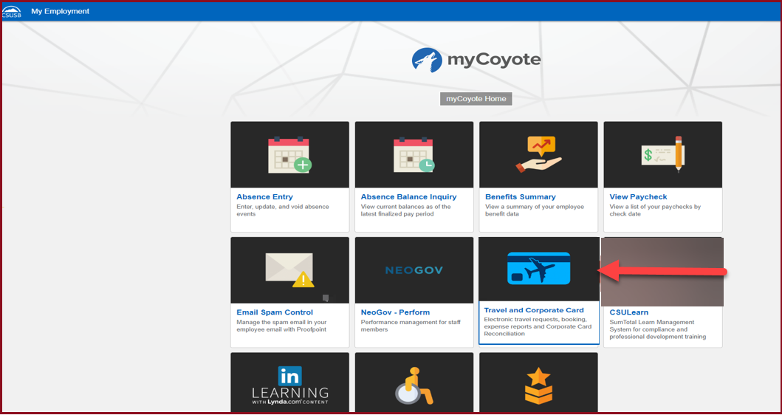
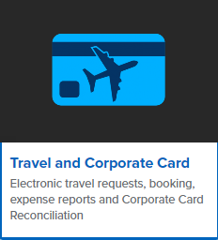
On the single sign on page, type in your mycoyote ID and password, hit enter and then either choose My Employment or, Administrative Systems and click on the Travel and Corporate card Icon as shown below:

Slide 3
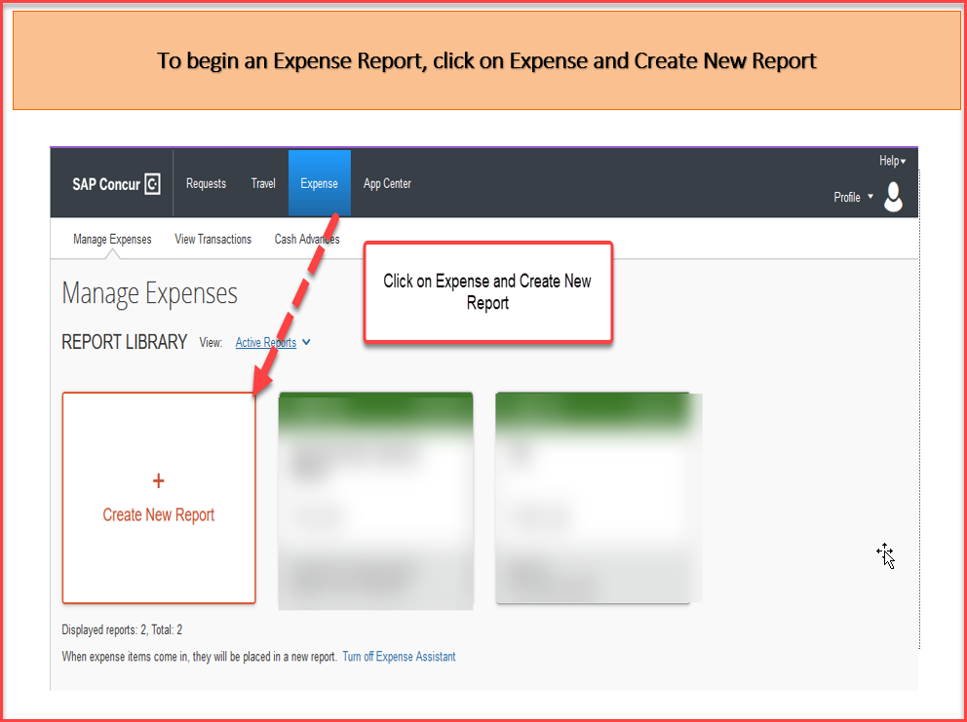

Slide 4
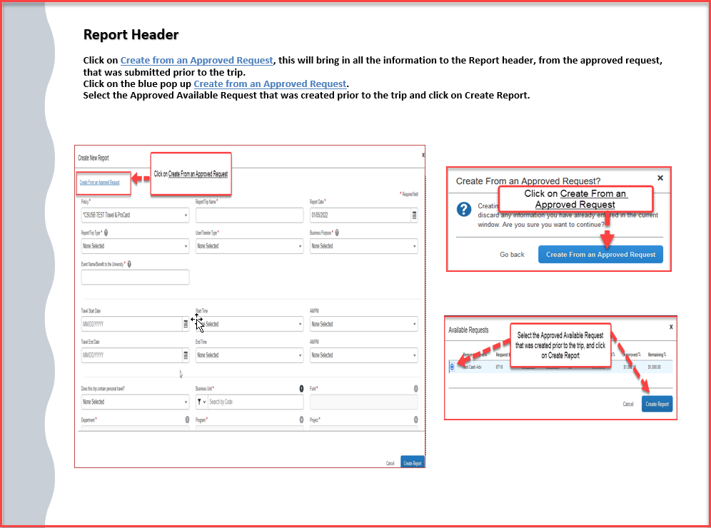

Slide 5
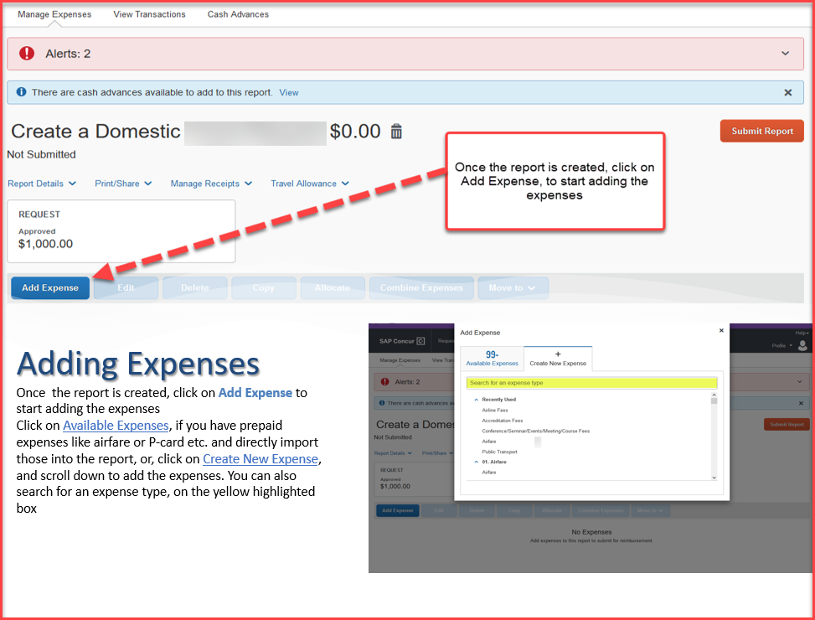

Slide 6
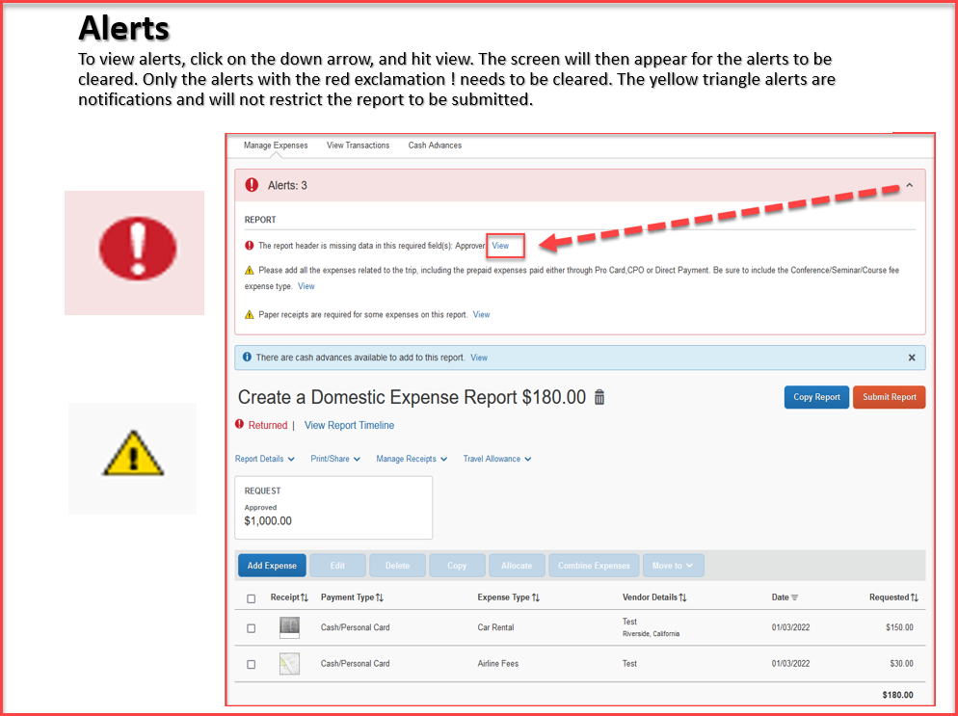

Slide 7
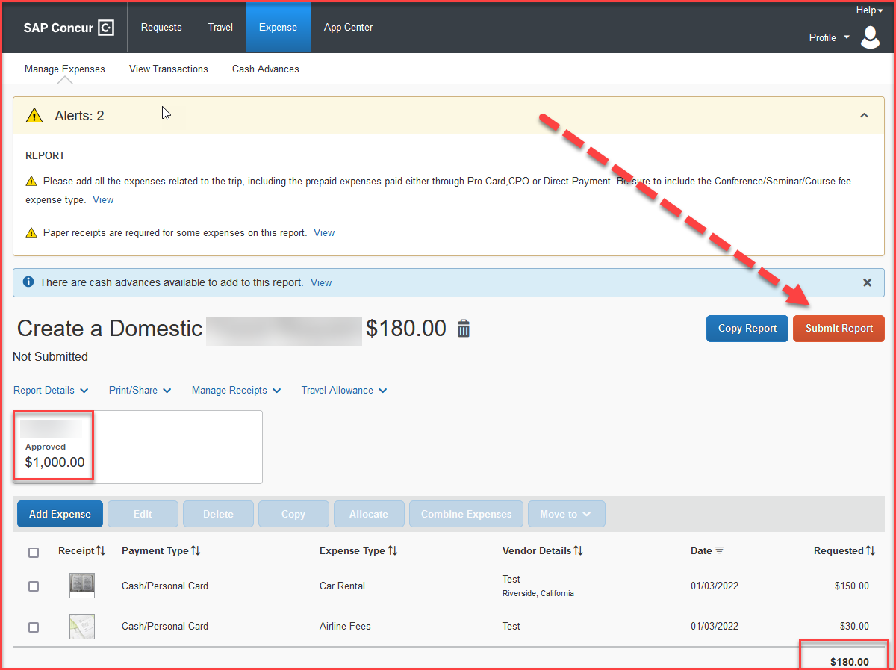
When all expenses have been entered and all the red alerts are cleared, you are now ready to submit the report!
The amounts entered in segments for airfare, domestic hotel and rental car will appear here as estimated expenses in addition to the ones entered from the expenses tab.

Slide 8
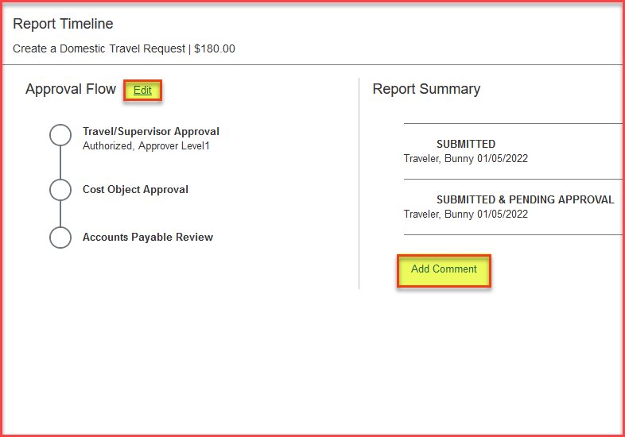
Expense Report Workflow Steps
Travel/Supervisor Approval --- This approver is the employee’s default manager
Cost Object Approval – The budget approver, or the approver listed in DACS for that department
Accounts Payable Review – The accounts payable travel processor
Please note: each approvers have 9 days to approve a Report, failing which the Report gets timed out, and the user will have to resubmit the Report
The employee can also add additional approvers by clicking on the Edit option next to Approval Flow and add a comment as well. All these changes can be done, only before the report is submitted.

Slide 9
THANK YOU!
If further information or assistance is needed, please do not hesitate to contact Accounts Payable/Travel at 909-537-3158
Notes:
Updated August, 2017 CL

