Slide 1
Create a Mileage only expense report

Slide 2
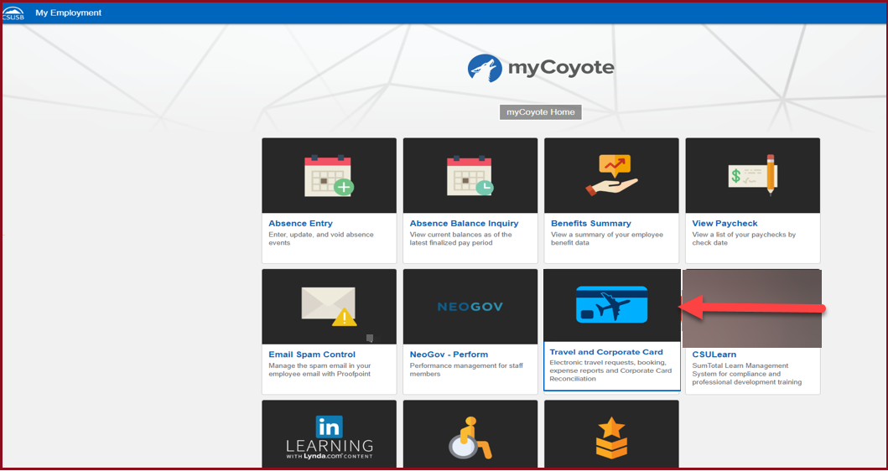
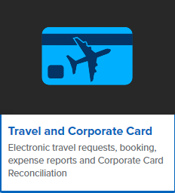
On the single sign on page, type in your mycoyote ID and password, hit enter and then either choose My Employment or, Administrative Systems and click on the Travel and Corporate card Icon as shown below:

Slide 3
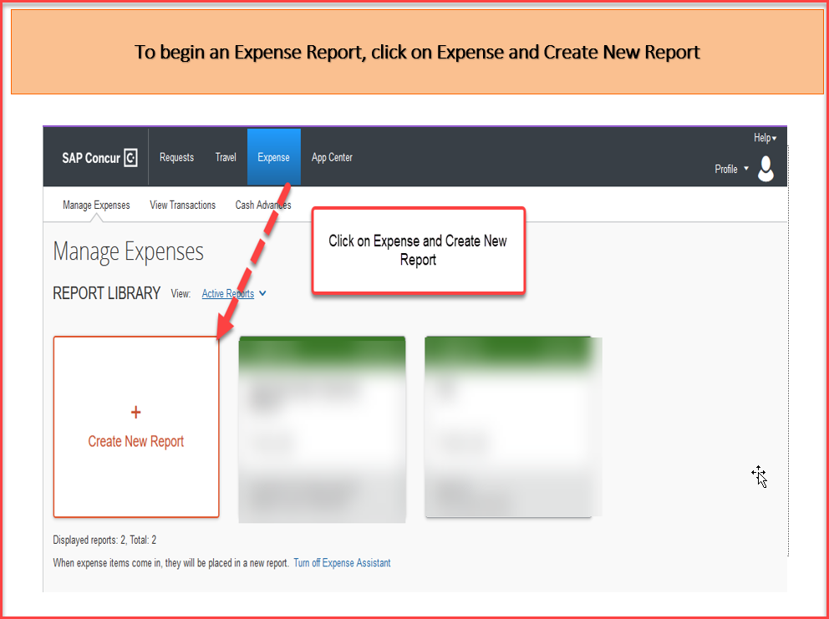

Slide 5
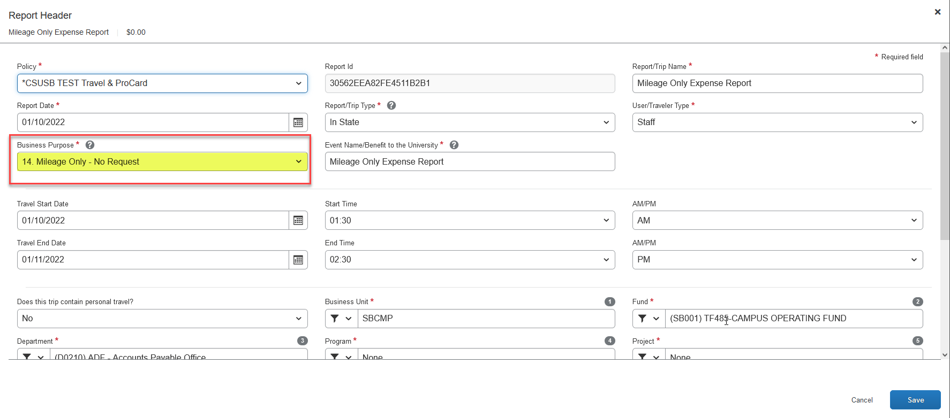
Report Header The Travel Business Purpose must be number 14. Mileage Only - No Request The Event Name/Benefit to the University, can be the same as the Report/Trip Name If you are not aware of the chart field string information and the approver, reach out to your department. Once all the information has been filled into the Report Header, click on Create Report

Slide 6
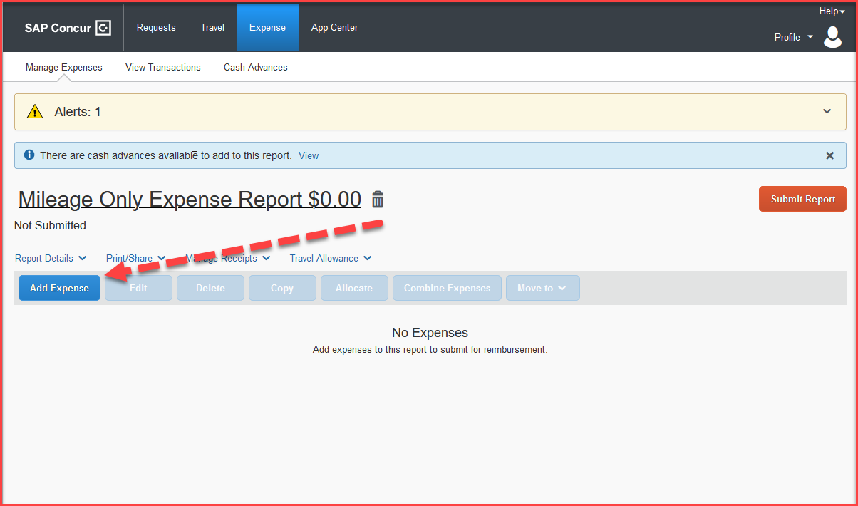
Adding Expenses Once the report is created, click on Add Expense to start adding the expenses Click Create New Expense tab and scroll down to add the Personal Car Mileage expense type. You can also search for an expense type, on the yellow highlighted box

Slide 7
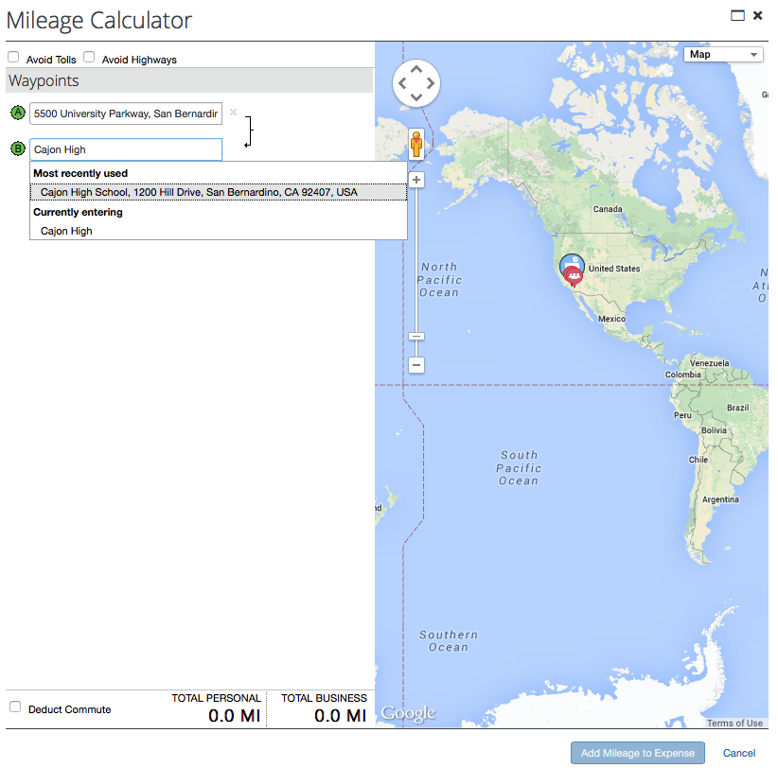
Adding the Mileage correctly After clicking on Personal Car Mileage, a mileage calculator pops up. Please enter the beginning address and then add the locations visited. The system saves the most used destinations. Remember commute mileage is not reimbursable so use the address, home, or headquarters, closest to your destination. There is also a deduct commute button at the bottom on the left.
If you choose to click the deduct commute box below, a box will appear that will require your home and headquarters address. There is another deduct R/T commute mileage box that also needs to be checked.

Slide 8
Enter each destination and click on calculate route to bring up the address and the next box. After entering the destination(s) for a single trip day, click calculate route again, (then click make round trip if necessary) and navigate to the bottom and click on “Add Mileage to Expense”.

Slide 9
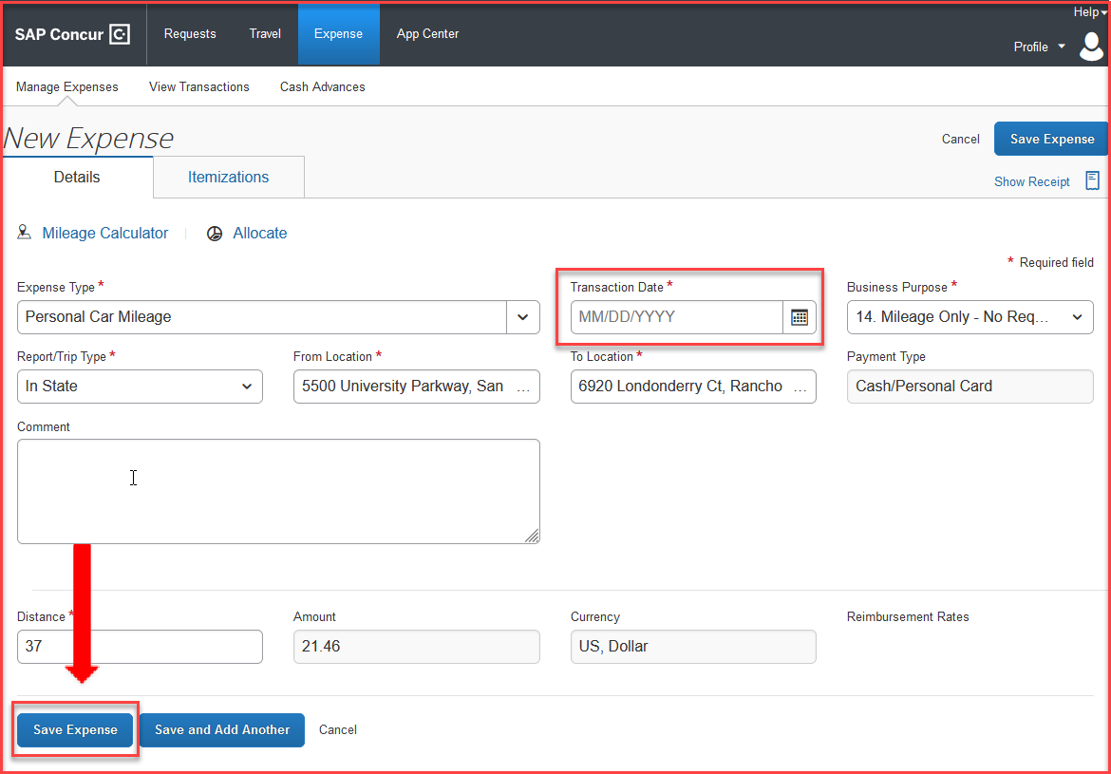
Enter the date of travel on the Transaction Date box. Be sure to click on the save expense button on the bottom of the page to save each entry. Comments specific to the trip may be added in the comment box for the approver to see.

Slide 10
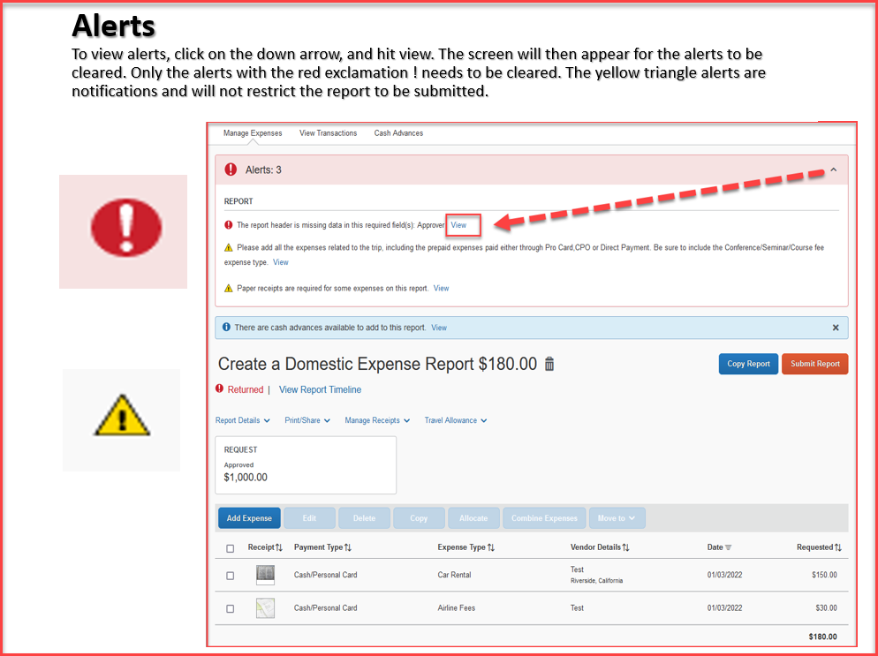

Slide 11
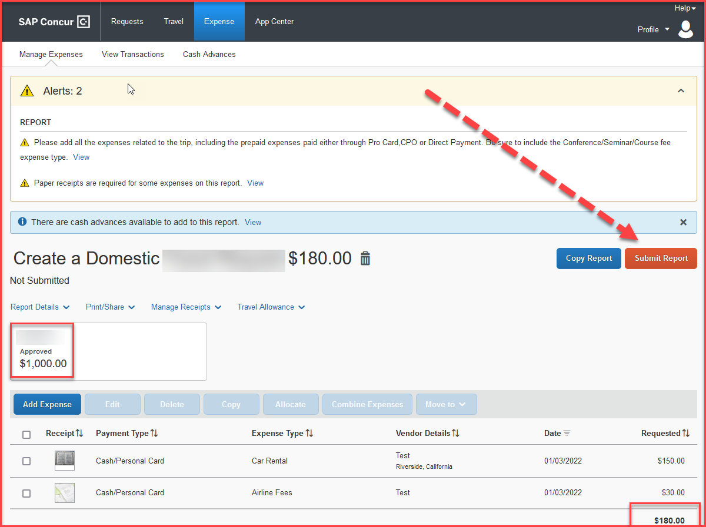
When all expenses have been entered and all the red alerts are cleared, you are now ready to submit the report!
The amounts entered in segments for airfare, domestic hotel and rental car will appear here as estimated expenses in addition to the ones entered from the expenses tab.

Slide 12
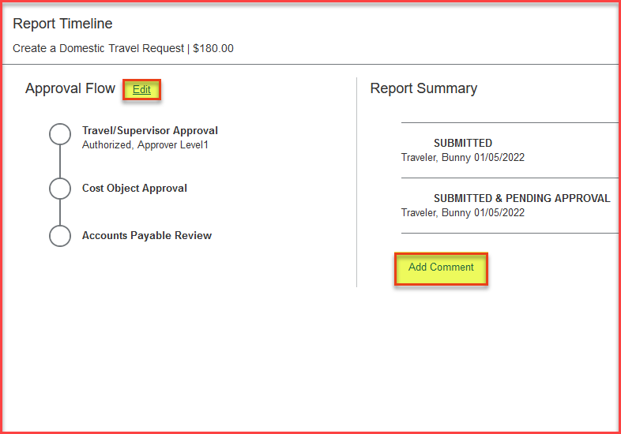
Expense Report Workflow Steps
Travel/Supervisor Approval --- This approver is the employee’s default manager
Cost Object Approval – The budget approver, or the approver listed in DACS for that department
Accounts Payable Review – The accounts payable travel processor
Please note: each approvers have 9 days to approve a Report, failing which the Report gets timed out, and the user will have to resubmit the Report
The employee can also add additional approvers by clicking on the Edit option next to Approval Flow and add a comment as well. All these changes can be done, only before the report is submitted.

Slide 13
THANK YOU!
If further information or assistance is needed, please do not hesitate to contact Accounts Payable/Travel at 909-537-3158
Notes:
Updated August, 2017 CL

