Slide 1
Presenter: Twillea Evans-Carthen University Ombuds Officer, Director, Ombuds Services
Moving From “Good” to “Great” Work
Relationships Starts with Me!

Slide 2
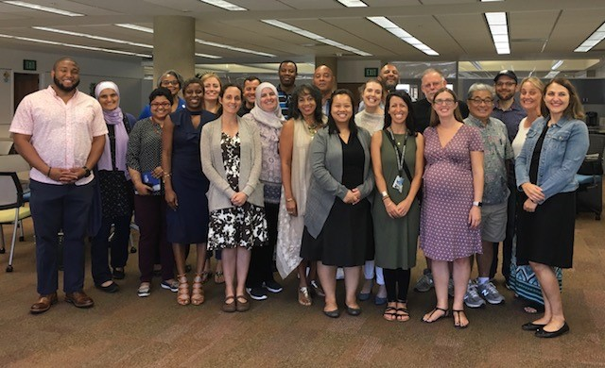

Slide 3
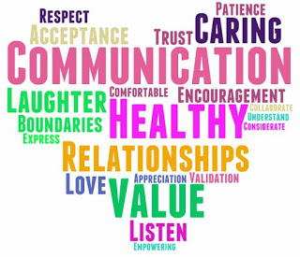
Objectives
Organizational Values
Respectful Guidelines
Definitions (Kahoot)
Perception of Workplace Behavior
Diversity, Equity & Inclusion
Conflict Communication Coaching
Steps To Manage Emotional Intelligence

Slide 4
CSUSB Core Values
Inclusivity
Innovation
Integrity
Respect
Social Justice and Equity
Sustainability
Transparency
Wellness and Safety

Slide 5
Respectful Communication Guidelines
R = take RESPONSIBILITY for what you say and feel without blaming others
E = use EMPATHETIC listening
S = be SENSITIVE to differences in communication styles
P = PONDER on what you hear and feel before you speak
E = EXAMINE your own assumptions and perceptions
C = keep CONFIDENTIALITY
T = TRUST ambiguity because we are NOT here to debate who is right or wrong

Slide 6
Definitions Let’s Play Kahoot!
Open your web browser on your cell phone and navigate to Kahoot.it
Enter the following PIN number to participate in the correct game/quiz
Choose a unique username
https://create.kahoot.it/details/diversity-awareness/2ad4f33f-5af0-4778-ad28-f4718f544858

Slide 7
Perception of Workplace Behavior
Differences in understanding individual perceptions
Unexpected behavior impacts productivity, performance, communication, student success
Campus and Systemwide Resources
Perceptions result in different responses including,
Aggressions
Bully
Incivility
Respectful interpretation of perception

Slide 8
Why Being Respectful to Your Coworkers is Good for Business https://www.ted.com/talks/christine_porath_why_being_respectful_to_your_coworkers_is_good_for_business?language=en

Slide 9
Diversity Awareness, Equity, and Inclusion
Dimensions of Personal Identity
Perception Exercise
Perception of Aggressive Behavior
Perception of Bullying
Perception of Micro-aggressions
Perception of Inclusion

Slide 10
Conflict Communication Tips
Active Listening
Non-verbal Communication
Use “I” Statements
Remain Calm
Control Tongue and Tone
Confront the situation not the person
Avoid
Advising
Threatening
Other

Slide 11
Four Emotional Intelligence Capabilities
Relationship Management
Self-Awareness
Social-Management
Social Awareness

Slide 12
Questions

Slide 13
Contact Information
Twillea Evans-Carthen
University Ombuds Officer, Director of Ombuds Services
California State University, San Bernardino
5500 University Parkway
San Bernardino, CA 92407
tcarthen@csusb.edu
(909) 537-5635

