Slide 1
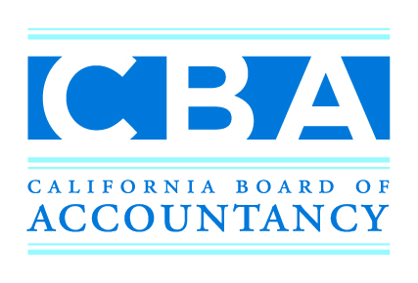
Uniform CPA Examination and CPA Licensure Requirements
Suzanne Gracia and Dustin Kramer
Examinations and Initial Licensing Unit

Slide 2

The Path to a
California CPA License
Examination
Education
Experience

Slide 3
Uniform CPA Examination
(CPA Exam)
National Computer-based Exam
Consists of Four Parts:
  Auditing and Attestation
  Business Environment and Concepts
  Financial Accounting and Reporting
  Regulation

Slide 4
Minimum Educational Requirements to take the CPA Exam
Conferral of a bachelor’s degree or higher
Completion of 24 semester units in accounting subjects
Completion of 24 semester units in business-related subjects
The 24/24

Slide 5
3:2 Program Option
Master of Science in Accountancy
Students enrolled in the program Can sit for CPA Exam prior to conferral of bachelor’s degree.
  Must have met all bachelor degree requirements.
  Must have letter sent from registrar’s office in addition to transcripts.

Slide 6
Applying for the CPA Exam is Easy
Create online client account on CBA website.
Request transcripts to be sent directly to CBA.
Print, sign and submit the application and processing fee to the CBA.

Slide 7
CPA Exam Testing Windows
There are 4 testing windows each year:
    January 2 – March 10
    April 1 – June 10
    July 1 – September 10
    October 1 – December 10

Slide 8
Selecting and Scheduling Your Exam Sections
Select Your Sections From Client Account
Pay Your Fees to NASBA
Receive Your Notice to Schedule
Schedule Your Exam

Slide 9
Important Testing and Score Info
Be on Time!
Bring Your NTS and Valid Forms of ID
Scores are Posted to Your Client Account
Congratulatory Letter!

Slide 10
Obtaining a CPA License in California
Examination
Education
Experience

Slide 11
Educational Requirements for
CPA Licensure
150 Semester Units Required for Licensure
In addition to the 24/24, you need:
20 semester units of accounting study
10 semester units of ethics study

Slide 12
Experience Requirements for CPA Licensure
General Authority
  One Year General Experience
Attest Authority
  Minimum 500 Attest Hours

Slide 13
Are You Ready to Apply?
The Bonus “E” Ethics Exam
Fingerprinting
Application, Photo and Fee
Criminal Conviction Disclosure Form

Slide 14
So You Have Applied…
Now What?
Receive Acknowledgement Card
Receive Status Letters
Receive Pre-approval Letter
Receive CPA License Number

Slide 15
Self Assessment
CBA Provides Great Tools to Assist You
Fill-able Worksheet
Detailed Instructions
Available on Website Under Applicant Tab: http://www.dca.ca.gov/cba/applicants/ed-requirements.shtml

Slide 16
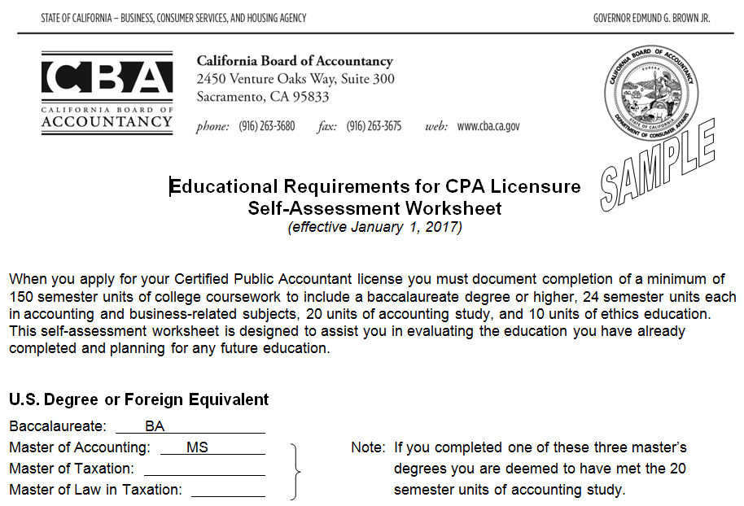

Slide 17
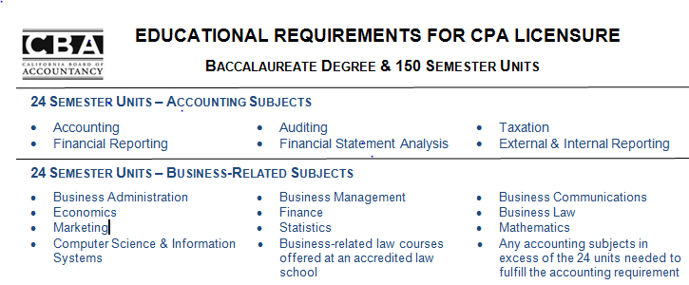

Slide 18
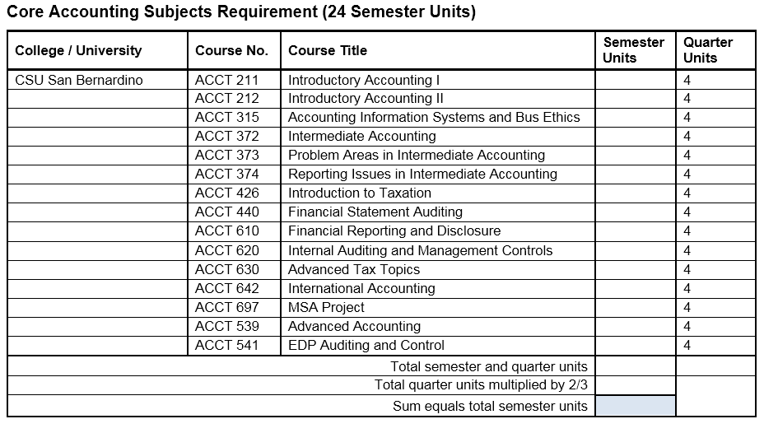

Slide 19
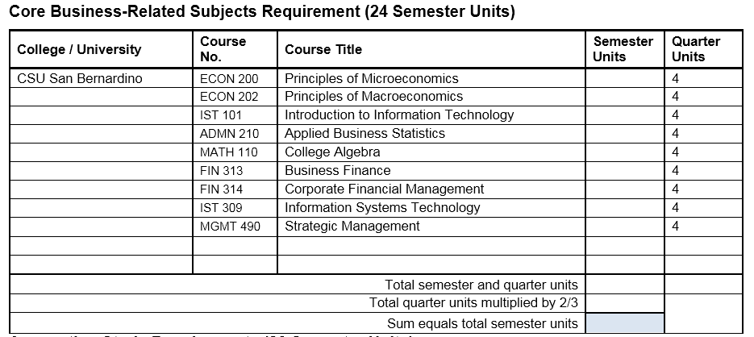

Slide 20
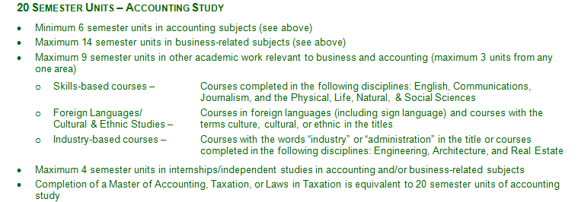

Slide 21
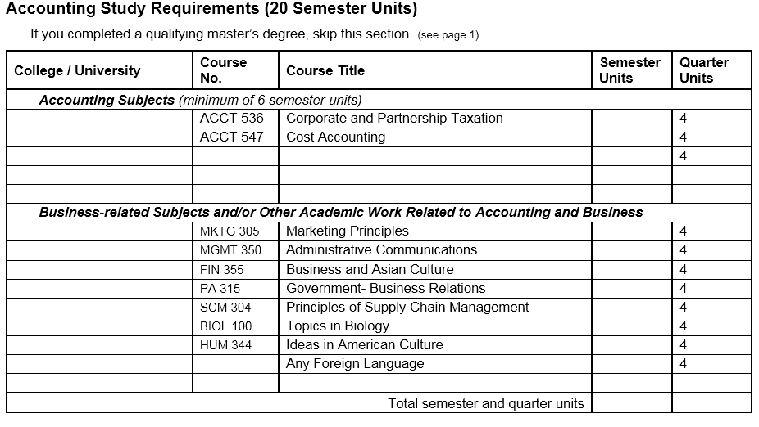

Slide 22
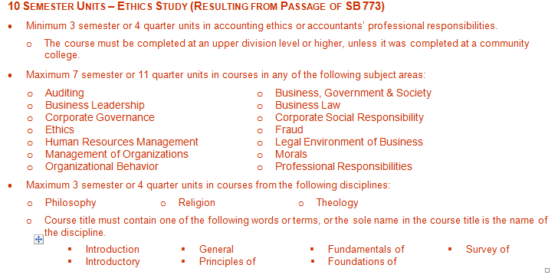

Slide 23
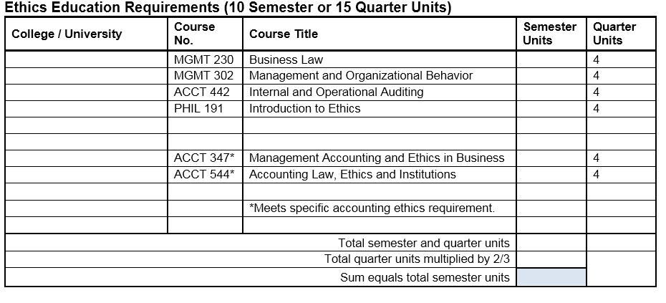

Slide 24
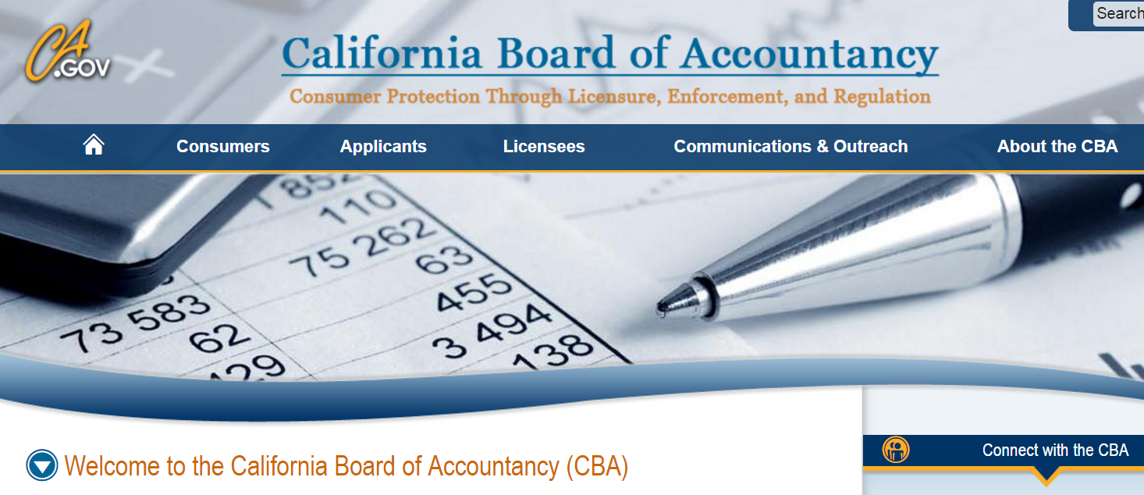
For More Information
Visit www.cba.ca.gov

Slide 25

Contact Us for Help
Outreach@cba.ca.gov (916) 263-3680
Examinfo@cba.ca.gov (916) 561-1703
Licensinginfo@cba.ca.gov (916) 561-1701
Twitter: @CBANews
Facebook and LinkedIn:
California Board of Accountancy

