Slide 1


Richard H. Jahns Distinguished Lectureship In Applied Geology
2018-19 Deborah Green
Notes:
Thank you for intro. Thank you to AEG and GSA EEGD. 31st Lecturer, Second Woman, First in 20 years. Diverse voices, etc.

Slide 2
What is Applied Geology?
Notes:
Applied Geology context.

Slide 3
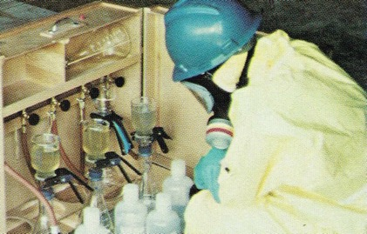
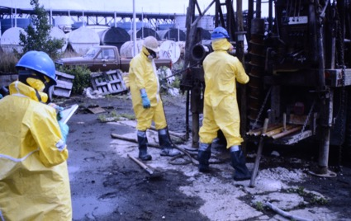
Examples of Environmental Projects:
Investigation and remediation of contaminated sites.
Site selection and characterization for proposed waste sites.
Inspections and audits of sites where wastes may be disposed.
Notes:
My environmental geology examples.

Slide 4
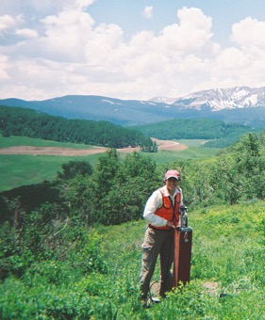
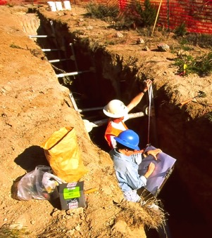
Examples of Engineering Geology Projects:
Landslide studies.
Paleoseismology studies.
Developing water resources.
Geotechnical studies of foundations.
Notes:
My engineering geology examples.

Slide 5
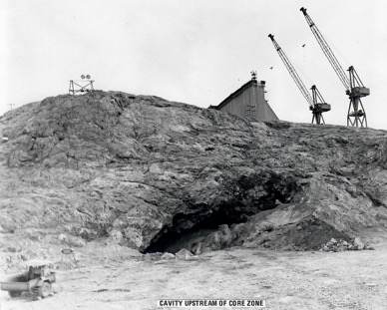
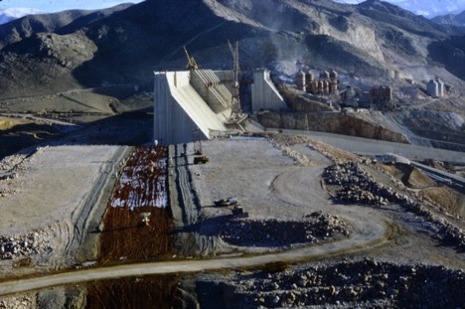
Examples of Engineering Geology Projects:
Site selection/characterization for large infrastructure projects, such as dams.
Notes:
Add pic of foundation of Keban – other engineering geology examples.

Slide 6
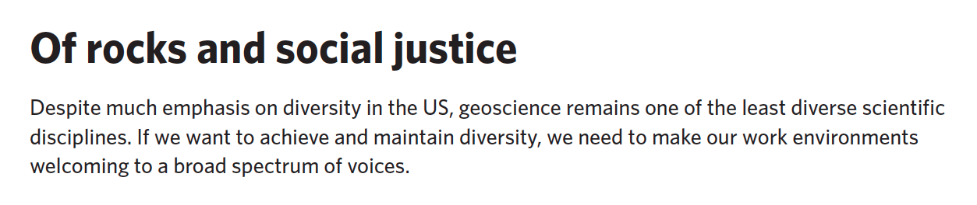
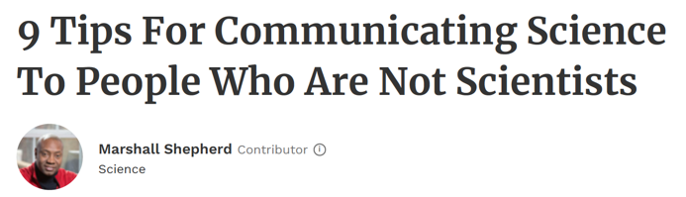
Notes:
What I didn’t know, and wished I had, as a student and issues relevant to scientists and citizens today – like lack of diversity in our profession and how to communicate science to non-scientists.

Slide 7
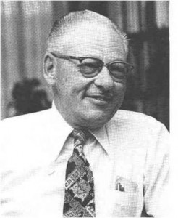
Dick Jahns
1915-1983
Notes:
Info on Dick Jahns.

Slide 8
How to Build a Geology
Career You Love

Slide 9
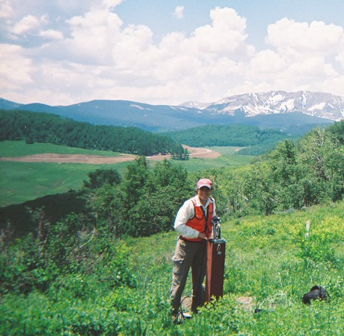
Find Your Calling
Notes:
My calling, and my job

Slide 10
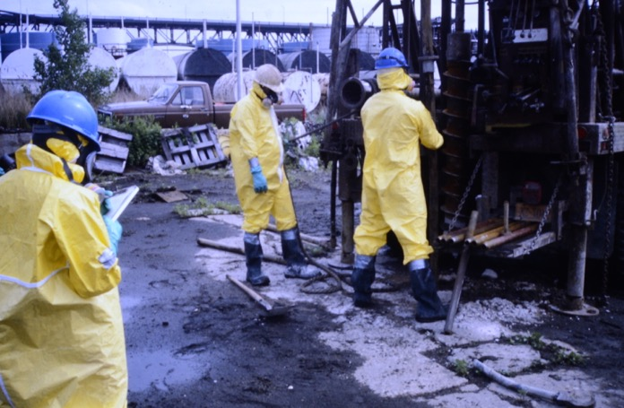

Slide 11
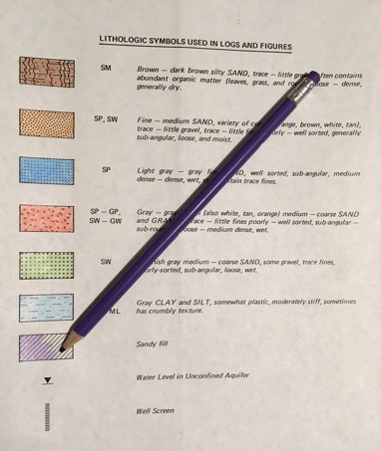
Notes:
First day on the job for me.

Slide 12
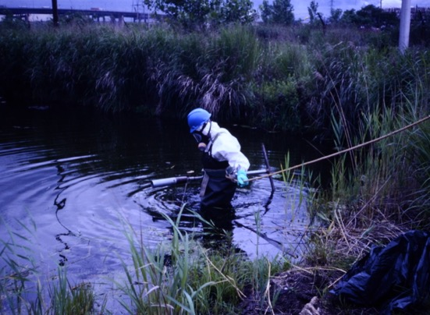
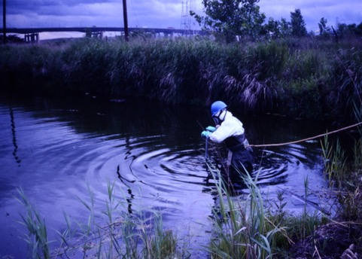
Notes:
Collecting sediment samples

Slide 13


Slide 14
Consulting
Contracting
Industry
Governmental Agencies
Teaching
Self Employment

Slide 15
Consulting Work
Geological work for clients that need problems solved.
Consulting firms can range in size from a few people to thousands of employees.
Local, regional, national, or international.
Highly specialized or take on wide varieties of work.
Technical work, project management, or business development, or a combination of all those things.

Slide 16
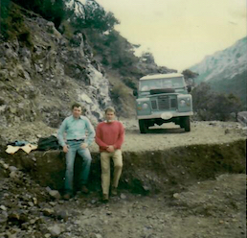
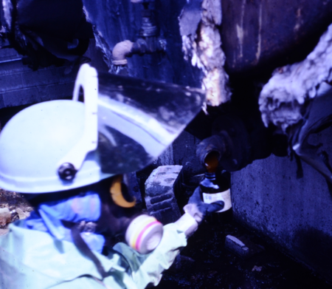

Slide 17
Contracting Work
Provide support services for consulting or industrial clients.
Support services can include: laboratory testing, construction or demolition work, drilling, and excavation.
Contractors tend to be local or regional, but specialty contracting can be national or international.
Tends to be hands-on. Technical work, project management, business development, or a combination of all those things.

Slide 18
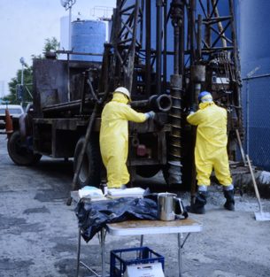
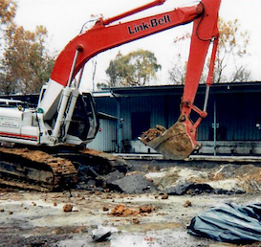

Slide 19
Working for Industry
Some industries employ scientists/engineers rather than using outside consultants. Or they employ us to manage consulting work being done for them.
Industry is often the client of consultants and contractors.
Serve as an internal consultant.
Project management for outside consultants’ work.
Represent your company when meeting with regulatory agencies.

Slide 20



Slide 21
Governmental Agencies
Research- and education-oriented groups (like the USGS) and regulatory agencies (like the USEPA).
There are local/regional, state, and federal governmental agencies.
For a regulatory agency, work is often more overseeing and reviewing others’ work than doing technical work.
Working for a governmental agency may provide more job stability and a more regular schedule than working for a consultant or contractor.

Slide 22






Slide 23
Teaching
Opportunities on all levels, from elementary school to colleges and universities. Includes a wide variety of work, from strictly teaching to advising students at many levels to doing research in your chosen field.
Some levels will have many more job opportunities than others.
Once established in education, there should more job stability and a more regular schedule than working for a consultant or contractor.
May have more vacation time than consulting, contracting, or working for industry.

Slide 24
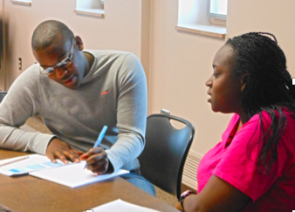
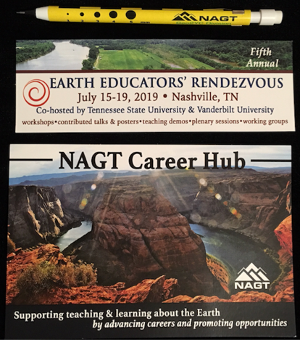



Slide 25
Self Employment
Self employment is an option in consulting and contracting. Generally best to have at least some professional experience before embarking on your own.
More autonomy for yourself. More responsibility for yourself (and your employees).
Possibly more flexibility, but it depends on your clients’ needs.
May have more risks. May have more rewards.
Must learn about the business side of the work, as well as the technical.

Slide 26
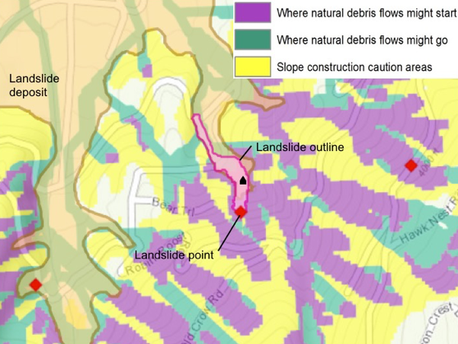
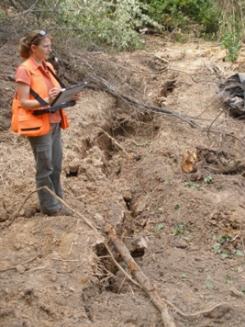

Slide 27
The secret of getting ahead is getting started.
Mark Twain

Slide 28
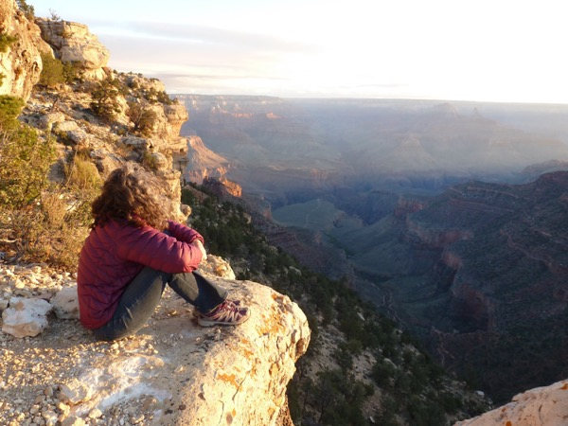

Slide 29


Notes:
Holly, can you add the logos for the AEG Foundation and the GSA Foundation here?

Slide 30
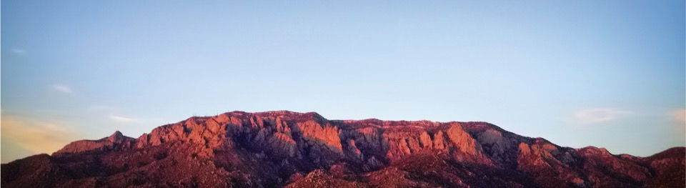

geologistwriter.com/distinguished-lecturer/
Notes:
Finish up, thank you’s, and encourage questions and conversation, if time.

