Slide 1
Accessibility for faculty

Slide 2
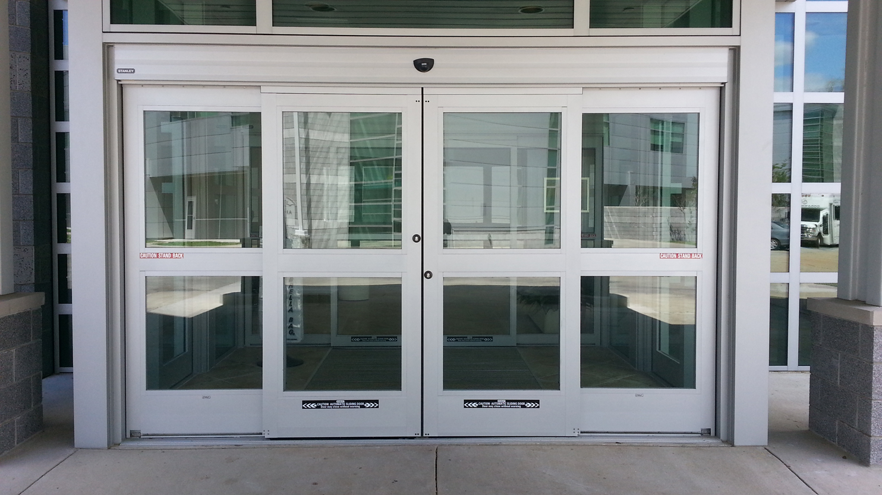
The Larger Universal Design

Slide 3
Universal Design for Learning (UDL)
Consider the potential needs of all learners when designing and delivering instruction
Identify and eliminate unnecessary barriers to teaching and learning while maintaining academic rigor
Provide multiple means of engagement, representation, and action & expression

Slide 4
Digital Accessibility
Ensures all people have equal access to information
Accessibility best practices lead to increased usability for all
Accessible Technology vs. Assistive Technology

Slide 5
Accessibility and UDL
Accessible Feature | Disability- Specific | Also Good For
Captions & Transcripts | Deaf & Hard of Hearing | English language learners, those in noisy or quiet environments, studying
Document Structure | Blind or Visually Impaired | Limited dexterity, people in a hurry
Alternative Text | Blind or Visually Impaired | Poor internet access
Sufficient Color Contrast | Visually impaired | Everyone
Digital PDFs | Visually Impaired | Literacy, portability
Descriptive link text | Learning Disabilities, Blind | Everyone

Slide 6
Additional Accessibility Considerations
Use legible font and font size
Don’t use color alone to convey meaning
Use proper lists
Use built-in accessibility checkers in Office and Acrobat

Slide 7
Accessibility Tools
Grackle Docs
Add-on for Google Docs, generates accessible PDFs
Colour Contrast Analyser
Evaluates foreground and background for contrast
EquatIO (available via Software Center)
Accessible equations
Blackboard Ally
Accessibility checker for content in LMS

Slide 8
YouTube and You
Autogenerated Captions ≠ Equal Access
Grammar
Spelling
Misinterpreted words
Misaligned caption blocks
Notes:
Rosa

Slide 9
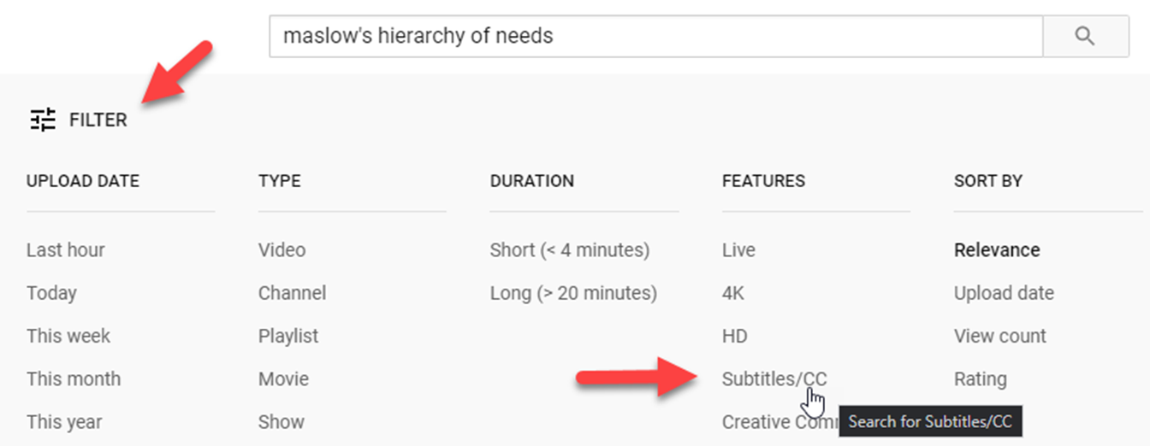
Finding Captioned Content

Slide 10
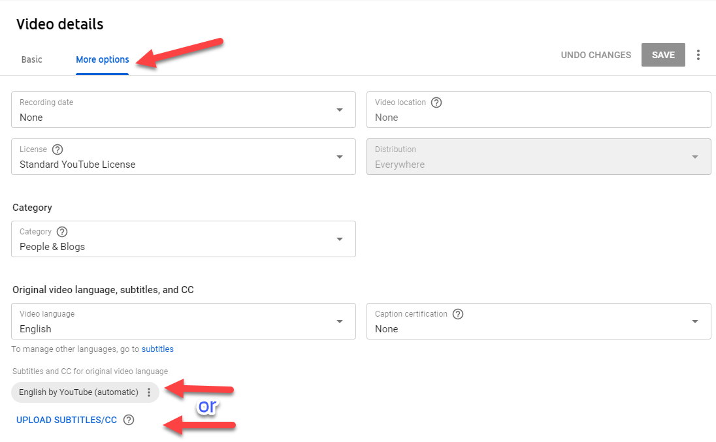
Edit Options in YouTube Studio

Slide 11
What is Blackboard Ally?
Accessibility tool that integrates into Blackboard
Gives instructor an indicator of accessibility of uploaded content
Click on gauge to get details on which accessibility improvements will have the biggest impact
Guided instructions on how to fix
Gives students instant alternate formats
Ally generates a variety of alternate formats that students can download for the preferred learning style
Student view does not show accessibility score
The more accessible the content, the better the alternate formats

Slide 12
Blackboard Ally Instructor View
For uploaded content:
At-a-glance indicator
Guided remediation

Slide 13
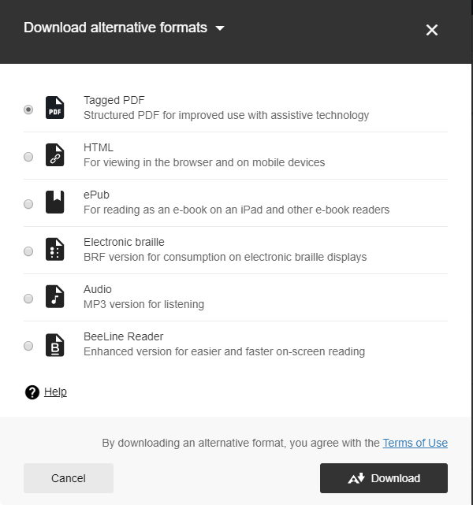
Blackboard Ally Student View
For Uploaded Content
Offered after each file:
Dropdown menu

Slide 14
Accessibility for One = Usability for Many

Slide 15
Contact Me!
Christine.Fundell@csusb.edu
csusb.edu/ats

