Slide 1
Sap Concur App login Process

Slide 2
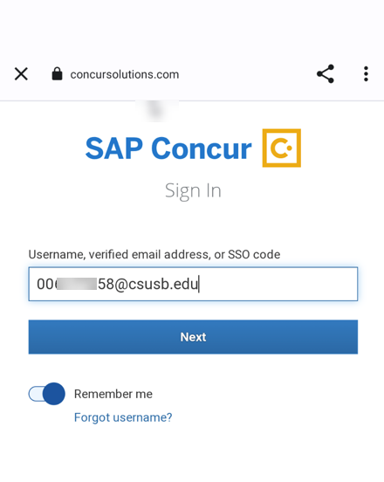
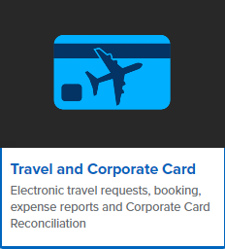
Go to the app store of your phone and download SAP Concur App and sign in using your Coyoteid@csusb.edu, as shown below, and click on Next:

Slide 3
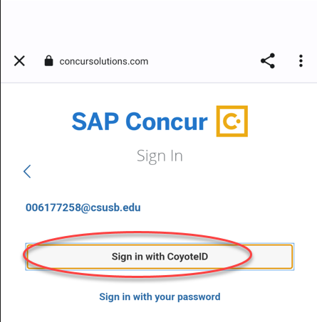
Please select Sign in with Coyote id
Notes:
This page is your home page
Go over all information on this page

Slide 4
Enter your Coyote id and Password – this will be your Mycoyote login id and password

Slide 5
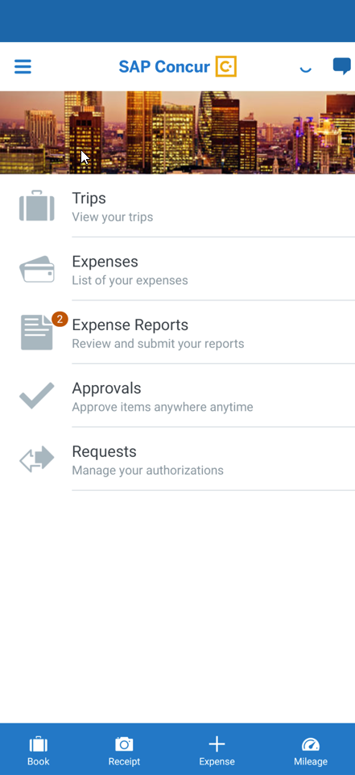
Once the Duo authentication security login is done, the SAP Concur App will open . Now you can open the Receipt capture option and download your receipts in your Concur profile!

Slide 6
THANK YOU!
If further information or assistance is needed, please do not hesitate to contact Accounts Payable/Travel at 909-537-3158
Notes:
Updated August, 2017 CL

