Slide 1
CPT Info Session
Introduction
For quick answers to common questions concerning CPT, please follow the below links.
So, you wish to work off-campus. CPT, a benefit of the F-1 visa, can help. Attending this course is your first step toward learning more about this off-campus employment authorization. Please review the content herein and then schedule time to meet with an advisor prior to applying for this immigration benefit. The following pages will provide answers to the below questions.
What is CPT?
How do I qualify?
What is the application process?
What are the requirements?
What are my next steps?
Are there any additional resources?
Disclaimer: The information contained herein is provided as a service to the students, faculty, staff, employees and administrators of CSU San Bernardino (CSUSB), and is not intended to constitute legal advice. The Center for International Studies and Programs (CISP) endeavors to provide useful information, but makes no claims, promises or guarantees about the accuracy, completeness or adequacy of the information contained in or linked via this email. Nothing provided herein should be considered legal advice nor a substitute for the advice of competent legal counsel and neither CSUSB nor CISP has any responsibility for the results obtained from the use of this information.

Slide 2
What is CPT?
Contents
Home
What is CPT?
How do I qualify?
What is the application process?
What are the requirements?
What are my next steps?
Are there any additional resources?
Curricular Practical Training (CPT) is the permission to work. Your department will provide the opportunity. According to regulations CPT is an off-campus work authorization provided by the U.S. government to help international students meet course or degree requirements. The training must be connected to the student's academic program. In other words, it must be required:
for the degree identified on the Form I-20,
to earn internship/independent study credit, or
to complete a project or thesis.

Slide 3
CPT Regulations
Contents
Home
What is CPT?
How do I qualify?
What is the application process?
What are the requirements?
What are my next steps?
Are there any additional resources?
The governing Code of Federal Regulations can be found at 8 CFR 214.2(f)(10)(I) .
"An F-1 student may be authorized…to participate in a curricular practical training program which is an integral part of an established curriculum".

Slide 4
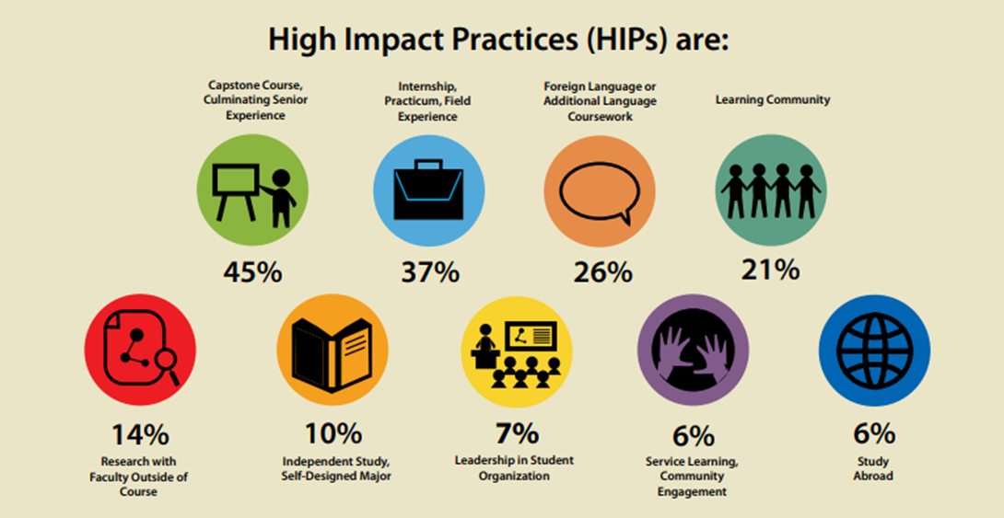
High Impact Practices (HIP)
Contents
Home
What is CPT?
How do I qualify?
What is the application process?
What are the requirements?
What are my next steps?
Are there any additional resources?
Internships are an example of a HIP, High Impact Practice. HIPs are "opportunities to integrate, synthesize, and apply knowledge are essential to deep, meaningful learning experiences” (Kuh, 2008). Students who participate in High Impact Practices enjoy higher levels of learning success in higher education, which is why CSUSB supports such opportunities. Participating in an Internship, Practicum, Field Experience is beneficial for your education.

Slide 5
Eligibility Requirements
Contents
Home
What is CPT?
How do I qualify?
What is the application process?
What are the requirements?
What are my next steps?
Are there any additional resources?
To be eligible for CPT, you must be able to answer "yes" to the following six questions:
Have you been enrolled for one (1) academic year, two (2) semesters, or are you a graduate student or doctoral student?
Do you have an offer letter from an employer?
Is the employment related to your major?
Is the employment required to earn your degree, earn internship/independent study credit, or complete your thesis or project?
Has your department approved the CPT opportunity?
Have you completed and submitted the CPT application?

Slide 6
Must work to earn your degree
Contents
Home
What is CPT?
How do I qualify?
What is the application process?
What are the requirements?
What are my next steps?
Are there any additional resources?
Must work to earn your degree
If your degree program requires you to work to get your degree, you are allowed to work CPT.
Qualified programs on campus, for example:
Masters of Public Administration (MPA)

Slide 7
Must work to earn your culminating experience
Contents
Home
What is CPT?
How do I qualify?
What is the application process?
What are the requirements?
What are my next steps?
Are there any additional resources?
Must work to earn your culminating experience
If your Master's Project or Thesis requires you to work to get your degree, you are allowed to work CPT.
Qualified activities, for example:
Working in a school for a Thesis on educational development.
Working in a computer science position to gain experience for a certain programing tool to complete a Master’s Project.

Slide 8
Must work to pass a class
Contents
Home
What is CPT?
How do I qualify?
What is the application process?
What are the requirements?
What are my next steps?
Are there any additional resources?
Must work to pass a class
If your degree program requires you to work to get your degree, you are allowed to work CPT.
Qualified class for example:
ADMN 5753 Internship
FIN 5755 Internship

Slide 9
How you qualify for CPT
Contents
Home
What is CPT?
How do I qualify?
What is the application process?
What are the requirements?
What are my next steps?
Are there any additional resources?
Assignment
Talk with your Program Coordinator or Faculty Advisor to see which CPT opportunity would be right for you. You will need to determine if your program 1) requires you to work off-campus, 2) requires you to submit a Thesis or Master's Project, or 3) has internship classes.

Slide 10
One (1) Academic Year
Contents
Home
What is CPT?
How do I qualify?
What is the application process?
What are the requirements?
What are my next steps?
Are there any additional resources?
Have you been enrolled for one (1) academic year?
Two academic semesters must be completed to be eligible for CPT if you are an undergraduate student.
Graduate students who are earning a Master's degree or EDD may work their first semester.

Slide 11
Do you have a job?
Contents
Home
What is CPT?
How do I qualify?
What is the application process?
What are the requirements?
What are my next steps?
Are there any additional resources?
ContentsHome
What is CPT?
How do I qualify?
What is the application process?
What are the requirements?
What are my next steps?
Are there any additional resources?
To be approved for CPT, an employment offer letter is required.
Submit your offer letter with your CPT application
The offer letter must be written on company letterhead and include:
Job title
Detailed job description
Address where employment will take place
Number of weekly working hours
The start and end dates of CPT employment

Slide 12
Requirements for CPT
Contents
Home
What is CPT?
How do I qualify?
What is the application process?
What are the requirements?
What are my next steps?
Are there any additional resources?
Has your faculty advisor approved CPT?
Your faculty advisor must sign your CPT Consent Form.
F-1 Curricular Practical Training (CPT) - Faculty Advisor Consent Form
Did you complete our form?
Submit your employment offer letter and proof of course registration with your application
Ensure your form is signed by
You,
Your faculty advisor

Slide 13
Request a CPT I-20
Contents
Home
What is CPT?
How do I qualify?
What is the application process?
What are the requirements?
What are my next steps?
Are there any additional resources?
Once you have your letter, faculty adviser approval, and internship class registered (if required) you will submit a request through the International Students Service Requests Page.

Slide 14
Reporting Requirements
Contents
Home
What is CPT?
How do I qualify?
What is the application process?
What are the requirements?
What are my next steps?
Are there any additional resources?
You are required to notify CISP when:
Your personal address changes,
Employment shifts between part-time and full-time,
Your supervisor or the location of your employment change; and,
Employment ends prior to the CPT authorization end date.

Slide 15
Impact of CPT on OPT
Contents
Home
What is CPT?
How do I qualify?
What is the application process?
What are the requirements?
What are my next steps?
Are there any additional resources?
Part-time CPT has no effect on OPT eligibility.
But, one year of full-time CPT results in forfeiture of OPT for your current level of education (e.g., bachelors).

Slide 16
Once approved for CPT
Contents
Home
What is CPT?
How do I qualify?
What is the application process?
What are the requirements?
What are my next steps?
Are there any additional resources?
You will receive a new I-20 authorizing CPT
Do not forget to apply for a Social Security Number (SSN) if necessary!

Slide 17
CPT Quiz! - Final
Contents
Home
What is CPT?
How do I qualify?
What is the application process?
What are the requirements?
What are my next steps?
Are there any additional resources?

Slide 18
FAQ's
Contents
Home
What is CPT?
How do I qualify?
What is the application process?
What are the requirements?
What are my next steps?
Are there any additional resources?
What type of work experience qualifies as CPT?
You may apply for CPT if the work experience is an integral part of the degree program. This includes any type of required internship, or any required work for which course credit is received. The internship must be directly related to your academic program.
Am I eligible to apply?
In order to apply, you must have completed one academic year as a full-time student, unless you are in a master’s program and it is required for you to start right away. Students must also be in good standing with immigration and registered for a full-time course load (with the exception of summer). Finally, you must complete the CPT course to have permission.
I am a graduate student who just started at CSUSB, can I apply for CPT?
Yes, graduate students at CSUSB can apply for CPT their first semester.
Will the CPT count toward my degree?
CPT may or may not count towards your degree. It depends on your program and your qualification to work CPT. At the very least, you can take an internship that will count on your transcripts. The internship might not count towards your degree requirements but can be taken as an extra class.

Slide 19
FAQ’s cont.
Contents
Home
What is CPT?
How do I qualify?
What is the application process?
What are the requirements?
What are my next steps?
Are there any additional resources?
How much CPT can I use? Will it affect my eligibility for OPT in the future?
Students are not limited to the amount of CPT they may utilize; however, students who have engaged in one year or more of full-time CPT are not eligible for Optional Practical Training (OPT). Part-time curricular practical training is not counted towards OPT eligibility. Your department may have restrictions on the amount of time a student participates in internship classes or CPT. Please make sure to discuss your options with them.
How do I apply?
Obtain an internship offer letter from your prospective employer on company letterhead specifying: your job title and responsibilities, whether the internship is full-time or part-time and the dates of employment. Complete the CPT Certification Form on the other side, along with the Faculty Advisor Consent Form. All requests take 5 working days to complete. Do not work until you receive the new I-20!
Can I begin my internship while I’m waiting for authorization?
No. You MUST be approved for CPT before your internship begins and have a CPT I-20 issued from our office. We do not back-date CPT authorization, so make sure you plan early and submit an application well before your internship is scheduled to begin. You should allow at least 5 working days for CISP to process the application.
Can I change my employer, the dates, or my status as full-time or part-time once I’ve been approved?
No. You may only work for the employer listed on your I-20, for the specific dates listed, and only full-time or part-time as authorized. Any changes require an entire new application packet and would necessitate a new CPT I-20.

Slide 20
FAQ’s cont. (2)
Contents
Home
What is CPT?
How do I qualify?
What is the application process?
What are the requirements?
What are my next steps?
Are there any additional resources?
What do I need to do to renew my CPT authorization next quarter?
You must submit all new documentation (including a new offer letter and Faculty Advisor Consent Form) along with a new CPT certification form for each quarter in which you would like to work. You must also continue to register for the internship course each quarter, as necessary.
I’m a graduate student. What if I’m also working part-time on-campus as a TA or a GSR? What if I have a fellowship?
If the combined time you plan to work (both CPT and on-campus employment) exceeds 20 hours per week, you should contact the Graduate Studies and/or your Departmental Advisor to discuss how this will affect your funding (fellowship, etc.). Working more than 20 hours total may be considered full-time employment by either your department or the Graduate Division and will affect your funding, so please check with them.
What dates can I request for my CPT? Can I work during breaks between quarters or after my program is finished?
The dates of your CPT authorization must match the dates of the semester in which you will do your internship. If are approved for CPT during the summer and will enroll in a full-time course load for the fall, to continue in your program, you may be eligible to have your CPT extended to cover the break between summer and fall. If you will complete your program in the summer, your CPT must end by the last day of the summer semester.
Your primary purpose is to study and obtain a degree. Employment cannot get in the way of these requirements nor can you gain employment eligibility without taking this course. Doing so could result in termination of your F-1 status.

Slide 21
CPT eligibility by degree or class requirement
Contents
Home
What is CPT?
How do I qualify?
What is the application process?
What are the requirements?
What are my next steps?
Are there any additional resources?
CPT eligibility by degree or class requirement handout

