Slide 1


Retirement/FERP Info Session
Notes:
Mrs. Lisa White

Slide 2
Today we will cover
Best Retirement Date
CalPERS Pension Options
Benefits & Medicare
Your Retirement Application
Faculty Early Retirement (FERP)
Questions
Notes:
Mrs. Lisa White

Slide 3

Things to consider when choosing the best retirement date
Notes:
Ms. Lisa White

Slide 4
Things to consider when choosing your retirement date
The current academic year ends May 27, 2021. To continue benefits and earn service credit, your retirement date can be August 15th.
Academic year faculty should refer to the academic calendar to determine their retirement date.
Twelve month faculty, after considering the benefit factor and age, can choose any desirable date.
Summer Session
10W 06-02 thru 08-09
6W1 06-02 thru 07-07
6W2 07-08 thru 08-11
Your retirement date needs to be 1 day after summer session ends August 12, 2021.
The 2021/2022 academic semester term begins August 16th. If you want to FERP during this academic year you must retire before the fall semester term begins.
Notes:
Ms. Winsome Laos

Slide 5
Things to consider when choosing your retirement date
Benefit Factor (formula)
Final Compensation (highest 12mo consecutive salary earned)
Service Credit
Benefit Factor:
Two percent at age 55 (2% @55), reaches the maximum at age 63 at 2.5%. If you are already age 63 or better, then a date based on age does not matter.
Notes:
Mrs. Lisa White

Slide 6
Benefit Factor Examples for 2% @ 55 formula
Age 55
20 years of service
Using minimum benefit factor (2% @55):
2 x 20 = 40%
(highest 12 months consecutive salary earned)
Age 63
28 years of service
Using maximum benefit factor (2.5% @63):
2.5 x 28 = 70%
(highest 12 months consecutive salary earned)
Notes:
Mrs. Lisa White

Slide 7
Things to consider when choosing your retirement date
Highest 12 month compensation
Next to consider in the formula is the highest 12-months of compensation. CalPERS looks back 12 consecutive months from the retirement date to capture the highest 12-months of compensation for 2% @ 55. Other formulas will either average or look back at 36 consecutive months.
Finally look at and/or consider your Service Credit.
Notes:
Mrs. Lisa White

Slide 8
Sick Leave balance
Your Sick leave balance is reported and converted into additional service credit. To know the conversion equivalency, take your sick leave balance (hours) and divide by 2,000;
Another method of converting hours is by dividing your total sick leave hours by 8 (total days) and multiply by .004
State Miscellaneous & Industrial Benefits https://www.calpers.ca.gov/docs/forms-publications/state-misc-industrial-benefits.pdf
Notes:
Mrs. Lisa White

Slide 9

CalPERS Pension
Your options & how they affect your monthly pension
Notes:
Ms. TAR

Slide 10
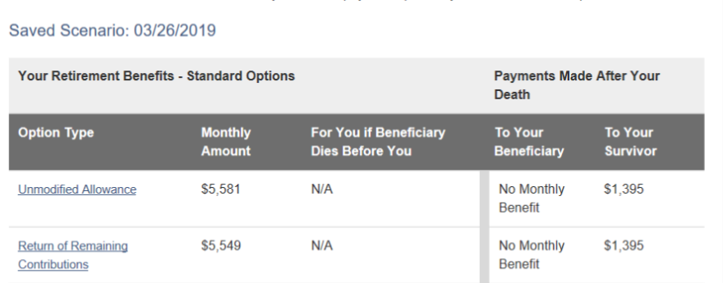
CalPERS Pension Options
Unmodified Allowance
Provides the highest “Monthly Amount”. There is no continuing monthly benefit “To Your Beneficiary” (may be different from your Survivor) and no return of unused member contributions upon your death.
Note, “To Your Survivor” a slight “Monthly Amount”, no reduction in members “Monthly Amount”.
Return of Remaining Contribution Option 1
Upon your death, provides a lump-sum payout of any remaining member contributions in your account to your named beneficiaries. This option does not provide your beneficiary an ongoing monthly benefit (see example below).
Note, “To Your Survivor” slight “Monthly Amount”, slight reduction in members “Monthly Amount”.
Notes:
Ms. TAR

Slide 11
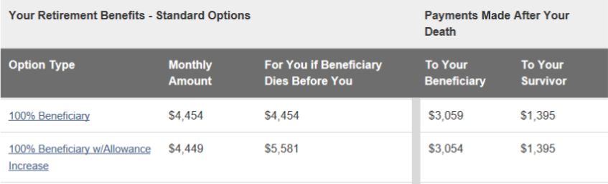
CalPERS Pension Options
100 Percent Beneficiary Option 2
Provides 100 percent of the “Monthly Amount” to your named beneficiary upon your death (usually same as Survivor). Upon both your deaths (member & Survivor), a lump-sum payout of any remaining member contributions in your account will be paid to one or more named secondary beneficiaries.
Note, Survivor receives same “Monthly Amount” (combined payments), reduction in members monthly benefit.
100 Percent Beneficiary with Benefit Allowance Increase
Option 2W
Provides 100 percent of the “Monthly Amount” to your named beneficiary (usually same as Survivor) upon your death. If your beneficiary dies before you, or you have another qualifying event, such as a change in marital status, your “Monthly Amount” will increase to the Unmodified Allowance (slide 11). No lump-sum payout option.
Note, Survivor receives same “Monthly Amount” (combined payments ), reduction in members monthly benefit.
Notes:
Ms. TAR

Slide 12
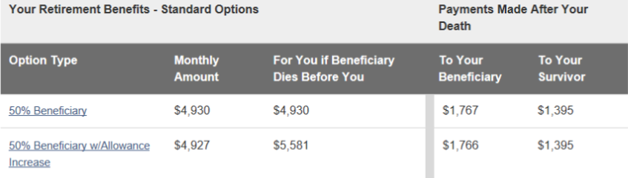
CalPERS Pension Options
50 Percent Beneficiary Option 3
Provides 50 percent of the “Monthly Amount” to your named beneficiary upon your death (usually same as Survivor). Upon both your deaths (member & Survivor), a lump-sum payout of any remaining member contributions in your account will be paid to one or more named secondary beneficiaries.
Note, Survivor receives half of your “Monthly Amount” (combined payments), reduction in members monthly benefit.
50 Percent Beneficiary with Benefit Allowance Increase Option 3W
Provides 50 percent of the “Monthly Amount” to your named beneficiary (usually same as Survivor) upon your death. If your beneficiary dies before you, or you have another qualifying event, such as a change in marital status, your “Monthly Amount” will increase to the Unmodified Allowance (slide 11). No lump-sum payout option.
Note, Survivor receives half of your “Monthly Amount” (combined payments ), reduction in members monthly benefit.

Slide 13
Benefits & Medicare
Notes:
Ms. TAR

Slide 14
Benefits & Medicare
Your CalPERS health & dental plans continue into retirement. You can elect vision and enhanced dental and continue them by paying additional plan costs.
If Medicare eligible (age 65 or better), you must enroll in both Medicare A & B. Do not elect C (Medicare Advantage) or D (Prescription Drug plan).
Dental benefits continue into retirement at the Basic Level of coverage unless you are participating in the Faculty Early Retirement Program (FERP).
If you participate in the FERP program .5 time base each semester or 1.0 for one semester, vision will be paid for 1 year and enhanced dental continues monthly while you are FERPing.
Notes:
TEAM BF

Slide 15
Benefits & Medicare
Retiree CalPERS Health Benefits
Retiree Dental Benefits
Retiree Vision
Medicare Enrollment deferred until retirement and retirement is after age 65, you will have a Special Enrollment Period and to avoid penalty, we must complete the Request for Employment Information form from Social Security.
https://www.cms.gov/Medicare/CMS-Forms/CMS-Forms/Downloads/CMS-L564E.pdf
Notes:
Ms. TAR

Slide 16
Contributions to the 403(b) plan
If you plan to contribute to a Fidelity 403(b) account, your appointment must show as active in their system. Due to short time frames, we need to coordinate your semester appointment in both the PeopleSoft and Payroll systems and notify Chancellor’s Office to update Fidelity’s system.
So we can assist you, we request you do the following:
Two weeks before you return to FERP, email HR Benefits benefits@csusb.edu so we can begin the notifications.
By the 5th of September/February, log in to your Fidelity account. https://nb.fidelity.com/public/nb/calstate/home
Change your deduction amount by at least $1.00.
Review your next pay warrant to see if the deduction was successful. If not, notify HR Benefits.
Notes:
Lisa White

Slide 17
Your Retirement Application
Notes:
Ms. TAR

Slide 18
your retirement application
You must complete your retirement application through CalPERS no later than 90 days before your retirement date, and prior to your FERP start date.
You can apply for service retirement online using MyCalPERS at www.calpers.ca.gov or contact CalPERS directly by calling (888) 225-7377 (Cal-PERS). Please note this must be completed by the employee and cannot be submitted by CSUSB.
The regional office locations are:
San Bernardino Regional Office
6500 East Hospitality Lane, Suite 330
San Bernardino CA 91203
Glendale Regional Office
655 North Central Avenue, Suite 1400
Glendale CA 91203
Orange Regional Office
Orange Center Tower
500 N. State College Blvd., Suite 750
Orange CA 92868
Notes:
Ms. TAR

Slide 19
your retirement application
My|CalPERS https://my.calpers.ca.gov/web/ept/public/systemaccess/selectLoginType.html
Service Retirement Election Application
https://www.calpers.ca.gov/docs/forms-publications/service-retirement-election-app.pdf
YouTube Your Retirement Options & Online Application https://www.youtube.com/watch?v=Fdc_vLoXwl0&t=605s
Notes:
Ms. TAR

Slide 20
Resources
CalPERS 2021 Health Premiums – State Only
CalPERS 2021 Health Premiums – Out of State
Medicare B Premium
Notes:
Ms. TAR

Slide 21
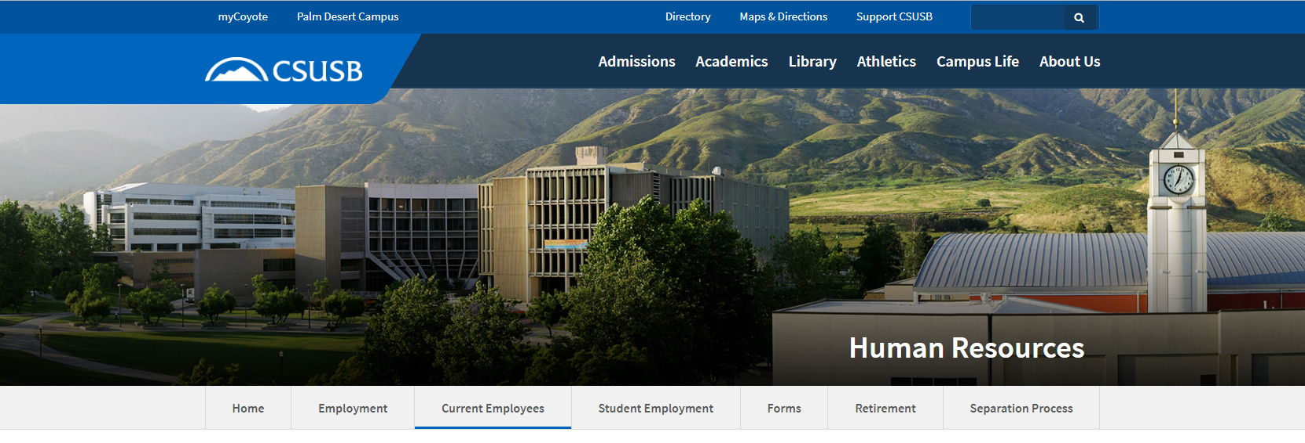
Place your screenshot here
HR Benefits Team
Phone: (909) 537-5143
Email: benefits@csusb.edu
Notes:
TEAM BF

Slide 22
Faculty Early Retirement (FERP)
Notes:
Ms. Winsome Laos

Slide 23
Faculty Early Retirement (FERP)
The Faculty Early Retirement Program (FERP), provides eligible, tenured retired faculty members an opportunity to earn income for a limited duration for post-retirement CSU employment.
Notes:
Ms. Winsome Laos

Slide 24
Faculty Early Retirement (FERP)
The FERP retirement application deadline for the 2020/2021 academic year is February 15, 2021.
The period of employment are based on the needs of the department and must be approved by the Dept. Chair, the College Dean and the Provost.
The approved workload schedule should to be attached to the FERP application.
The period of employment may be one semester at full-time or two semesters at half-time.
The current duration for FERP is a maximum of five years.
You may elect to keep up to 48 hours of sick leave into FERP
FT/1.0 workload is 30 WTUs
FT/1.0 FERP @ .50 time-base is 15 WTUs
½ workload is 7.5 WTU (Fall and Spring Semester) 7.5 x 2 semesters equals 15 WTUs
If your workload is 4 classes @ 3 WTU = This consists of 12 WTUs direct instruction and 3 indirect, totaling 15 WTU’s.
Notes:
Ms. Winsome Laos

Slide 25
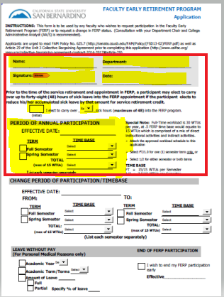
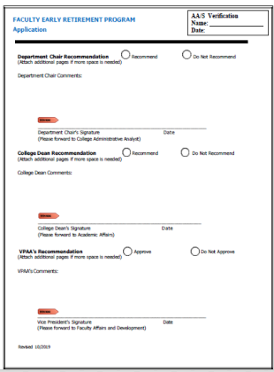
Faculty Early Retirement (FERP) APPLICATION
Notes:
Ms. Winsome Laos

Slide 26
Faculty Early Retirement (FERP)
Below is additional information about restrictions for those considering FERP who were hired on or after 1/1/2011.
These individuals are CalPERS members whose retirement formula is either 2% at age 60 (2011) or 2% at age 62 (2013).
  The Collective Bargaining Agreement (CBA) between the CSU and the California Faculty Association states that eligible tenured faculty members who have reached the age of 55 may participate in the FERP program.
  However, this language predates the 2011 and 2013 changes to CalPERS retirement formulas. Faculty hired on or after January 1, 2011 are not eligible to enter FERP until they reach the age of their respective retirement formula (age 60 or 62).
Notes:
Ms. Winsome Laos

Slide 27
CONVERSION OF CURRENT
FERP FACULTY
AY 2020-21
Full-time workload is 30 WTUs per year, at .5 FERP time base would equate to 15 WTUs which is comprised of a mix of direct instructional activities and indirect activities.
1.0 or 15 WTUs for one (1) semester term, or
.50 (1/2) or 7.5 WTUs for each semester term
A FERP timebase reduction may be requested. If granted, the reduction shall continue for the
remaining duration of FERP. This will impact your FERP benefits for dental and vision.
To work .50 each semester or 1.0 one semester, you must work (appointed) full-time (1.0) in the year preceding retirement. Per the CBA. the permissible "period of employment" shall refer to one (1) academic term not to exceed a total of ninety (90) workdays or fifty percent (50%) of the employee's regular time base in the year preceding retirement.
Notes:
Ms. Winsome Laos

Slide 28
Faculty Early Retirement (FERP)
Faculty Affairs and Development, FERP program information -
https://www.csusb.edu/faculty-affairs-development/faculty-resources/ferp
Faculty Affairs and Development -
https://www.csusb.edu/faculty-affairs-development
FERP application form:
AY
12 Month
FERP checklist
CBA -
Article 29
Notes:
Ms. Winsome Laos

Slide 29
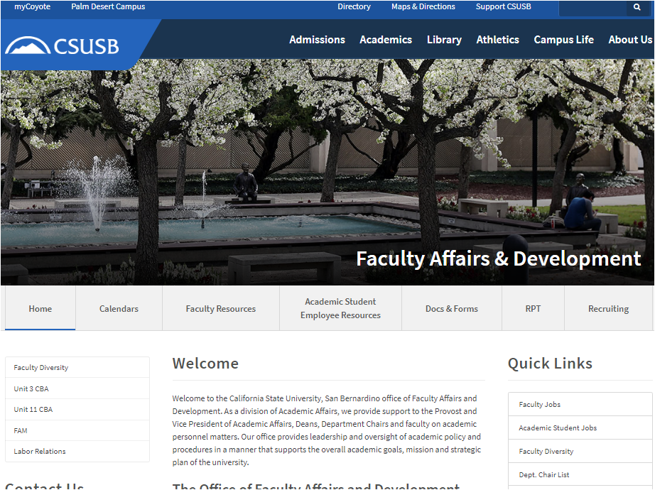
Place your screenshot here
Place your screenshot here
Place your screenshot here
FACULTY AFFAIRS
AND DEVELOPMENT
Phone: (909) 537-5029
Email: facultyaffairsanddevelopment@csusb.edu
Notes:
Ms. Winsome Laos

Slide 30
Thank You!
Any questions?
HR Benefits Team 909-537-5143
Lisa White and Tiffany Angel Ruiz
Faculty Affairs and Development 909-537-5029
Winsome Laos
Notes:
Mrs. Lisa White/TEAM BF

