Slide 1
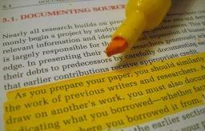
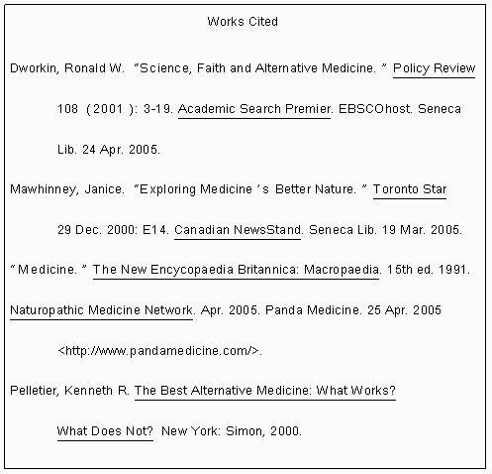
Understanding
Citation Styles
Presented by
Melissa Bone and Matthew Nunes
English 602

Slide 2

Understanding various citation styles is important
for several reasons.
Writing across the curriculum
Understanding the role of citation in various disciplines and
discourse communities
“Encouraging students to believe that MLA style and citation conventions of the humanities are appropriate for all topics, whatever the discipline, is intellectually chauvinistic” ( Dowdey 346).

Slide 3

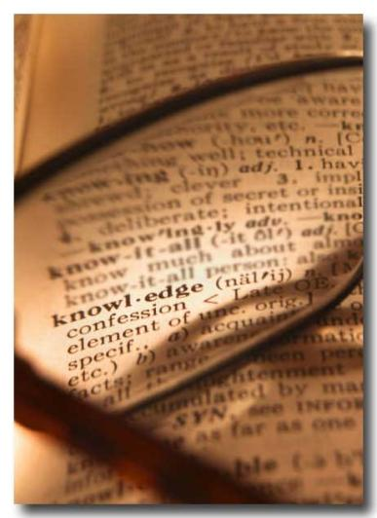
Understanding various citation styles, continued…
Understanding the method of research and traditions in scholarship
Understanding what knowledge is valued in various disciplines

Slide 4

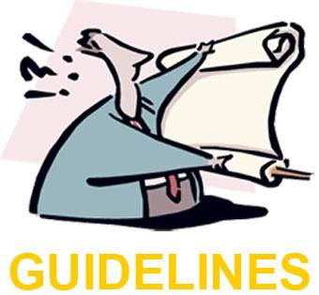
Understanding various citation styles, continued…
Dowdey cites Patricia Bizzell, who argues that “’to help poor writers […] we need to explain that their writing takes place within a community, and to explain what the community’s conventions are’ (230)” (331).

Slide 5
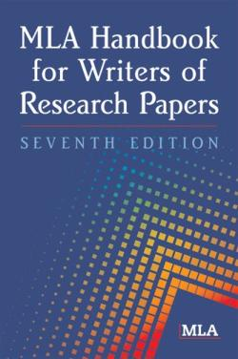
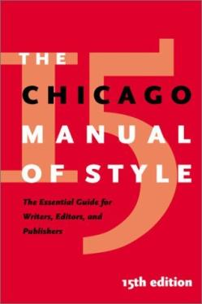
Citations in the Humanities emphasize authority and individuals’ ideas and words,
privileging the text.
Authors depend on shared background knowledge when citing other scholars
Relevant passages are cited; long quotations are frequent
Knowledge is seen as “an accumulation of perspectives”
74 % of scholarly journals use a standard style sheet, such as MLA or Chicago

Slide 6
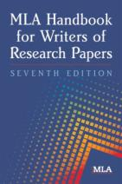
The author’s exact words
are used
Sample in-text citations:
Human beings have been described by Kenneth Burke as "symbol-using animals" (3). Human beings have been described as "symbol-using animals" (Burke 3).
The author is always given credit
Title of article in quotation marks
Sample works cited entries:
Bagchi, Alaknanda. "Conflicting Nationalisms: The Voice of the Subaltern in Mahasweta Devi's Bashai Tudu." Tulsa Studies in Women's Literature 15.1 (1996): 41-50. Print.
Gillespie, Paula, and Neal Lerner. The Allyn and Bacon Guide to Peer Tutoring. Boston: Allyn, 2000. Print.
Authors’ full names given
Journal titles not abbreviated
Place of publication usually named by city only
Only first name of publishing firm given
Date comes at the end of the citation

Slide 7
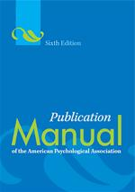
Citations in the Social Sciences are used as an appeal to authority, a starting point for research,
and a demonstration of accepted givens.
Citations are mostly clustered in the introduction and conclusion
Direct quotation is much more infrequent than in the Humanities; ideas rather than words are privileged
Proof is provided by surveys, statistical interpretation, and experimental data
Only 32 % of journals use a standardized style sheet like APA; most journals have an individualized style sheet

Slide 8
Parenthetical documentation by author and date
Sample in-text citations:
According to Jones (1998), APA style is a difficult citation format for first-time learners.
APA style is a difficult citation format for first-time learners (Jones, 1998, p. 199).
Sample reference list entries:
Berndt, T. J. (2002). Friendship quality and social development. Current Directions in Psychological Science, 11, 7-10.
Calfee, R. C., & Valencia, R. R. (1991). APA guide to preparing manuscripts for journal publication. Washington, DC: American Psychological Association.
Article titles not in quotation marks
Full journal titles given
Only initials of authors given
Date given prominent position
Titles not capitalized

Slide 9
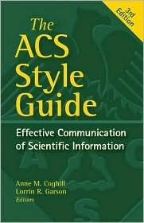
Citations in the Sciences are used to establish fact and privilege ideas only.
Citations are clustered at the beginning of articles, in introductory sections, or in reviews of literature, and often list multiple references.
Each citation tends to list multiple references, blurring distinctions between texts
Citations are for whole texts rather than passages; when direct quotations appear, the citation comes beforehand
The language of the original author is not at all important—proof in science scholarship is almost always shown through quantified data
Documentation styles vary greatly, even within a specific discipline

Slide 10
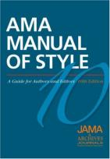
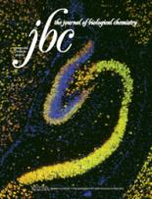
Numerical systems; minimal information
Sample in-text citations:
Oscillation in the reaction of benzaldehyde with oxygen was reported previously.³
Oscillation in the reaction of benzaldehyde with oxygen was reported previously (3).
Sample reference list entries:
Black DW: Laughter. JAMA 1984;252:2995-2998.
Smith, A., and Jones, C. (1971) J. Biol. Chem. 246, 127-131
Article title not always given; journal titles abbreviated
Author names in abbreviated forms

Slide 11
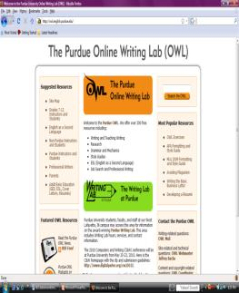
Teaching students to understand the role and importance of citation styles is essential in teaching them how to use citation styles.
Instructors should supplement these activities on the differences in various citation styles with activities and lessons on actually using these citation styles.

Slide 12
Works Cited
Dowdey, Diane. “Citation and Documentation Across the Curriculum.” Constructing Rhetorical Education. Ed. Marie Secor and Davida Charney. Carbondale: Southern Illinois UP, 1992.
Citation examples from Dowdey’s article and the OWL at Purdue website:
Purdue OWL. "MLA Formatting and Style Guide." The Purdue OWL. Purdue U Writing Lab, 24 Oct. 2009. Web. 1 Nov. 2009.

