Slide 1
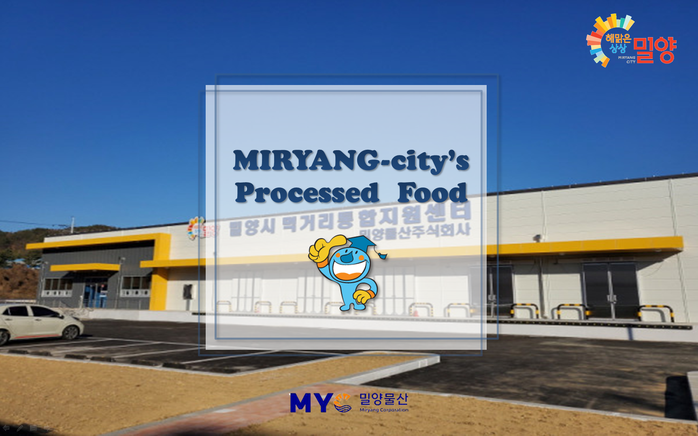

Slide 2
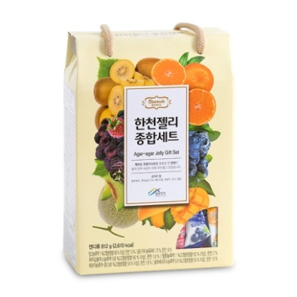
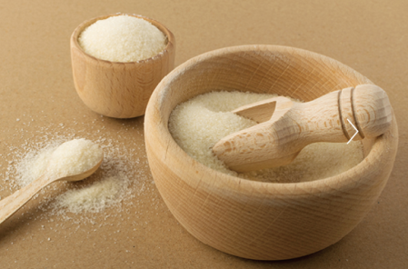
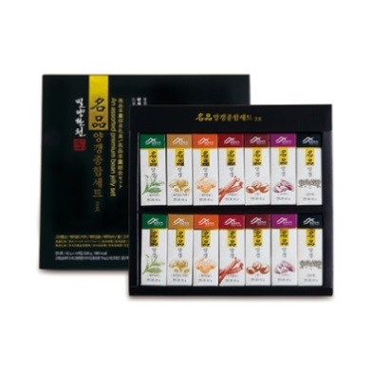
Representative Product
Agaragar Jelly Set
14g*58ea | 812g(1box) |
Starch syrup, Palatinose, Agar
Company Name: MIRYANG AGAR AGAR
CEO: Jung-hoon Oh
Address: 58-31, Bongyi-ro, Sannae-myeon,
Miryang-si, Gyeongsangnam-do, Korea
Tel: +82-55-384-2100
Homepage: https://miryangagaragar.com/shop/
Various flavor(Blueberry, Gold kiwi, Mandarine, Raspberry, Mango, Melon)
Cute package and sufficient capacity
Perfect for gifts!
World high-quality agar!
74%↑
Dietary Fiber
Premium Yanggaeng Set No.2
45g*14ea | 630g(1box) Red bean sweet paste
Various flavor(Red Ginseng, Gold kiwi, Mandarin, Green tea, Red bean, Sweet potato, Black sesame)
Healthy snack
Whole family can enjoy
Simple and luxurious package
Healthy Food
Low Calore
80-year-old
Agaragar Manufacturer
“Variety of Agar Products are prepared!”

Slide 3
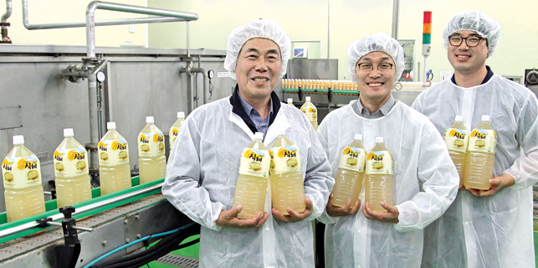
Representative Product
Haedamdri Rice Drink
500㎖, 2ℓ | PET | Rice, Malt
Based on the traditional method
Rice drink gives its unique flavor
Popular not only in Korea but also overseas markets such as USA
Company Name: Sandong Dates-Factory
CEO: Jung-in Kim
Address: 86-62, Pyochung-ro, Danjang-myeon,
Miryang-si, Gyeongsangnam-do, Korea
Tel: +82-10-8669-6736
Sweet Pumpkin Rice Drink
☞ Use 100% of regional product & pure
domestic raw material
☞ No artificial flavorings
☞ Acquired HACCP certificate
410㎖ | PET |
Sweet Pumpkin, Rice, Malt
Sweet pumpkin into the rice drink(Sikhye)
Natural sweet taste
Free from chemicals
“Bring up the original taste of the traditional Sikhye!”

Slide 4
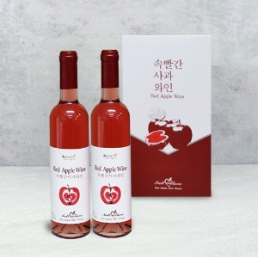
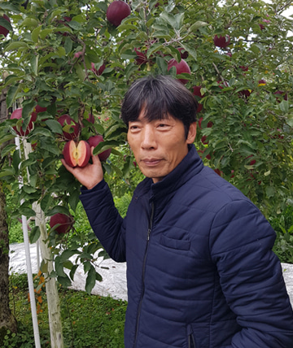
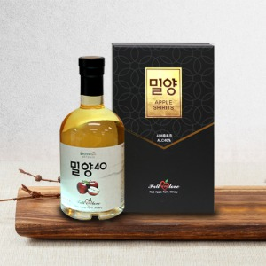
Representative Product
Red Apple Wine
500ml*2ea | 1box | Red Apple
Different from ordinary grape wine
You can taste the thicker tannin from the Red apple
Unique sweet and sour taste of the Red apple makes the special wine!
Company Name: Red Apple Farm
CEO: Yong-yoon Cho
Address: 25-40, Hayangji-gil, Sannae-myeon,
Miryang-si, Gyeongsangnam-do, Korea
Tel: +82-55-351-4556
Homepage: http://www.속빨간사과.kr
Red Apple(to the core)
Red Apple 100% Juice
350ml*1ea | 1box | Red Apple
☞ Red Love(cultivar)
: High sugar content
(more than 14 brix)
☞ Contains more than 15 times
the anthocyanin
☞ Sweet and sour taste
Aged in oak barrels for more than 2 years by distilling red apple wine
You can taste the richness and deep aroma of whiskey
Many enthusiasts for alcohol will like this!

Slide 5
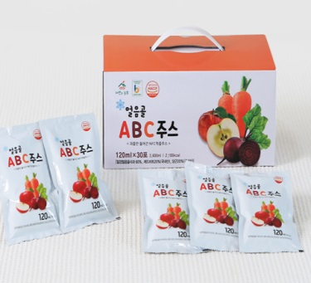
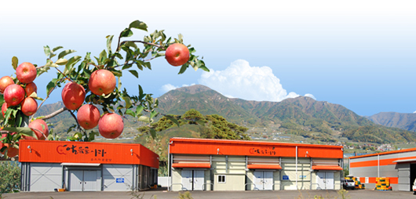
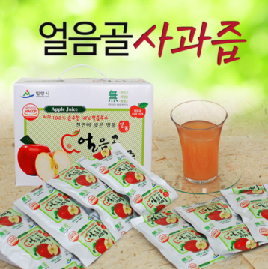
Representative Product
Ulumgol ABC Juice
120ml*30ea | 1box |
Apple, Beet, Carrot
Miryang Ulumgol Apple 60% + Korea Beet 20% + Miryang Carrot 20%
Superior freshness and taste
Contains its own scent and abundant nutrients
Snack for kids or a simple breakfast
Company Name: The Nature & A Farmer
CEO: Jeong-In Kim
Address: 591, Sannae-ro, Sannae-myeon,
Miryang-si, Gyeongsangnam-do, Korea
Tel: +82-10-4122-2125
Homepage: http://www.자연과농부.kr/
Ulumgol Apple Juice 100%
120ml*50ea | 1box |
Apple 100%
☞ Cultivating apples with mother’s heart
☞ Fragrant aroma and high-sugar content
☞ No sugar, No pigment,
No artificial additibes
☞ Acquired HACCP certificate and KMF
the Halal food certificate
Squeeze whole apple
Non-concentrated NFC juice that contains only 100% of Ulumgol Apples
Everyone of all ages and genders can enjoy eating
Also good for gifts
“The Nature & A Farmer put au naturel.”
자연과 농부는 자연 그대로를 담습니다.

Slide 6
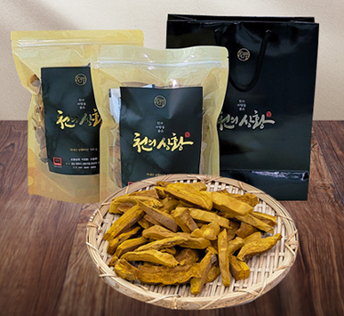
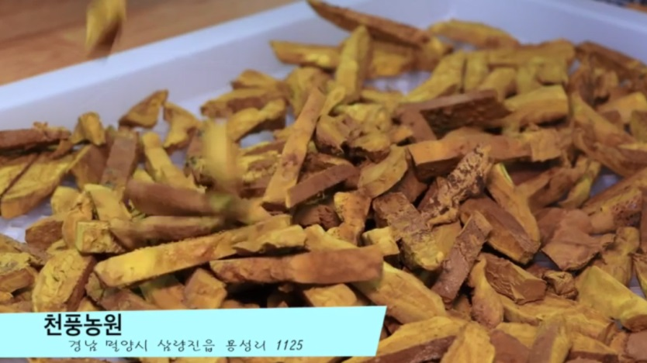
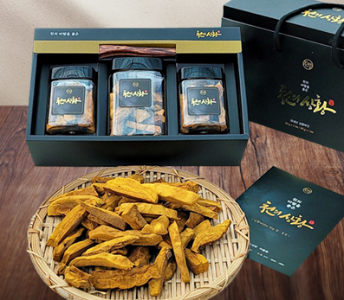
Representative Product
A thousand winds of Phellinus linteusⅠ
100g | 1 pouch | Phellinus linteus
Company Name: Chun-Pung Farm
CEO: Jung-hwan Lee
Address: 1125, Yongseong-ri, Samrangjin-eup,
Miryang-si, Gyeongsangnam-do, Korea
Tel: +82-10-3849-0894
Homepage: https://chunpungfarm.com
Cost-Effective product that packed 100g of Phellinus linteus
in a zipper bag with a paper bag.
FDA-certified
Top 10 Anti-cancer Foods
A thousand winds of Phellinus linteusⅡ
☞ Enhance immunity
☞ Improving vascular
disease
☞ Skin care
☞ Anti-aging
☞ Loss weight,
liver detox
80g(20g*2ea, 40g*1ea)|
1 box | Phellinus linteus
Non
Pesticide
Clean
Water
GAP
certification
Packed in plastic containers+tongs+
high-end boxes.
Good for gifts to give for special guest.
Phellinus linteus

Slide 7
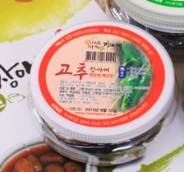
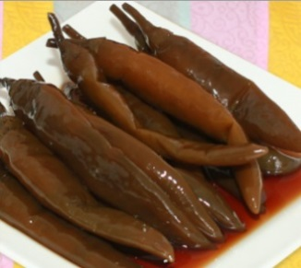
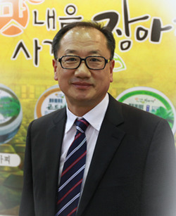
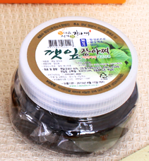
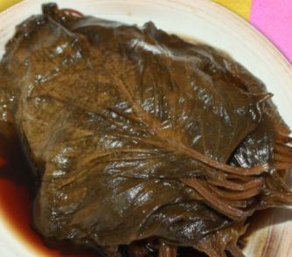
Representative Product
Pepper Jangajji
300g | PET | Pepper, Soy Sauce
Company Name: Cheong-Yang Food
CEO: Ok-ie Choi
Address: 92, Myeongrye-ro, Hanam-eup,
Miryang-si, Gyeongsangnam-do, Korea
Tel: +82-55-391-4930
Homepage: http://www.capsaicin.co.kr
Taste spicy and sweet at once because of combination of spicy cheongyang red pepper and soy sauce
Rich in Vitamin A, C, promotes digestion, blood circulation, lipolysis.
High quality Miryang agricultural products
Perilla Leaves Jangajji
Differentiaion
300g | PET | Perilla Leaf, Soy Sauce
Law-salt Jangajji
Healthy & Honesty Product
Taste crunchy and sweet because of fresh Perilla leaves and soy sauce
Rich in iron, Vitamin C, anti-cancer, effective in prevention of anemia and adult disease.
Best Quality
“Cheong-Yang Food Deliver Traditional Taste to the World!”
우리 전통의 맛을 세계에 전하는 청양의 장아찌

Slide 8
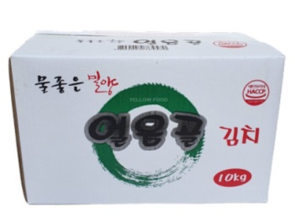
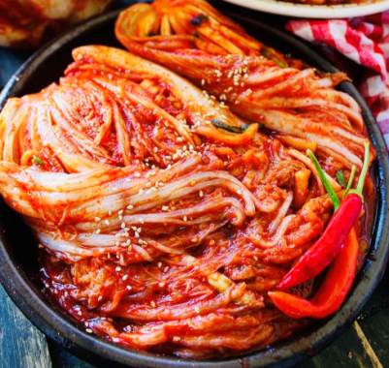
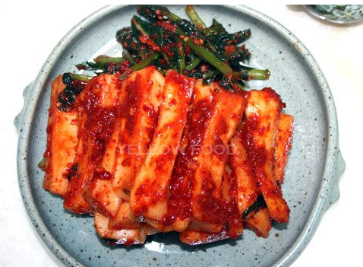
Representative Product
얼음골식품
Ulumgol Food
Baechu - Kimchi
10kg | 1box |
Cabbage, chilly powder, garlic, ginger etc.
Seasoning is made of deep-tasting broth (boiled with 13kinds of seafood such as anchovy liquid, dried pollack, large-eyed herring and kelp
Company Name: Ulumgol Food
CEO: Jeong-in kim
Address: 251-78, Joeum-ro, Sangnam-myeon,
Miryang-si, Gyeongsangnam-do, Korea
Tel: +82-55-391-6054
Homepage: https://smartstore.naver.com/icekimchi
Most delicious
Yeolmu - Kimchi
5kg | 1box |
Radish, chilly powder, garlic, ginger etc.
Use only
Highest
ingredients
Seasoning is made of deep-tasting broth (boiled with 13kinds of seafood such as anchovy liquid, dried pollack, large-eyed herring and kelp
Honest
Cleanest
“You can trust and eat Miryang Ulumgol Kimchi!”

Slide 9
THANK YOU

