Slide 1
Vital/Expanded Technologies Initiative (VETI) Developing a Winning Proposal
Sam Sudhakar, Ph.D.
Vice President & Chief Information Officer
Division of Information Technology Services

Slide 2
Background
Student Success Fee
Implemented Fall 2011
Vital/Expanded Technologies is a component of the fee

Slide 3
Student Success Fee Allocation
Revenues from the Student Success Initiative Fee goes towards the following four (4) priorities which comprise the Campus' Student Success, Graduation and Career Placement initiative:
Program | Academic Year Fee Rate | Percentage
Advising and Retention | $53.28 | 30%
Student Development | $29.97 | 16%
Expanded Technologies | $43.29 | 24%
Career Services | $53.31 | 30%
Total | * $179.85/Academic Year
* includes Higher Education Price Index (HEPI) increase of 1.8%

Slide 4
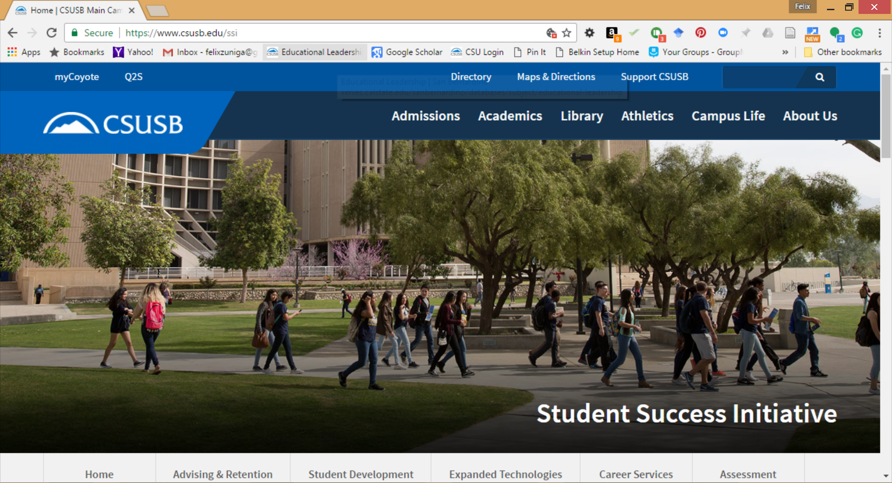
SSI Website

Slide 5
Unique Aspects of VETI
Student driven review committee
6/11 are students (majority)
Annual allocation based on enrollment toward student facing technology initiatives
Accountability for impact on student success
Assessment Reports on effectiveness

Slide 6
Committee Membership
Students
Alexis Maldonado
Yera Nenan
Shamiso Peresuh
Kristy Robles
Yusra Serhan
Julie Yang
Faculty
Kurt Collins, Professor of Art
Mihaela Popescu, Professor of Communication Studies- Provost Designee
Priyanka Yalamanchili, Professor of Special Education, Rehabilitation & Counseling
Administrators
Sam Sudhakar, VP & CIO
TBD

Slide 7
Timeline
Call for Proposals
January 09 – March 15, 2019, 5:00 pm
Committee Review
March 18 – May 3, 2019
Recommendation to SSI Steering Committee & President’s Cabinet Award Announcement
June 07, 2019
Funds Available
July 1, 2019

Slide 8
Eligibility
Any recognized ASI student organization
Any department within a college
Faculty proposals must have department chair and Dean approval
Any department within a division
Must have Vice President approval

Slide 9
Project Title | Amount to Fund
Equipping the New Honors Program Facility | $12,718.00
E-Learning Academy | $25,000.00
Pfau Library Enhanced Student Computing | $35,000.00
Google Jamboard: Smart Whiteboard for Small Classrooms | $27,792.00
Accessible Technology Blackboard Ally Pilot: Increase Accessibility of Course Content in LMS | $14,492.00
Watching molecules dance: defining "what is in this my sample" in the organic chemistry lab using FTIR spectroscopy | $23,000.00
Coyote Radio & Advertising Multimedia Lab Improvements | $15,889.00
CPEER - Cyberlab Project for Enhanced Education and Research | $32,000.00
Personal Public Speaking Virtual Studio, with Physical Lab at Vet Success Center | $24,350.00
From Consumer to Consummate Professional | $19,300.00
CAL Academic Advising and Student Engagement Modernization | $4,400.00
Tools to Record, Analyze and Integrate Neuroscience Study (TRAINS) | $66,014.00
Bone Densitometer for Assessment of Bone Mineral Density and Body Composition in Kinesiology Classrooms | $50,000.00
Online Change of Major Submission | $6,784.33
Technology for Independence (TFI) | $11,401.00
Virtual Connectivity for Students (VCS) | $30,000.00
CNC router system | $55,075.35
DisABILITY Sports Adapted Technology Initiative | $48,328.00
Digital Storytelling Lab for Student Journalism & Multimedia Production | $30,000.00
Integration of Web-Based Virtual Clinical Reality (VCR) Learning Experiences in Undergraduate Nursing and Kinesiology Courses | $8,160.00
DNA Sequencing Tools for Hands-On Genomics Education | $56,000.00
Computers, Laptops, Printers, ID Card Readers, Hot Spots and Computer Hardware for the ATHLETICS STUDENT SUCCESS CENTER | $23,460.00
Acquisition of an Inductively Coupled Plasma-Optical Emission Spectrometer for Modern Elemental Analysis in Multiple Disciplines | $88,900.00
Purchase of Roland VersaCAMMÂ® VS-300i Large-Format Inkjet Printer/Cutter | $19,527.00
Expanding Equal Access to Technology | $10,500.00
Operation UP-GRADE | $39,500.00
PDC Paws Radio | $15,700.00
Virtual Reality Lab for Producing Engaging Instructional Content (Continuation Grant) | $62,399.00
Advancing Yotie Wellness with Technology: Health Promotion FitBit Pack Program | $12,000.00
Advancing Computing Lab with High-Speed GPU Technology | $33,000.00
"Blood Lab" for biology, kinesiology and allied health majors | $42,458.00
VR-enabled classroom for teaching 21st century skills | $16,852.32
FY 18-19 Awards

Slide 10
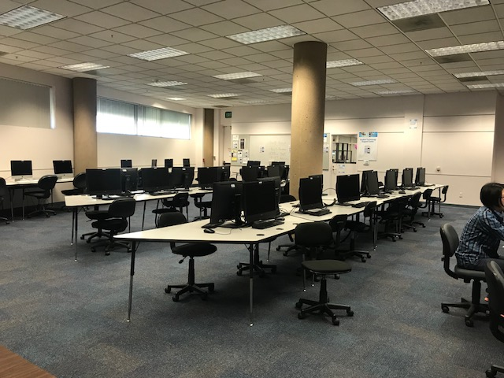
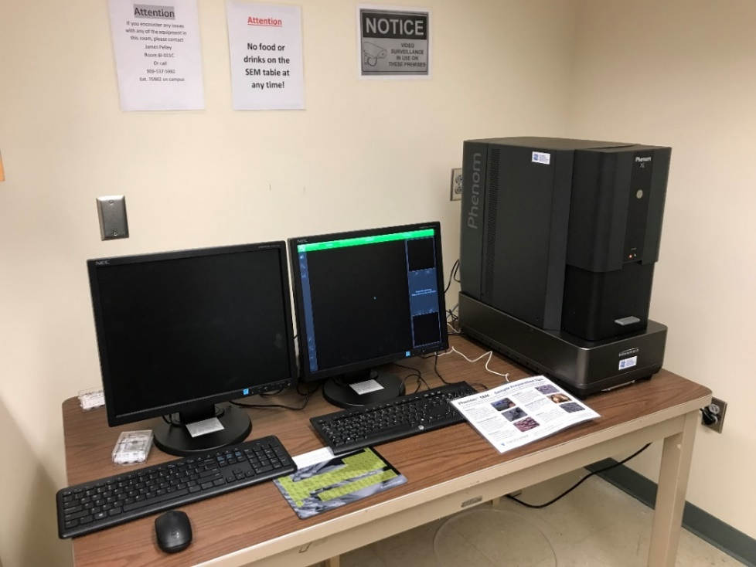
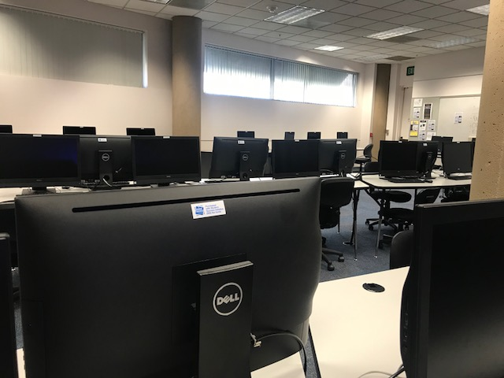
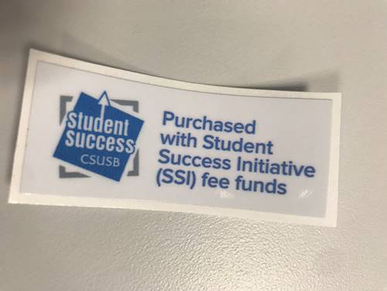
24/7 Study Space
A new scanning electron microscope for exploring the micro-universe

Slide 11
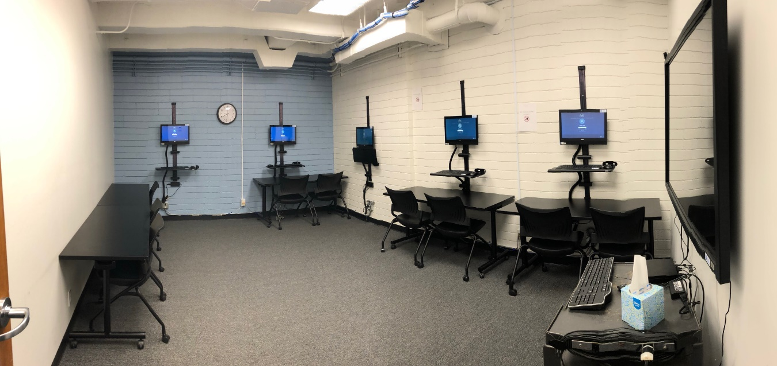
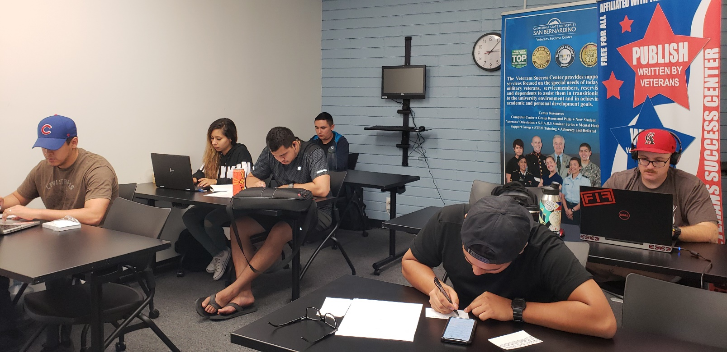
Veterans Success Center
Classroom

Slide 12
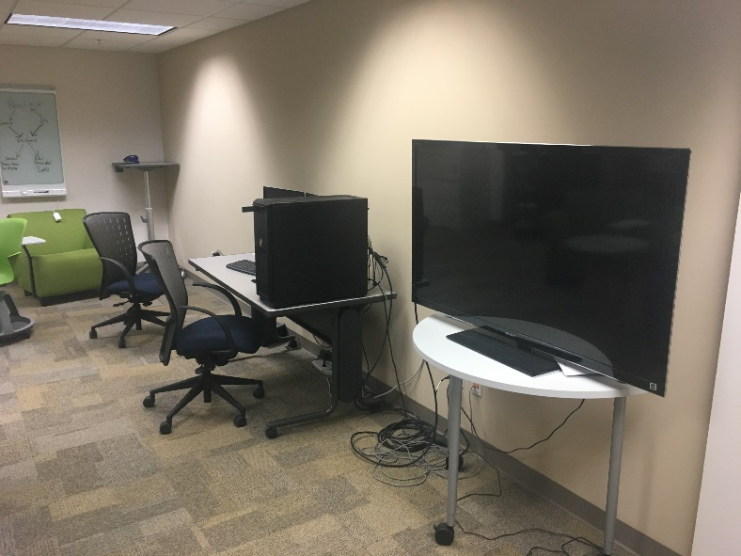
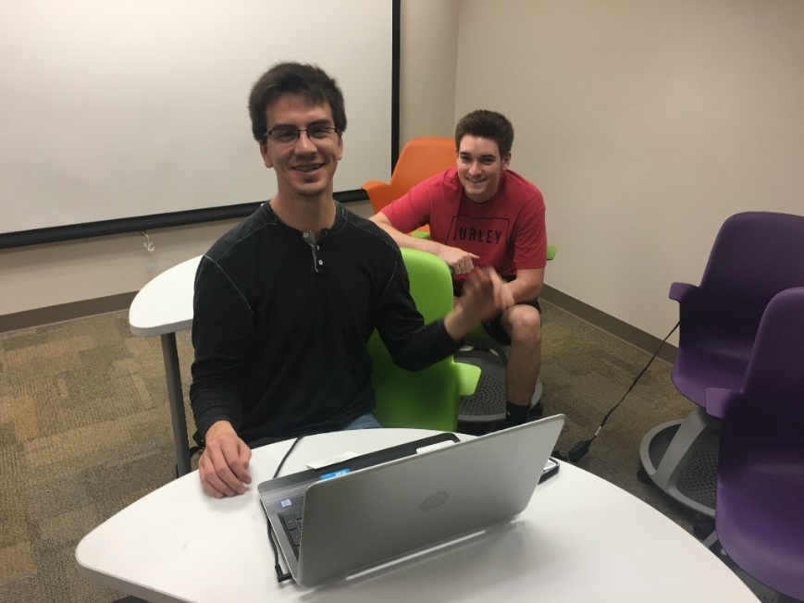
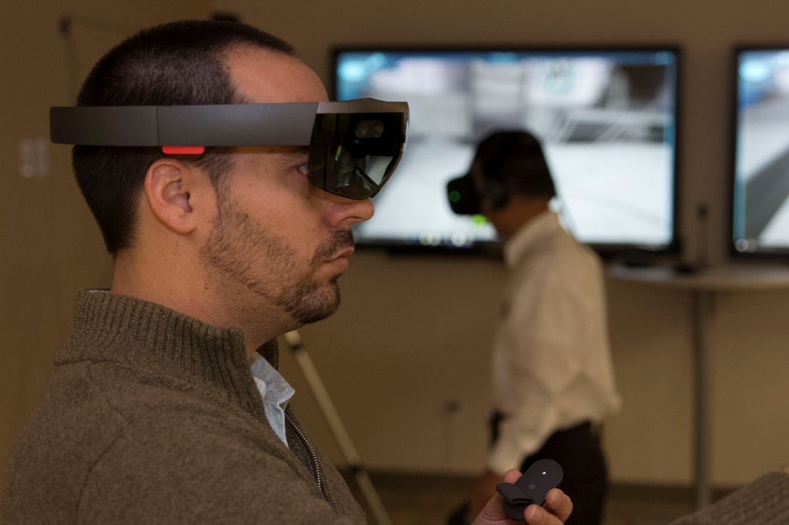
Virtual Reality Lab for Producing Engaging Instructional Content

Slide 13
Proposal Submission Process
Proposals submitted online at the VETI website
Committee reviews proposals online
Each proposal is discussed in committee and ranked
Shortlisted Applicants will be invited to “Pitch” their proposal
After all proposals are ranked, funding recommendations are sent to the Student Success Initiative (SSI) steering committee and the President’s Cabinet
Some proposals may receive partial funding

Slide 14
Components
Funding Available
FY 2019-20 - $750,000
FY 2018-19 - $910,000
FY 2017-2018 - $846,000
FY 2016-2017 - $750,000
Funds Distributions
55% General proposals
45% College Specific proposals

Slide 15
Selection Process
Proposals submitted shall be prioritized and recommended for funding based on the following proposed criteria:
Technology that is directly used to enhance instructional technology resources for students and the faculty in the classroom
Supports the CSU Graduation Initiative 2025 (https://www2.calstate.edu/graduation-initiative-2025)
Expands technology access at the Palm Desert Campus
Enhances student access across the institution
Enhances the student experience and success
Supports a high utilization rate for student constituent groups
Provides enhanced technology resources for students with special needs or disabilities
Provides enhanced training for student use of technology
Relative cost/rate of return on investment

Slide 16
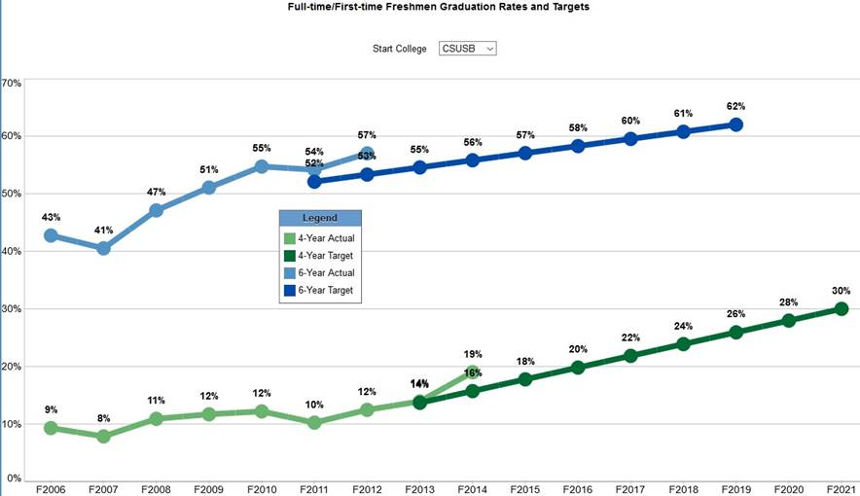

Slide 17
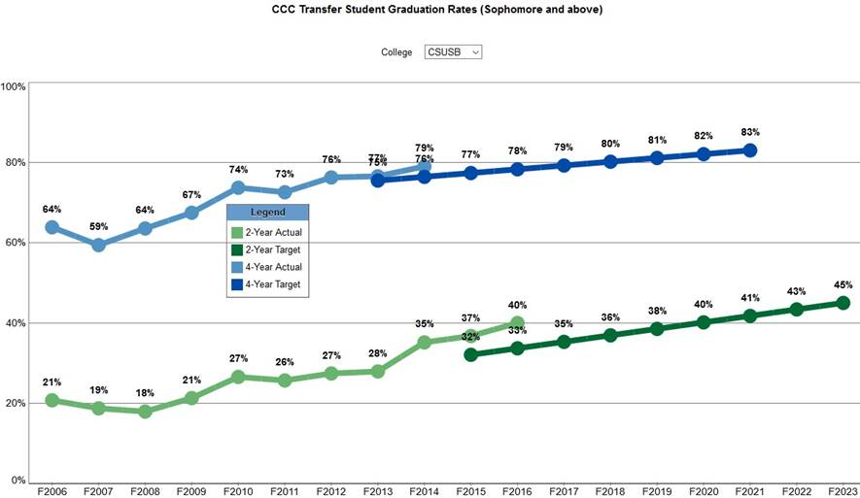

Slide 18
Tips
Provide a descriptive Title
The abstract (250 word limit) should speak to the way in which these purchases will support students overall success in their academic program
Students look for high impact projects – those that support the greatest number of students
Preference will be given to proposals that have letters of support from students/ASI recognized student organizations
How is this project going to be promoted to students?
This is an outcomes based initiative. You should be prepared to discuss what metrics you will use to determine effectiveness of the proposal (i.e usage counts, course grade improvements, student satisfaction survey)
Consider internal resources needed to accomplish project. Be sure they are available in the timeframe when funds are distributed and mentioned in the overall abstract. (e.g. Technical Support from College ITC)

Slide 19
Tips Cont.
Develop a reasonable timeline, include time to purchase, implement, test, and deploy
Estimate first term of use by students, it should not be more than 12 months out
Collaborative efforts are ranked higher – foster partnership
The committee appreciates proposals with matching funds but they are not ranked higher
Preference will be given to projects that have a sustainability plan built in
Be as detailed in the budget as possible. The final purchases will be compared to the budget request. Any items not identified will require another approval by the VP &CIO
A proportional amount of funds will be identified to support students at the Palm Desert Campus

Slide 20
Notification
All individuals who submitted proposals will be notified via email if they received an award or if their proposal was not funded
All decisions are final
The Campus Community is notified of all proposals that are funded

Slide 21
Important to Remember
Be prepared to demonstrate how funds are used
SSI Fair, Marketing, Signage, IT Governance Executive Committee
You can ask for help in the process
Unfunded VETI Proposals may be funded by other sources

Slide 22
Procurement Process
Awardees will attend a mandatory workshop on submission of procurement requisitions
Preferred vendor information – Be sure to include your local ITC or ITS in the vendor selection process
Product detail
Electronic and Information Technology Accessibility Guidelines
All purchase requests are processed through the ITS Budget Office
ITS Budget Office will monitor expenditures and report status regularly to the VP&CIO

Slide 23
Assessment Reports
All awardees will be required to submit a progress and summative report on the total expenditures and effectiveness of the project in meeting their stated objectives
A template for the reports will be provided
Progress Report will be due on February 1, 2020
Summative Report will be due on April 15, 2021

Slide 24
Important Sites
Name | Email
Vital/Expanded Technology Initiative | http://its.csusb.edu/vitalTechnology.html
Information Technology Services | http://its.csusb.edu/
Student Success Initiative | http://ssi.csusb.edu/
Institutional Research | http://ir.csusb.edu/

Slide 25
Contact information
Name | Email | Phone
Samuel Sudhakar | ssudhakar@csusb.edu | x75100
Vice President & CIO, ITS
Karina Alvarado | alvarado@csusb.edu | x75100
Executive Assistant to the VP/CIO, ITS
Gabby Guzman | gguzman@csusb.edu | x75081
ITS Budget Analyst

