Slide 1
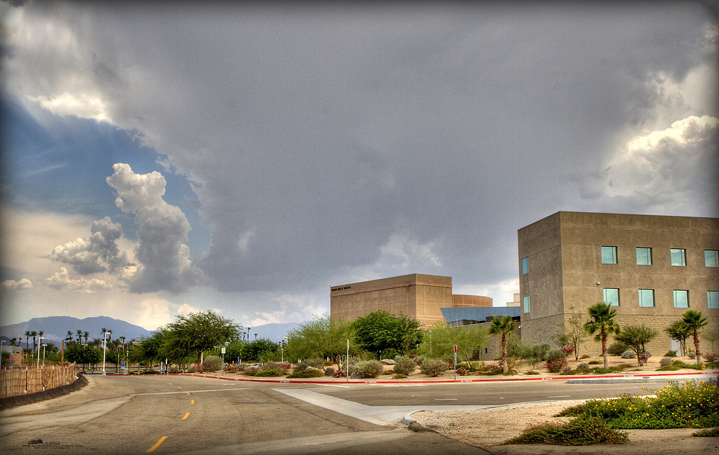


DRAFT MASTER PLAN
MAY, 2016
Palm Desert Campus
Cal State San Bernardino,

Slide 2
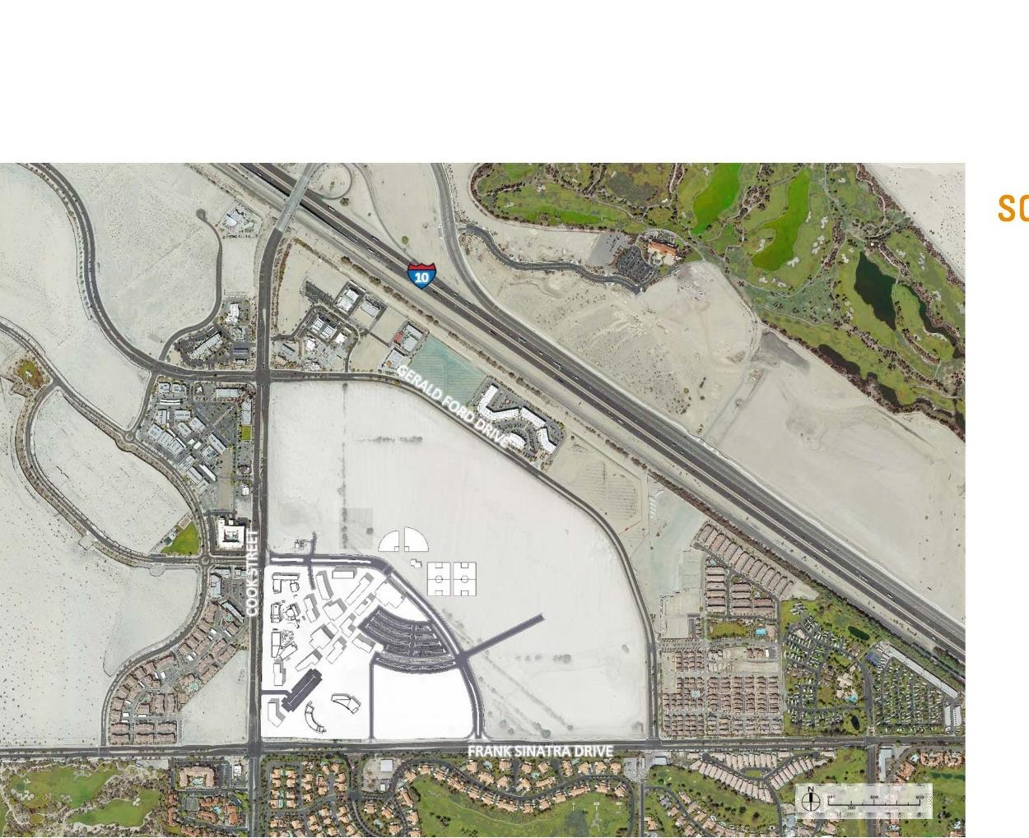
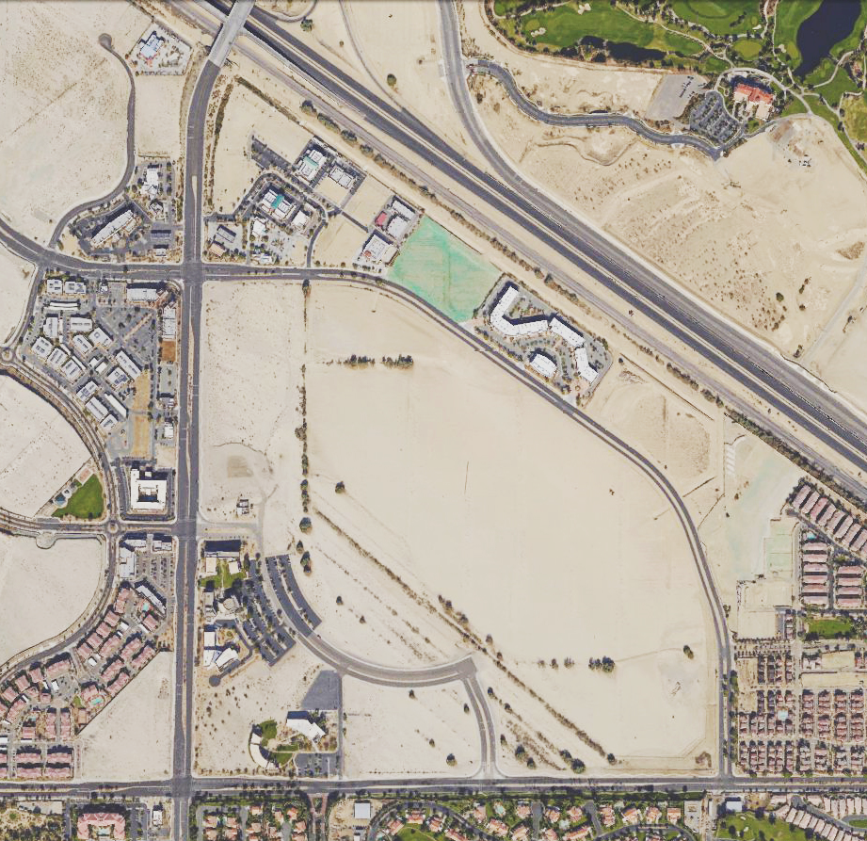
TO BE UPDATED

Slide 3
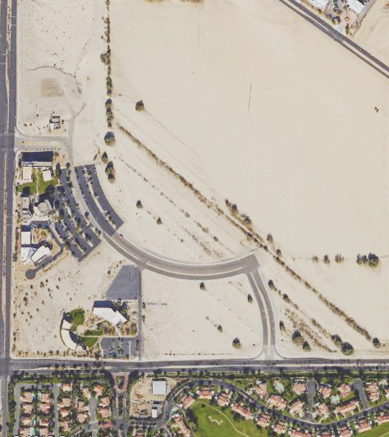
EXISTING PDC
CAMPUS

Slide 4
SCHEME 1
TIERED
CENTRAL SPINE

Slide 5
SCHEME 2
COURTYARDS

Slide 6
SCHEME 3
CENTRAL CORRIDOR

Slide 7


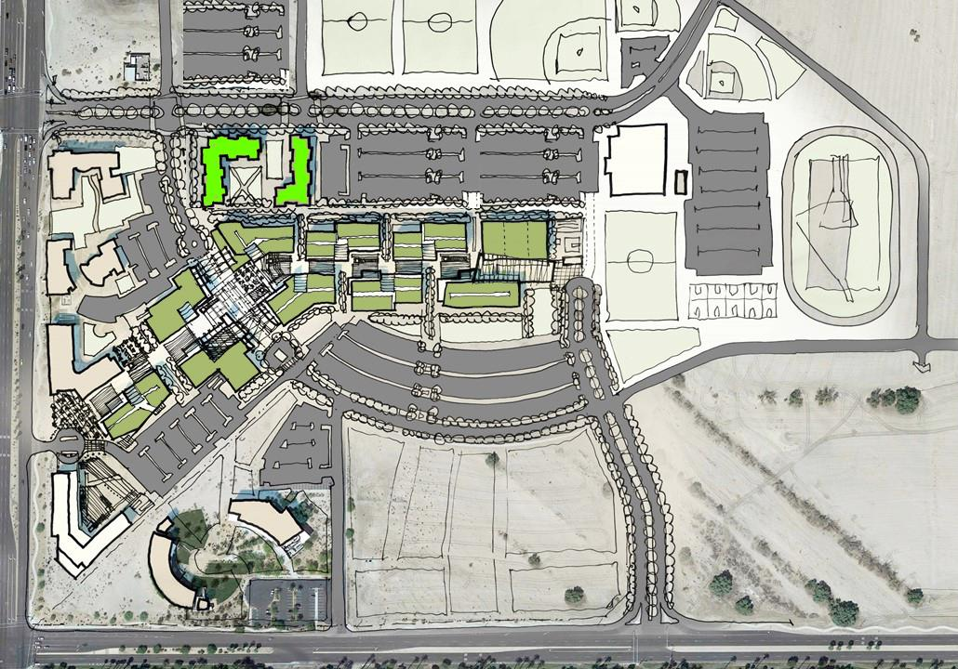
THE PALM DESERT CAMPUS
DRAFT
MASTER PLAN

Slide 8
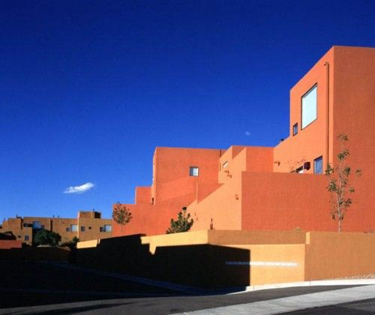
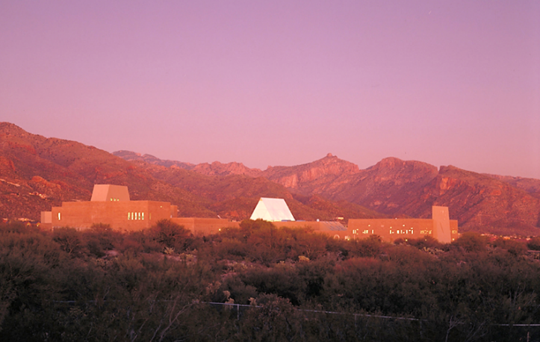
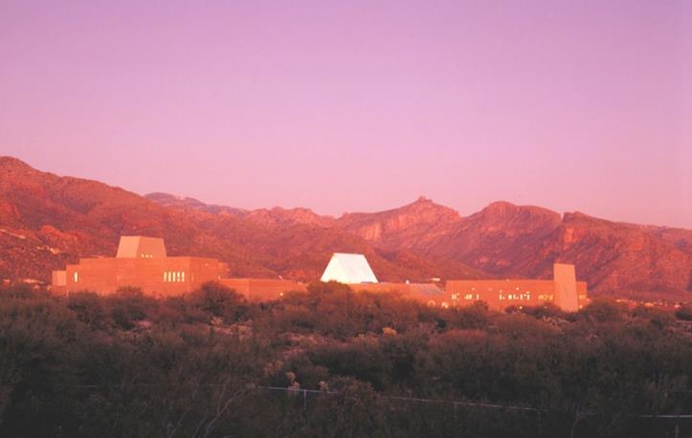
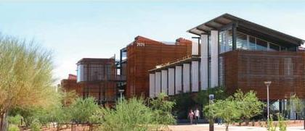
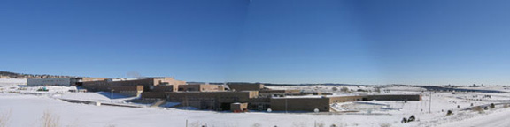
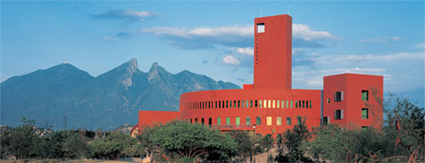
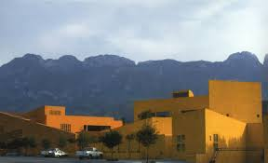
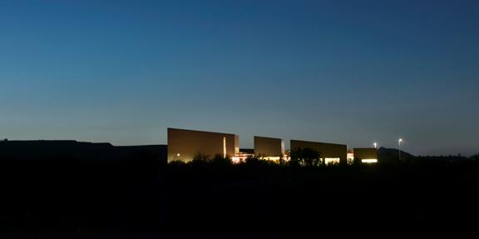
ARCHITECTURE TO DISTINGUISH THE CAMPUS

Slide 9
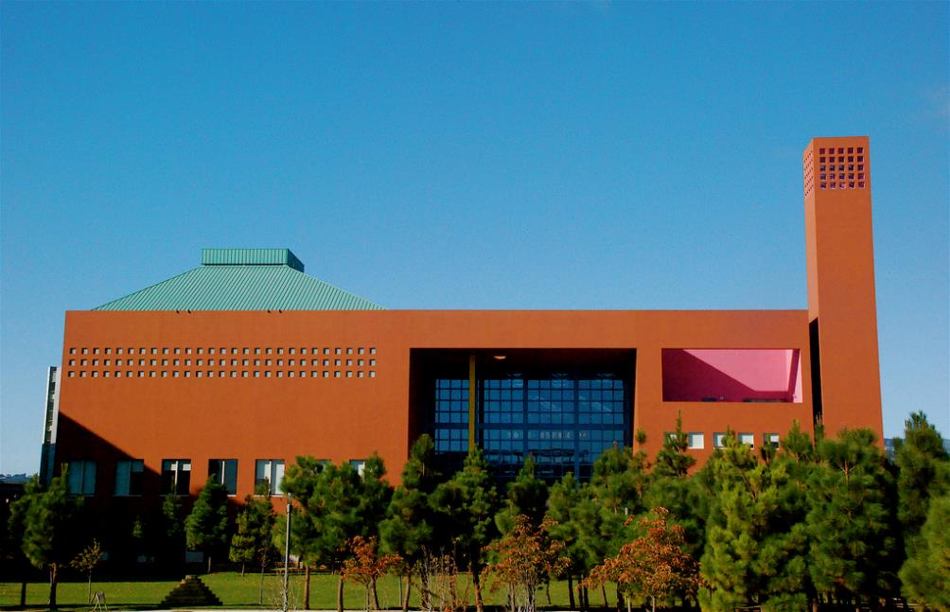
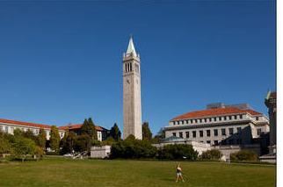
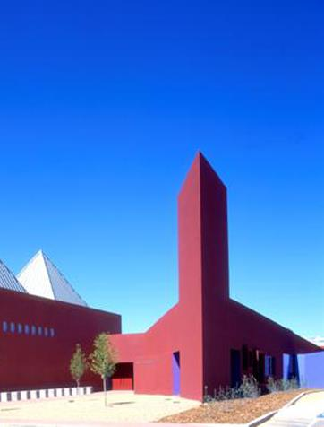
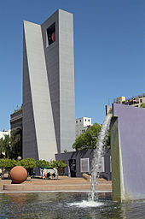
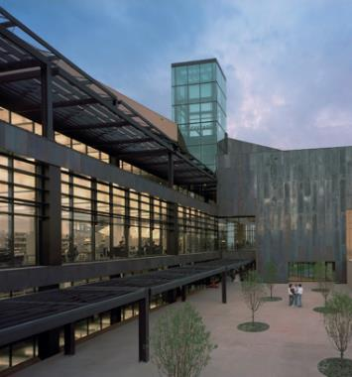
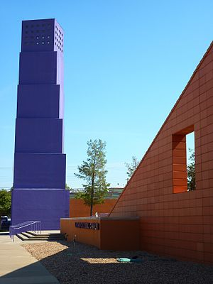
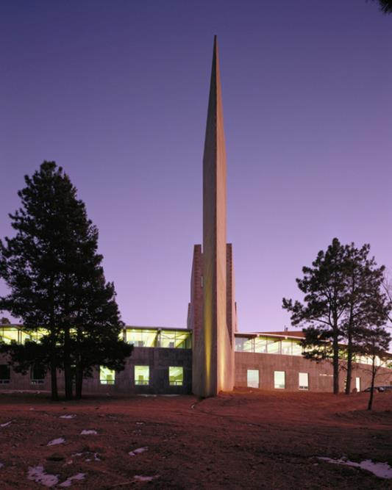
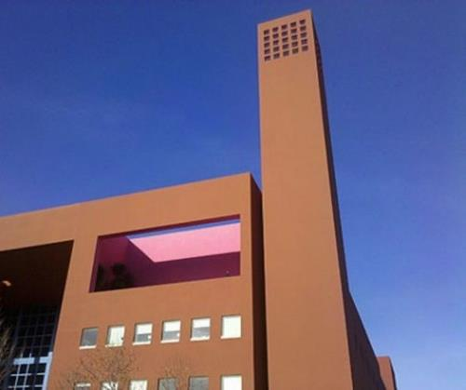
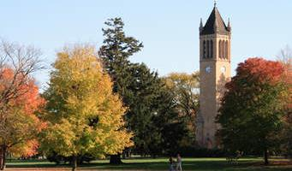
CAMPANILES AND CLOCK TOWERS

Slide 10
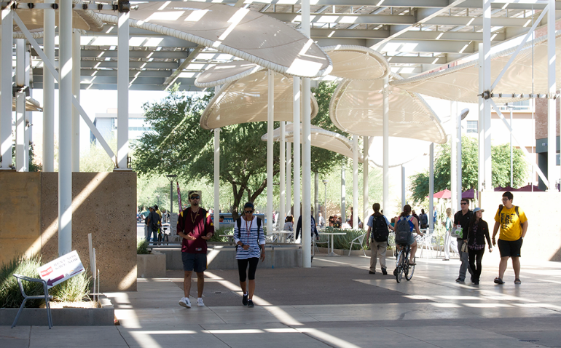
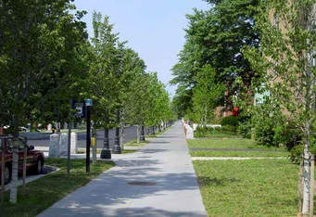
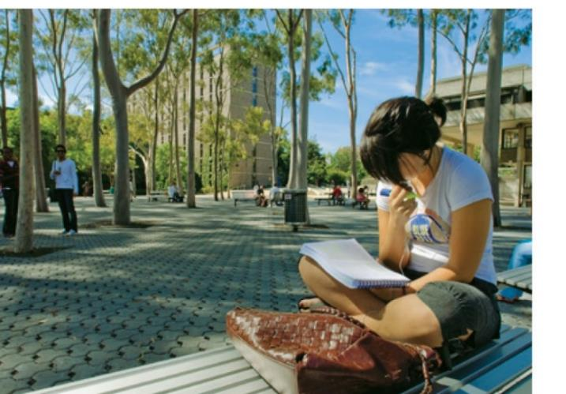
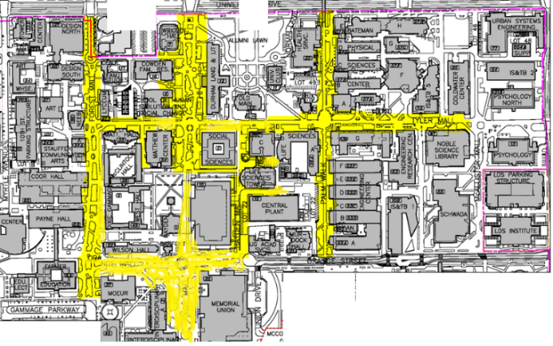
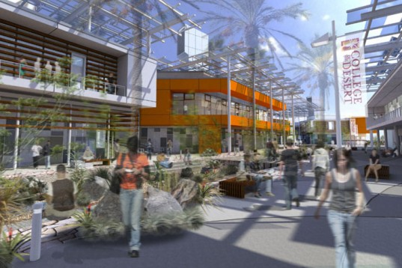
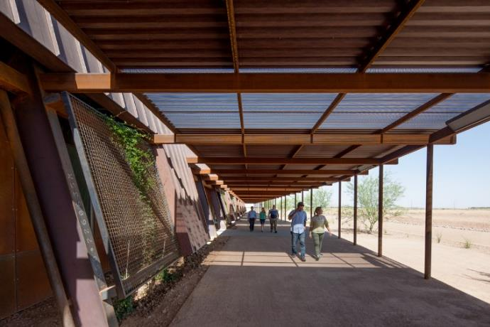
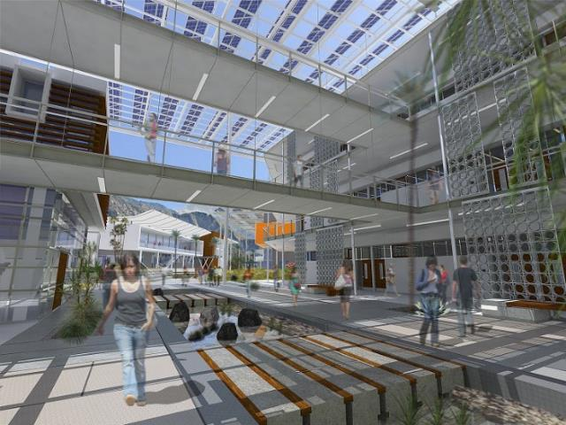
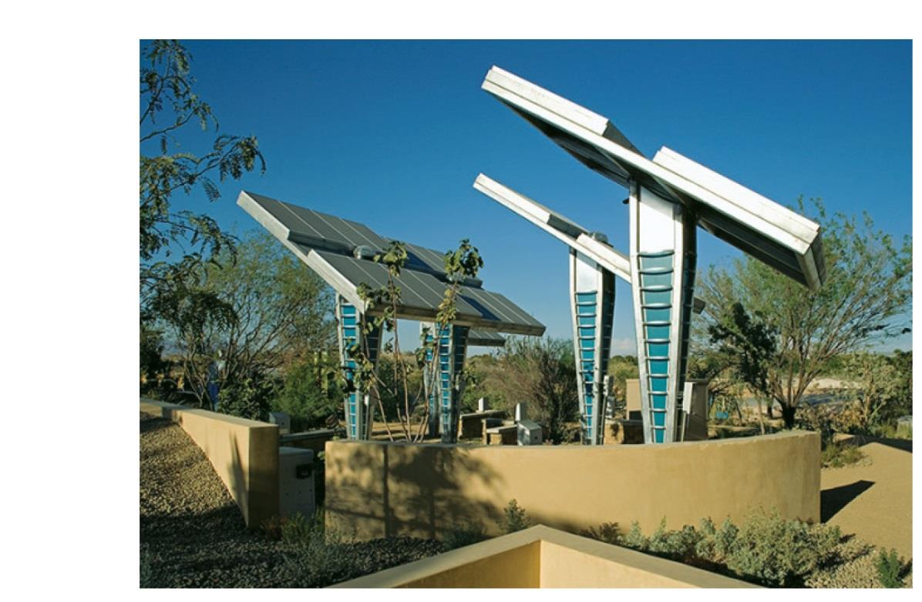
Linear pedestrian spines

Slide 11
Potential near term projects

Slide 12
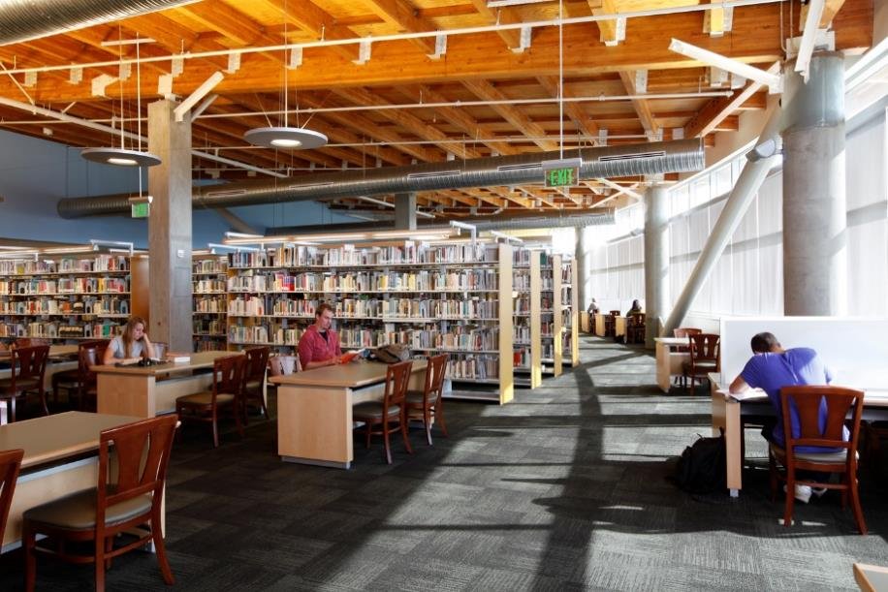
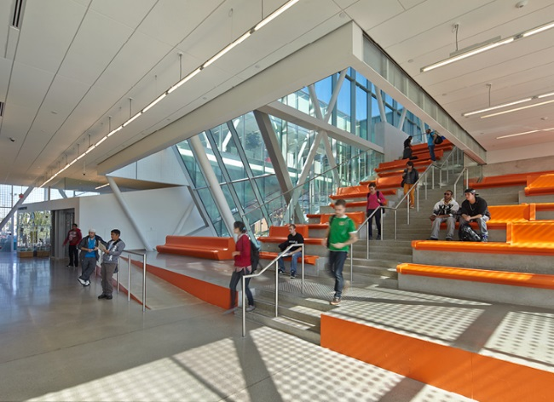
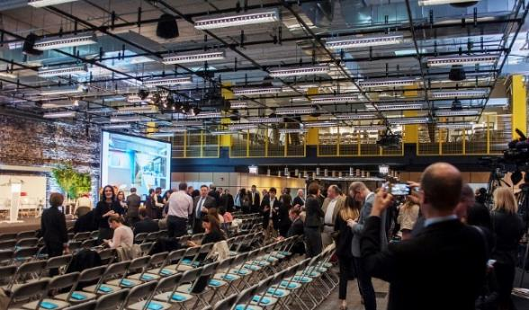
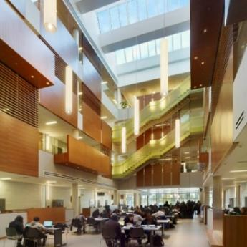
Library/campus centers

Slide 13
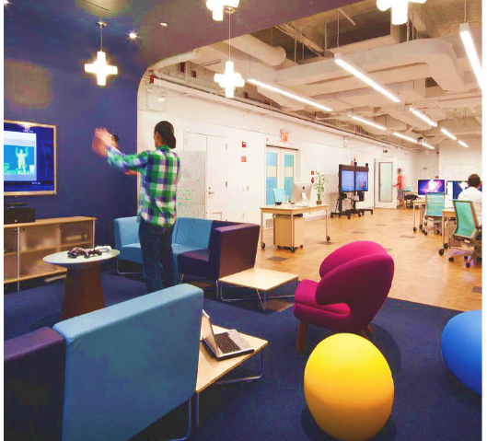
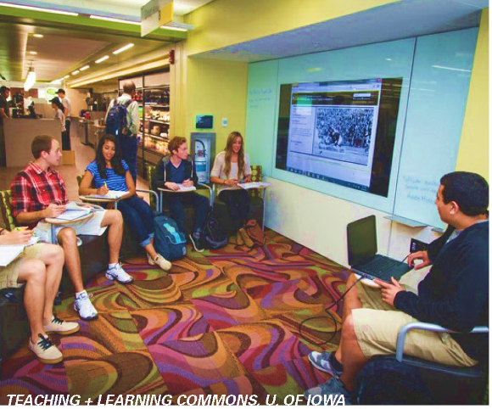
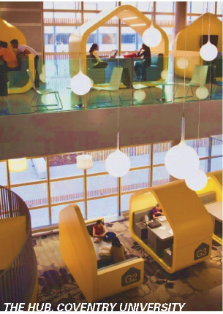
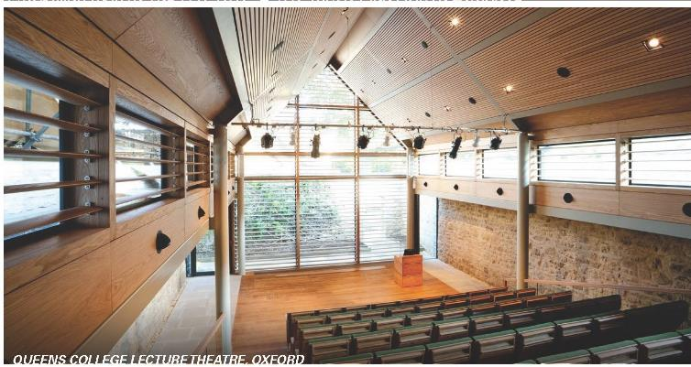
Physical education/gymnasium-arena
Classrooms/Lecture halls

Slide 14
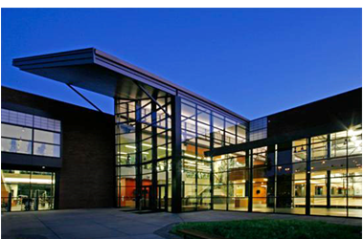

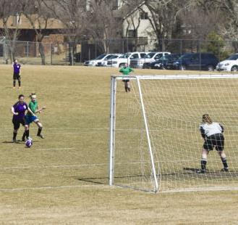
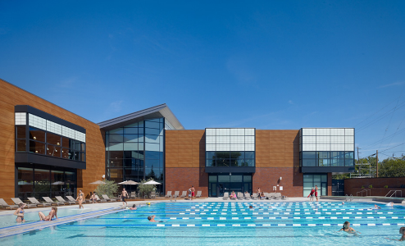
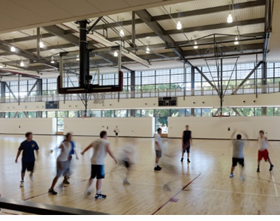
Physical education/EVENTS CENTER

Slide 15
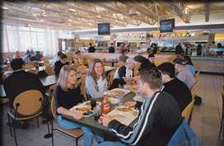
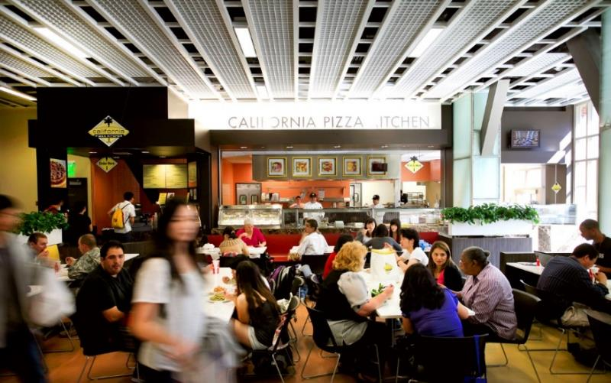
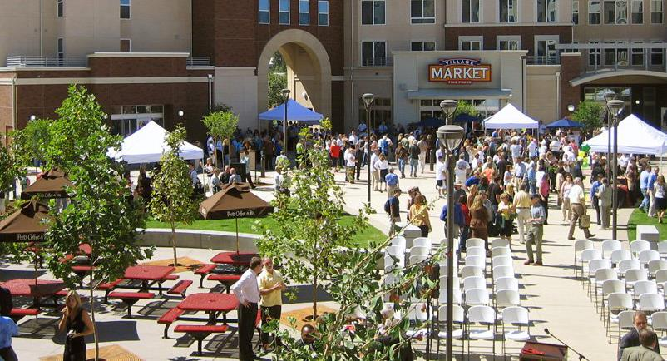
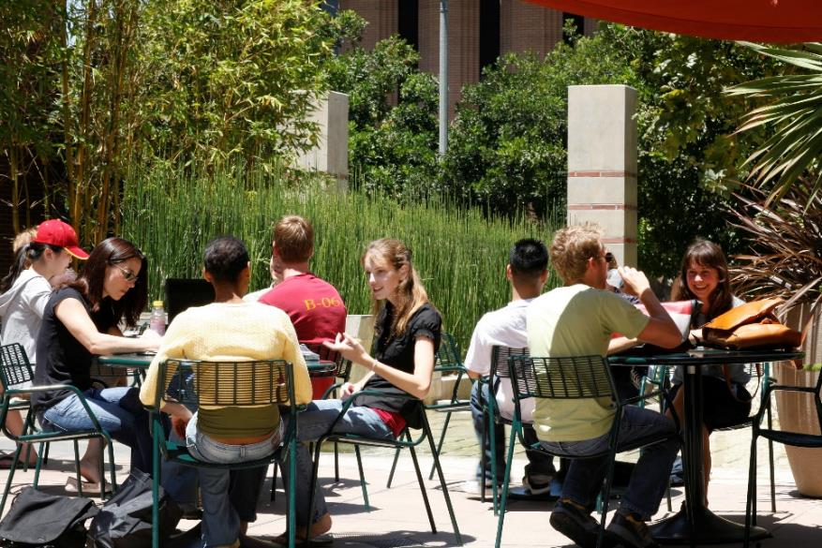
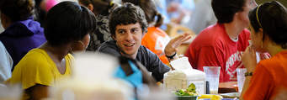
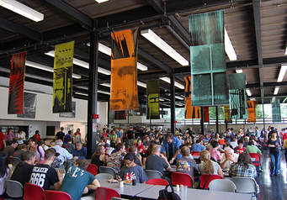
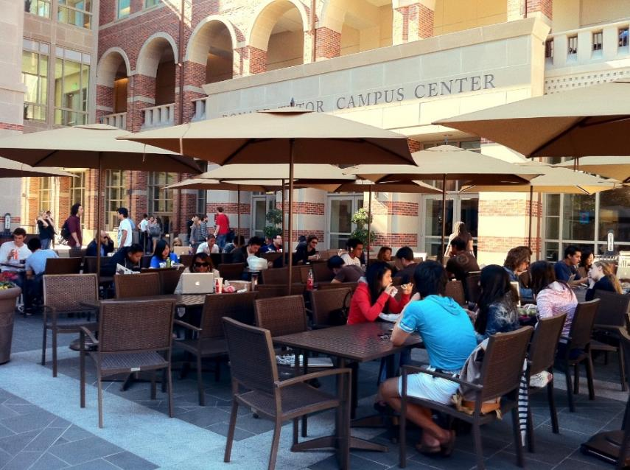
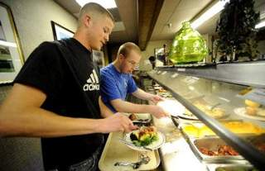
Student center/food service

Slide 16


CORRIDOR
Solar radiation study from April 1st to October 31st
High values of solar radiation in most outdoor areas in the east west axis

Slide 17

Solar Impact North-South versus East West
On an outdoor space with a north south axis a portion of the space receives sun during the morning and another during the afternoon. The central area receives more heat overall.
With an east west axis most of the same space (a certain distance from the south building) receives sun all day.

Slide 18

CORRIDOR
Wind direction = 315°
Wind Speed = 8.3 m/s
Wind can enter through some openings in the corridor space and expands towards the south opening.
N

Slide 19

CORRIDOR
Wind direction = 315°
Wind Speed = 8.3 m/s
Buildings block much of the wind in the corridor, velocity increases closer to the large opening.
N

Slide 20

SOLAR ENERGY

Slide 21







SHADE

Slide 22



VEGETATED SURFACES

Slide 23

EVAPORATIVE COOLING CASE STUDIES

Slide 24

EVAPORATIVE COOLING

Slide 25

IMPROVING OUTDOOR COMFORT
COOL TOWER cools air entering at lower level while solar tower helps evacuate the air as it is warmed

Slide 26



OUTDOOR TEACHING SPACES
Permeable shade blocks the sun and provides opportunity for air movement.
More shading to the south of occupied space.
Green roof cools by radiation the space below
Cool wall techniques on the south facades
Living roofs on south buildings
PV on north buildings.
Evaporative cooling conditions air at occupant level

Slide 27



OUTDOOR ACTIVE LEARNING SPACE
Outdoor active learning spaces in which learning activities continue are created.

Slide 28

TOOLS FOR SUSTAINABLE COMFORT

Slide 29
PERFORMANCE DRIVEN DESIGN

Slide 30

OVERLAY

Slide 31

DRAFT MASTER PLAN
MAY, 2016
Palm Desert Campus
Cal State San Bernardino

Slide 34









ACTIVE PEDESTRIAN STREETS

Slide 35
B
SCHEME 1
CENTRAL SPINE

Slide 36
SCHEME 2
COURTYARDS
B

Slide 37
Linear pedestrian spines

Slide 39
ACTIVE PEDESTRIAN STREETS

Slide 40
JOHN SPOOR BROOME LIBRARY
CAL State Channel Islands
Library/campus center

Slide 41
Tanimura and Antle Family Memorial Library
California State University, Monterey Bay
Library/campus center

Slide 43


FINAL MASTER PLAN
CALIFORNIA STATE UNIVERSITY SAN BERNARDINO
MASTER PLAN STEERING COMMITTEE | MAY 4, 2016

