Slide 1
Form 48 Preparation Instructions
PULLED FROM
AFROTCI 36-2011, CADET OPERATIONS, 12 AUGUST 2013

Slide 2
Form 48 Preparation Instructions
Must be completed prior to the end of your first term in ROTC.
The Form 48 is a “road map” that outlines ALL your academic classes until graduation.
All signatures must be in blue or black ink.
All other areas should be accomplished in pencil.
If the course titles of electives are not known or undecided, enter “General Elective” and the number of proposed credit hours.
Once the course title is known, erase the words “General Elective” and enter the proper course title.
Regardless of what system your school is on (semester, quarter, etc.), you should prepare your Form 48 using the quarter system (Fall, Winter, Spring, Summer).
Make sure to write “Field Training” in the summer after your sophomore year.
Ensure your academic advisor reviews the Form 48 initially and at least once every fall after that.

Slide 3
You and a cadre member will sign here AFTER your Form 48 has been reviewed by an institution official and a cadre member. In pen, of course.
Your institution official (usually an advisor) should sign here, in pen, after their initial review.
14
12
You and a cadre member will sign here AFTER your Form 48 has been reviewed during your mid-term counseling. In pen, of course.

Slide 4
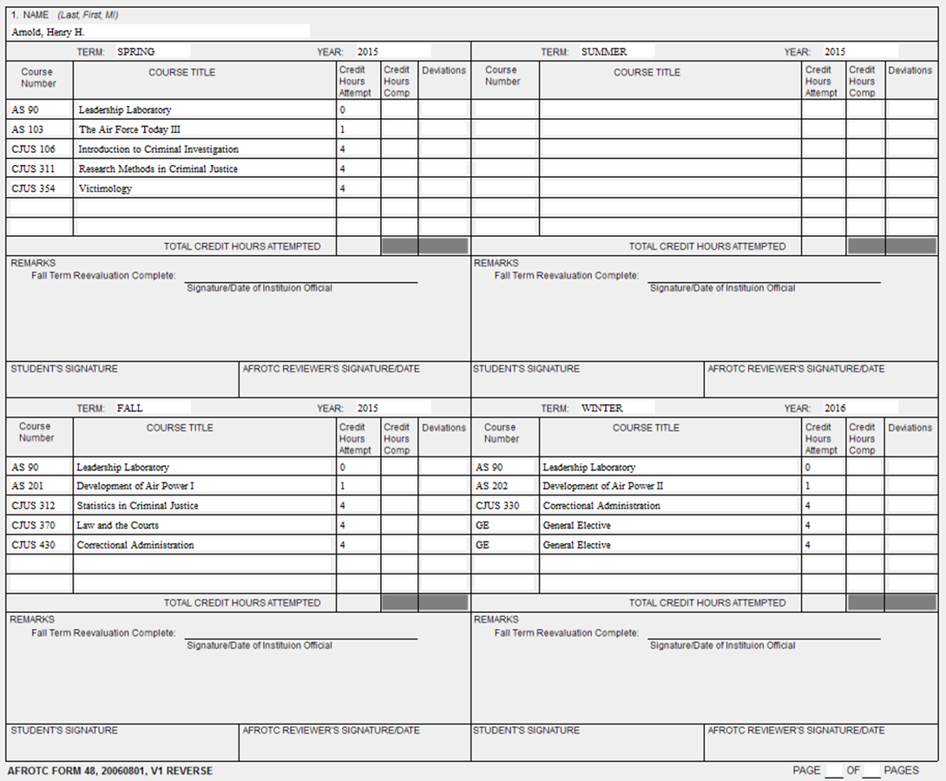
DO NOT fill out this column. Cadre will fill it out when they review your Form 48 during mid-term counseling.
12
This is how you properly annotate a General Elective or other course for which you do not yet know the title.
12
12
Your advisor or institution official needs to review your Form 48 every FALL term. This should be done BEFORE your mid-term counseling. After reviewing and making any changes, your advisor should sign…in pen, of course.

Slide 5
Ensure you put Field Training in for the summer after your sophomore year.
12
AS 300 and 400 level courses are 3 credit hours. AS 100 and 200 level courses are 1 credit hours.
You need to attempt a minimum of 12 credit hours EVERY TERM. The only exception is your last term before graduation.
12
12

Slide 6
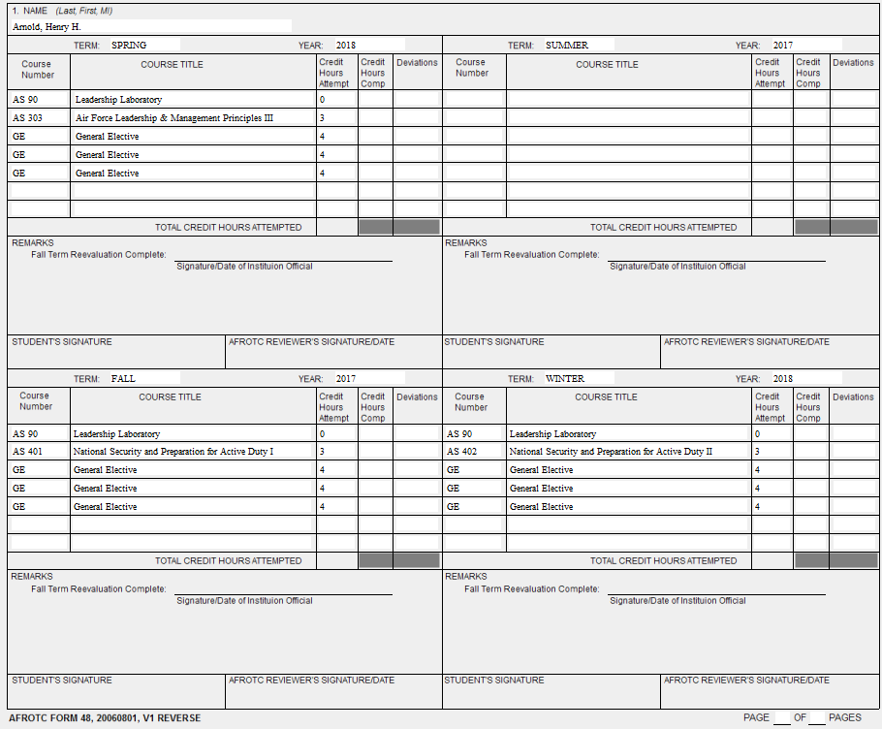
12
4 quarters per sheet (except the first page). Spring, Summer, Fall, and Winter
12
12

Slide 7
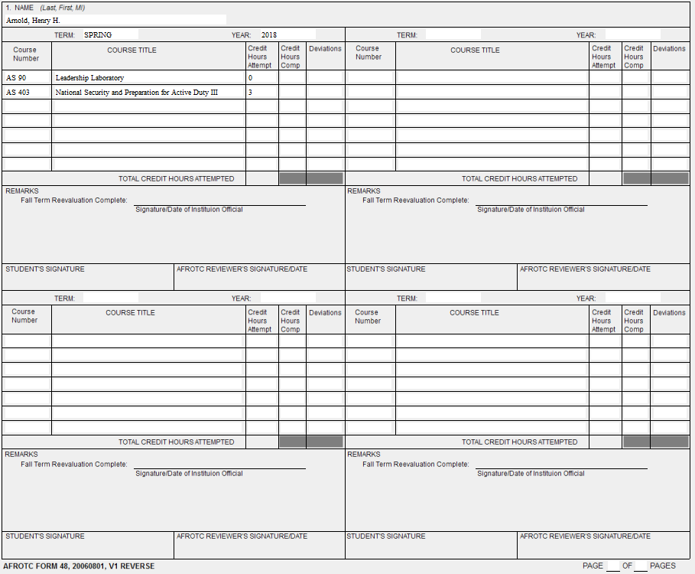
3
Less than 12 hours attempted in a single term is only authorized for your FINAL term.

Slide 8
ADDITIONAL INSTRUCTIONS
SECTION I – ADMINISTRATIVE DATA
Block 1 (Name). Self-explanatory.
Block 2 (Academic Institution). Enter the institution from which the applicant or cadet will receive their degree and the AFROTC detachment they are attending. If they are both the same, only one entry is required.
Block 3 (Academic Major). Enter one major field of study.
Block 4 (Institutional Official Review). Accomplished by the institution academic advisor. If the advisor refuses to review the plan, a detachment officer must determine whether the individual can meet degree and commissioning requirements using the institutional catalog. Attach a memorandum stating the reason an academic advisor did not review the academic plan.
Block 5 (Initial Review). Enter the specific degree (BA, BS, etc.) and the month and year (include fiscal year) the contracted degree is scheduled for completion. Ensure the determined date of graduation (DOG) and DOC are realistic; many technical majors take 4.5 to 5 years to complete.
Block 6. DO NOT sign here until AFTER graduation.
SECTION II – ACADEMIC PLAN
Annotate ALL courses planned for each term. Include summer terms, periods of non-attendance, extended status, co-op, field training, and terms abroad.
Course Number. Enter the appropriate information as listed in the school catalog.
Course Title. Provide short, abbreviated course titles when possible.
Credit Hours Attempted. Enter the number of credit hours for the specific term as specified for the course in the college catalog, regardless of whether the credit hours directly apply to the major. Once the credit hours for each course are annotated, add all hours under the column “Credit Hours Attempted” and place the sum value in the “Total Credit Hours Attempted” block.

