Slide 1



Materials Genome Approach to Organic Ferroelectrics and Piezoelectrics
  Tim Usher (presenting)
  Sara Callori
  Kimberly Cousins
  Douglas Smith
  Renwu “John” Zhang
Eva D. Zurek
Daniel Miller
Stephen Ducharme
Paulo Costa
Queenstown, New Zealand
Feb 14, 2017
http://materials.csusb.edu
NSF grants #1345163 & #1420645
Notes:
Include 3D CSUSB.

Slide 2
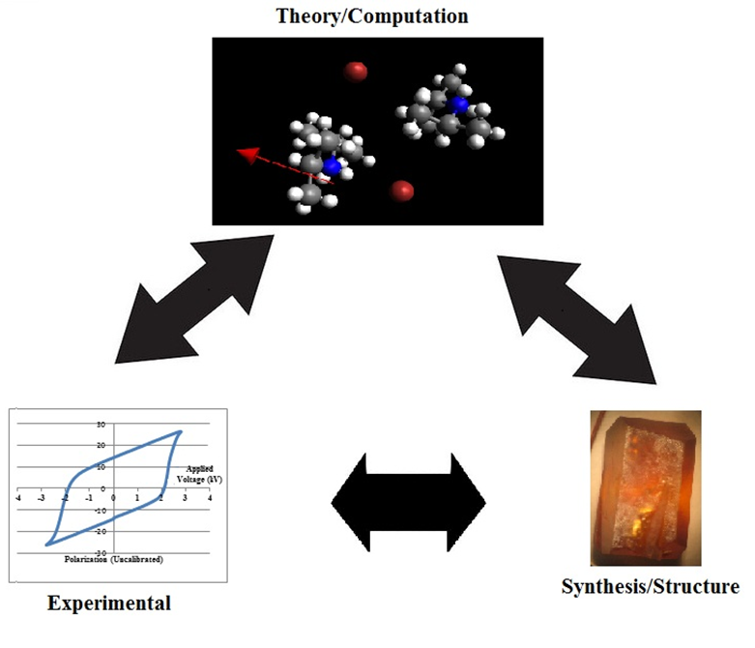
Cousins, Zurek, Miller
Density Functional Theory
(VASP)
Cambridge Crystallographic Data Centre (CCDS)
Other: GAMESS, Spartan, Avogadro, VESTA, WebMO,
VMD
Usher, Ducharme
Hysteresis, AFM, STM, PFM, epr, Positron Lifetime Spectroscopy, XRD, SQUID, DSC
Smith, Zhang, Callori, Costa
Synthesis, crystal, thin film, single molecular layer

Slide 3
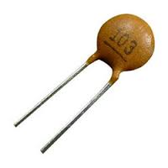


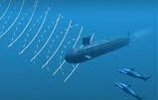
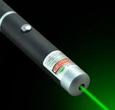


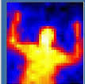
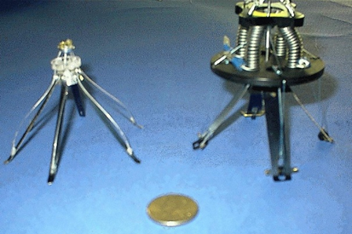
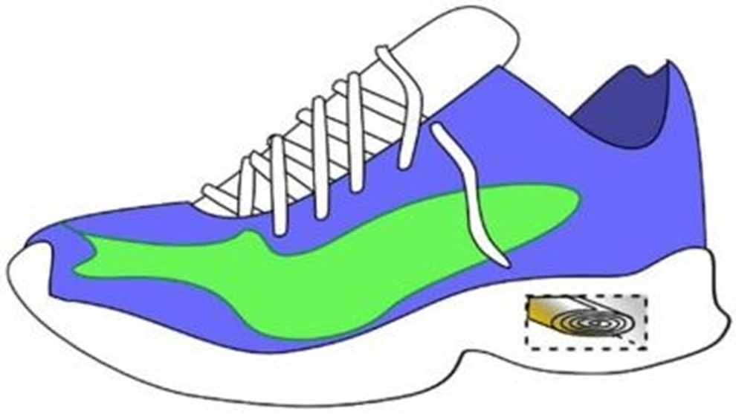

Applications
Science
Ferroelectrics properties <- -> structure, unique window into the solid state.
Excellent proving ground for theoretical predictions.
Many ferroelectrics are hydrogen bonded.
Bottom-up approach. However, molecules rather than atoms as build blocks.
capacitors
Gas grill lighters
sonar
(SHG)
IR detectors
Data storage in RFID cards
ultrasound
Microrobotics:
Palmer et al IEEE/ASME Trans.
on Mech, 2004
Morphing wings
Energy harvesters
Usher et al ISRN Mat.Sci. 2013

Slide 4
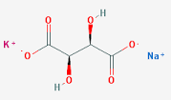
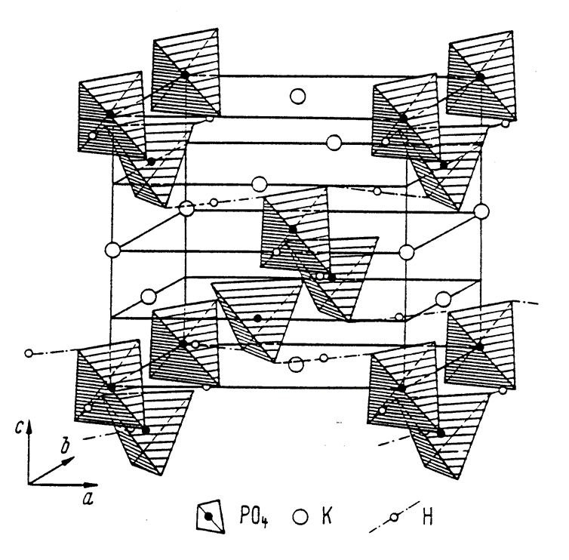
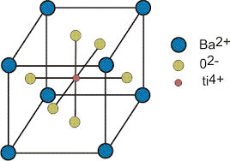
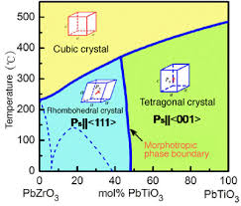
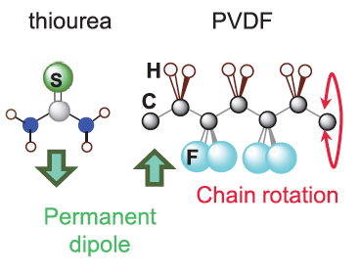
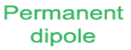
Brief, very selective, review
Rochelle salt (first ferroelectric, 1920). Organic double salt of tartaric acid,
Potassium Dihydrogen Phosphate. (KDP)Hydrogen bonded. One of the most studied ferroelectrics. Commercial use = SHG.
Barium titanate (inorganic)
PZT and its solid solutions. Inorganic ceramic. Most widely used piezoelectric. Morphotropic phase boundary.
PVDF polymer ferroelectric. Slower reversal speed and smaller piezo response.
SC. Abrahams published several articles about database mining for inorganic ferroelectrics.

Slide 5
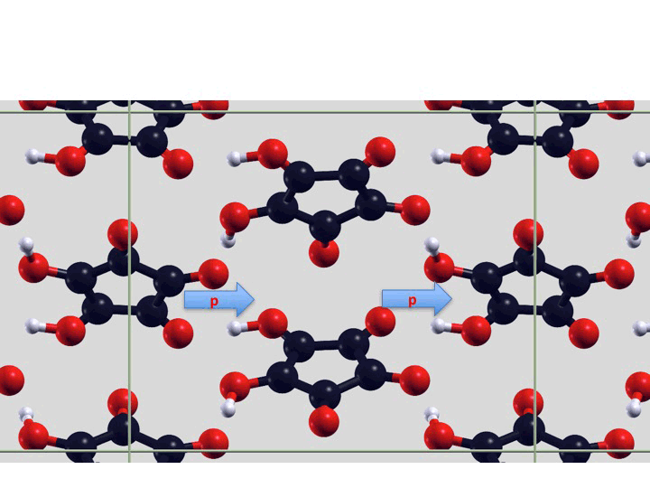
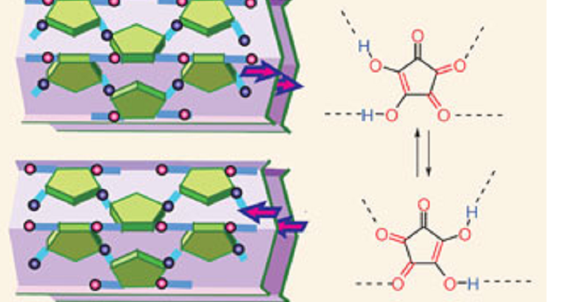

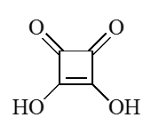
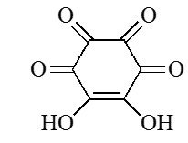
Oxo-carbon Acid Targets
Croconic Acid
Deltic: Not predicted to be ferroelectric. Attempting first synthesis.
Squaric : long known to be antiferroelectric and used as model for hydrogen bonded KDP
Rhodizonic: very hydroscopic. Seeking first anhydrous acid crystals.
Variations on Croconic Acid:
Salts of Croconic acid (cesium sodium croconate “red”).
Predicted to NOT be piezo or ferroelectric.
Synthesized and grew crystals anyway.
Interest: Few reports in journals. Not in CDB. Has an epr signal.

Slide 6
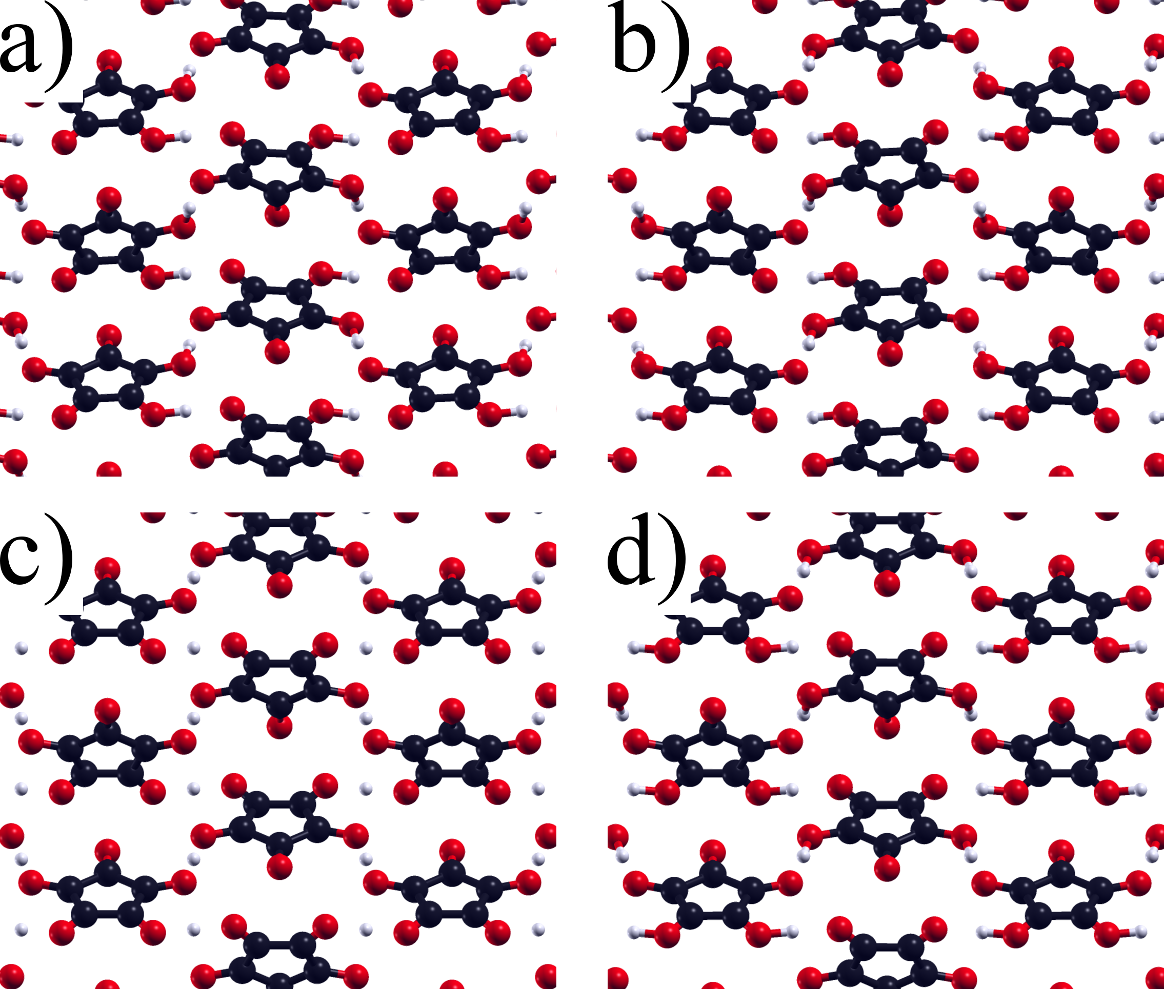
With a better understanding of the switching for known ferroelectrics, we can better predict novel compounds
Up - down
Left-right
Prior reports* assumed synchronous transfer of both protons during polarization switching (from a to b through high energy transition c: 1.15 eV higher in energy than a & b)
Using the Nudged Elastic Band method we located a lower barrier asynchronous pathway, image d, only 0.21 eV higher than a & b
Horiuchi, et al. 436 (2010) Nature, 789-792.
Di Sante, et al. 14 (2012), Phys Chem, 14673–14681
Up-down moves first
Notes:
As on prior slide: (a) is before proton transfer, (b)is after; (c) is interpolated synchronous transfer, 1.15 eV barrier; (d) is the saddle point predicted by NEB (0.21 eV barrier) NOTICE THE SIGNIFICANT difference in H transfer at the two sites: the “up down” proton has transferred further than the left-right proton at the saddle point.

Slide 7
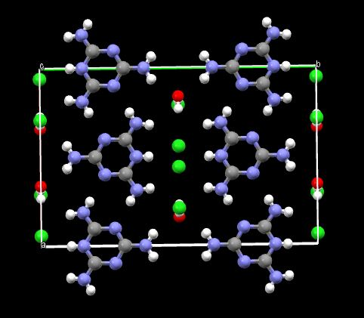
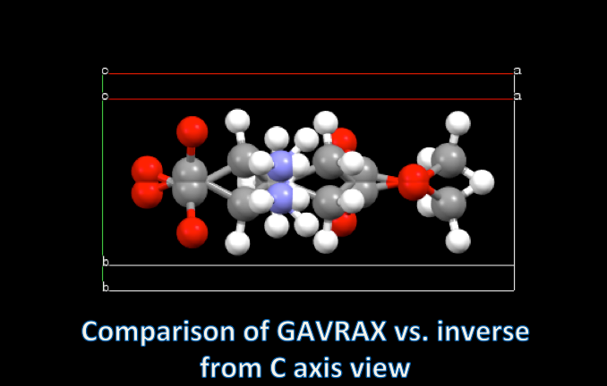
Database mining (CCDC known crystalline compounds) ferroelectric search criteria
Polar space group
Less than 10 carbon atoms
Close pseudosymmetric structure (using Bilbao Pseudo)
Dipole perpendicular to plane of inversion
Salts, either:
  Halide counterion – 7 candidates (plus 2 known ferroelectrics found)
  Ammonium and carboxylate groups—5 candidates
ZZZSBA
Notes:
Overview of two of our database searches of known co-crystals/organic salts found in the Cambridge Crystallographic Database. So far what your group calls “Mel” is the top structure; we have not yet successfully crystallized any of the group 2 salts—these are potentially biocompatible ferroelectrics since they have amino-acid-like structures.

Slide 8
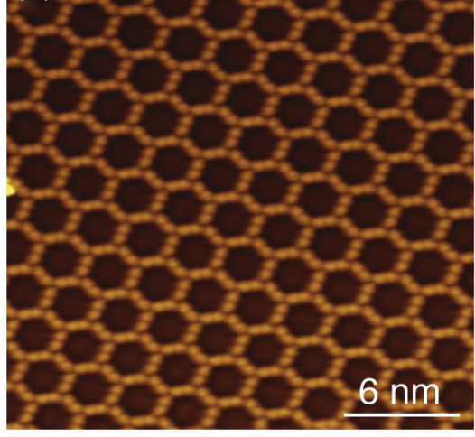
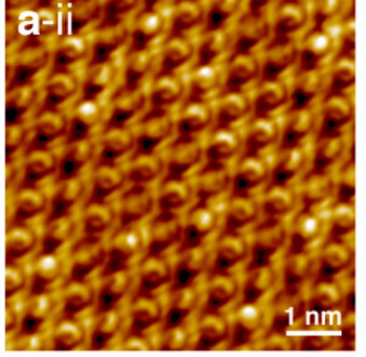
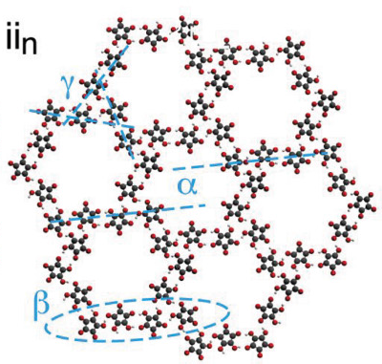
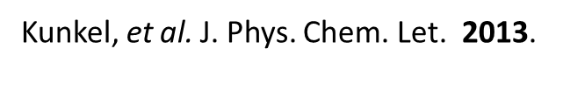
2-D, single layer
STM in vacuum at low temperature
Rhodizonic Acid
Croconic Acid
Silver substrate (111)
RA on Au (111)
anhydrous rhodizonic on Au due to high vac.
rhodizonic acid deprotonates into rhodizonate on Cu substrates upon annealing, forming clusters and metal−organic
coordination networks with substrate atoms.
Kunkel, et al. Phys Rev B, 2013.

Slide 9
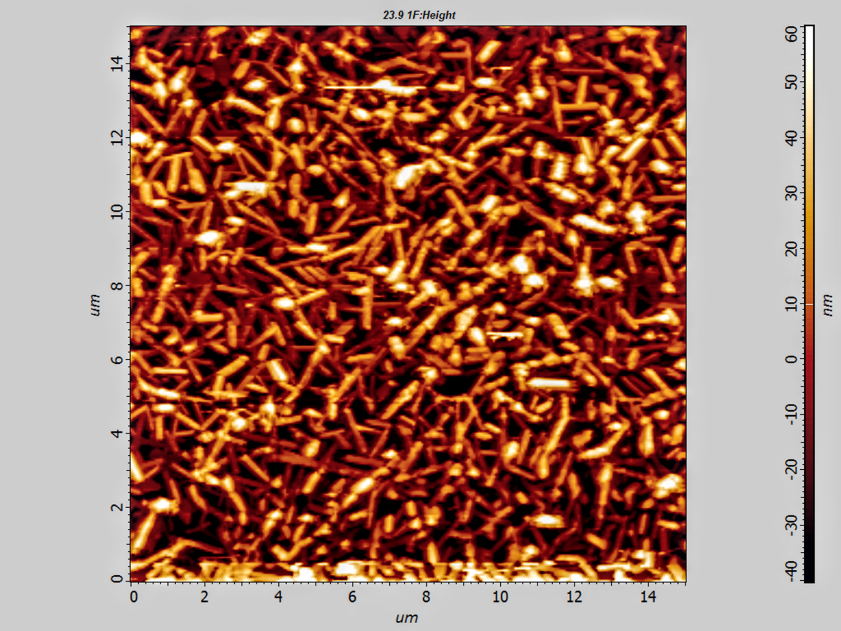
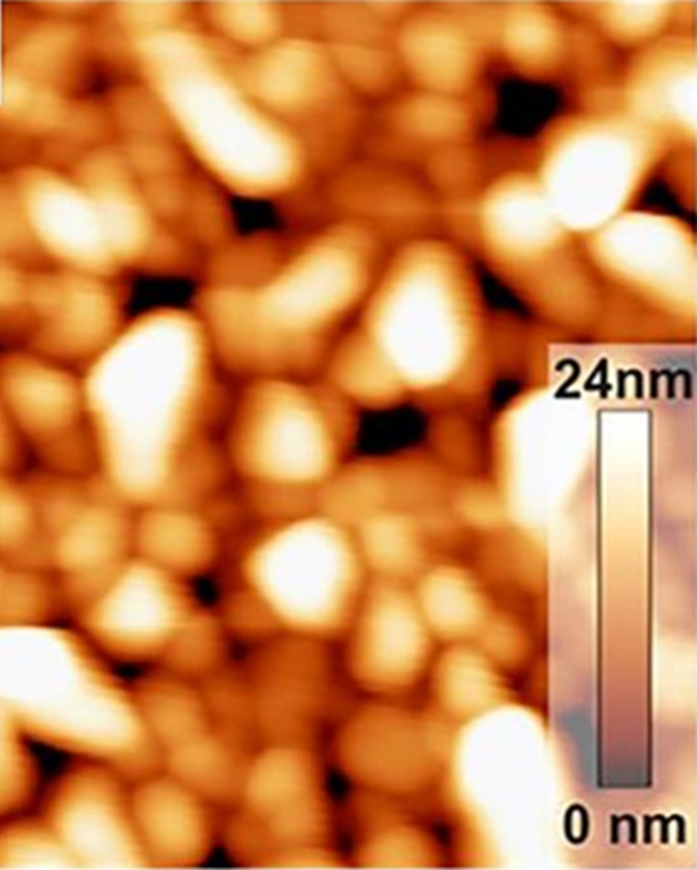
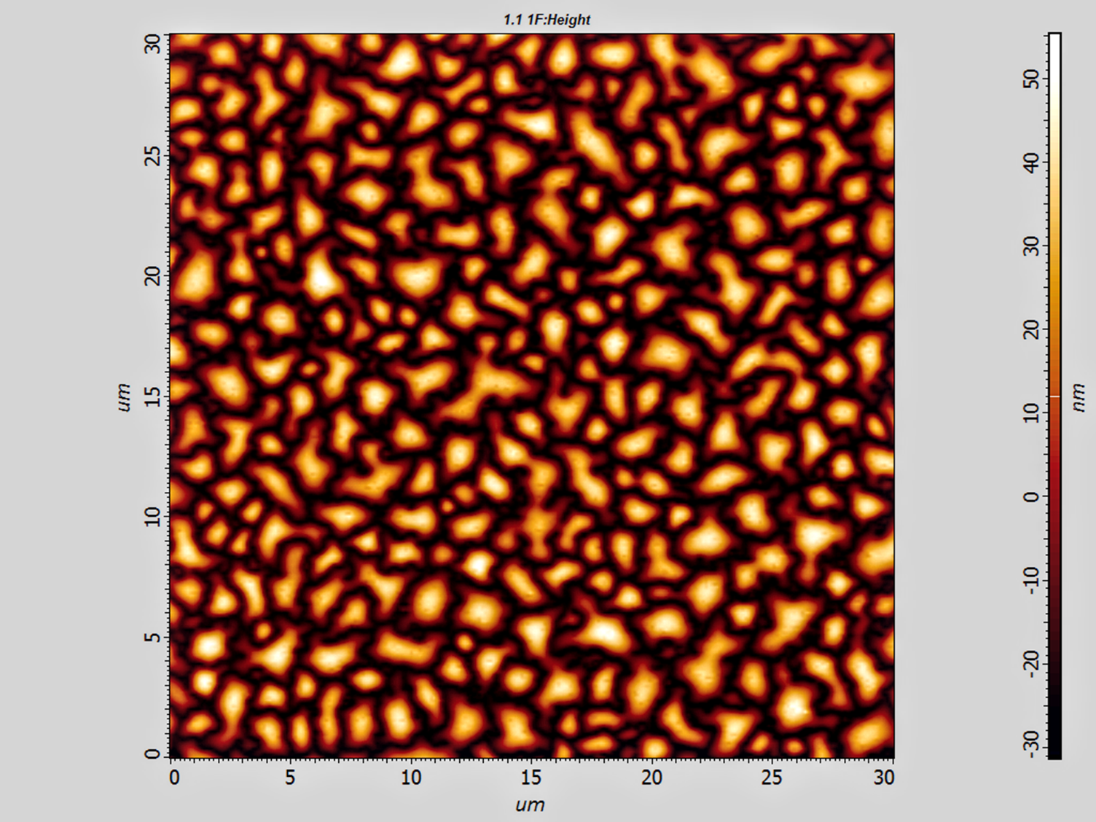
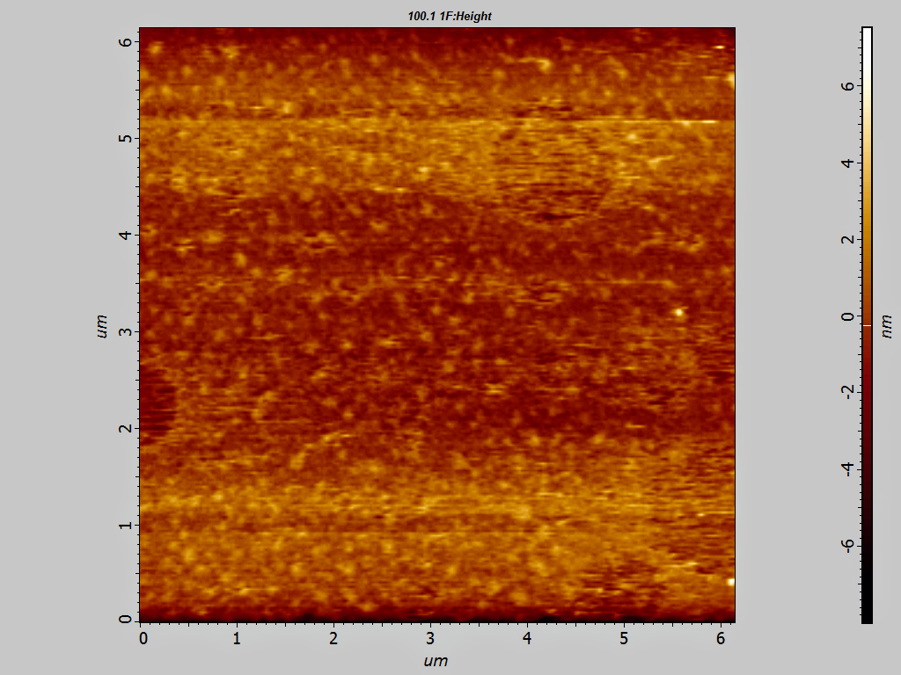
Croconic acid thin film
Room temp – not good (15x15 um)
-33ºC – better (8x8um)
Stamping method on Si (30x30 um)
Towards better, thin films: deposit at -33°C, "Stamping" which is imprinting the molecules directly onto the substrate, then heating them to smooth them out, and applying an electric field to the substrate during deposition using a mesh above the target,
E field on Si (6x6 um)

Slide 10
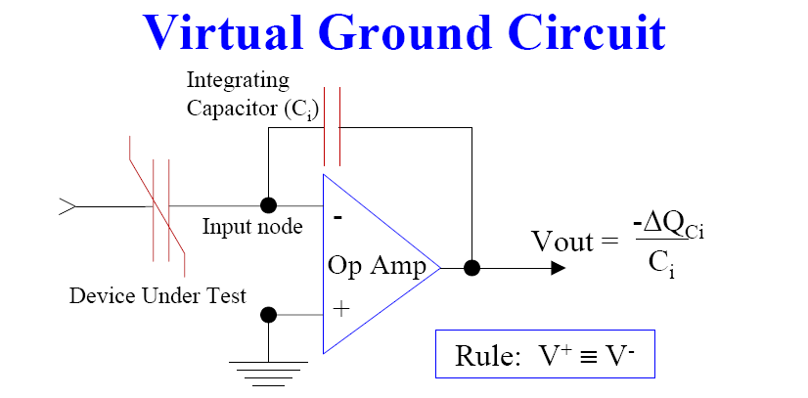
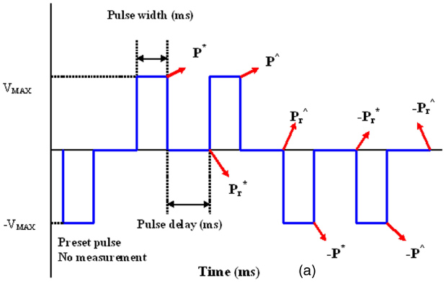
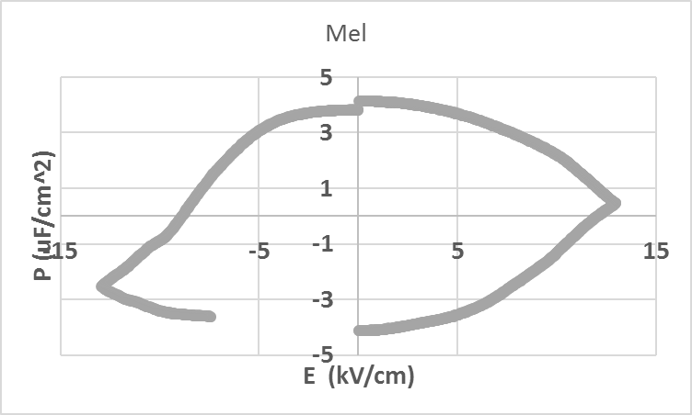
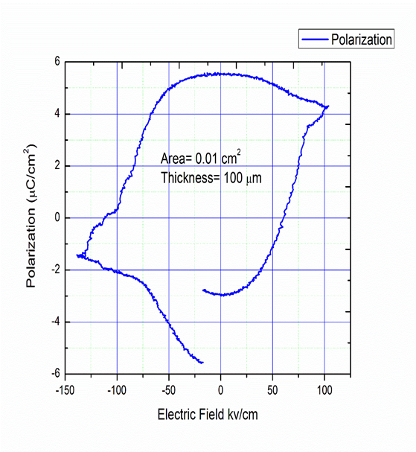
Electronic bulk hysteresis loop measurements
Croconic Acid room temp hysteresis
PUND
First results on newly predicted “Mel”
DIPA-B . Loop very slow 30 seconds!

Slide 11
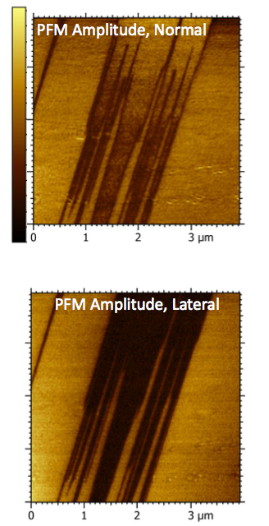
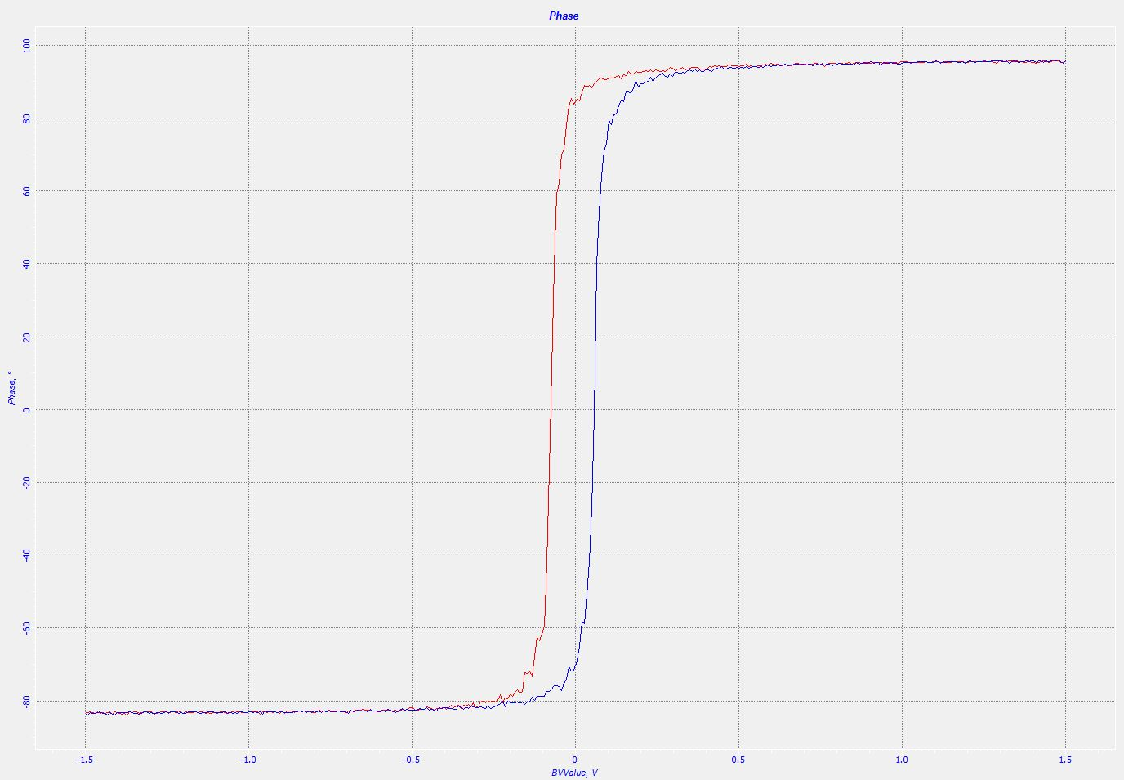
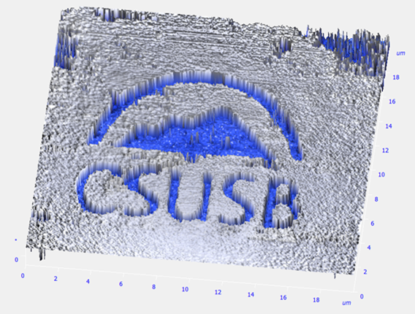
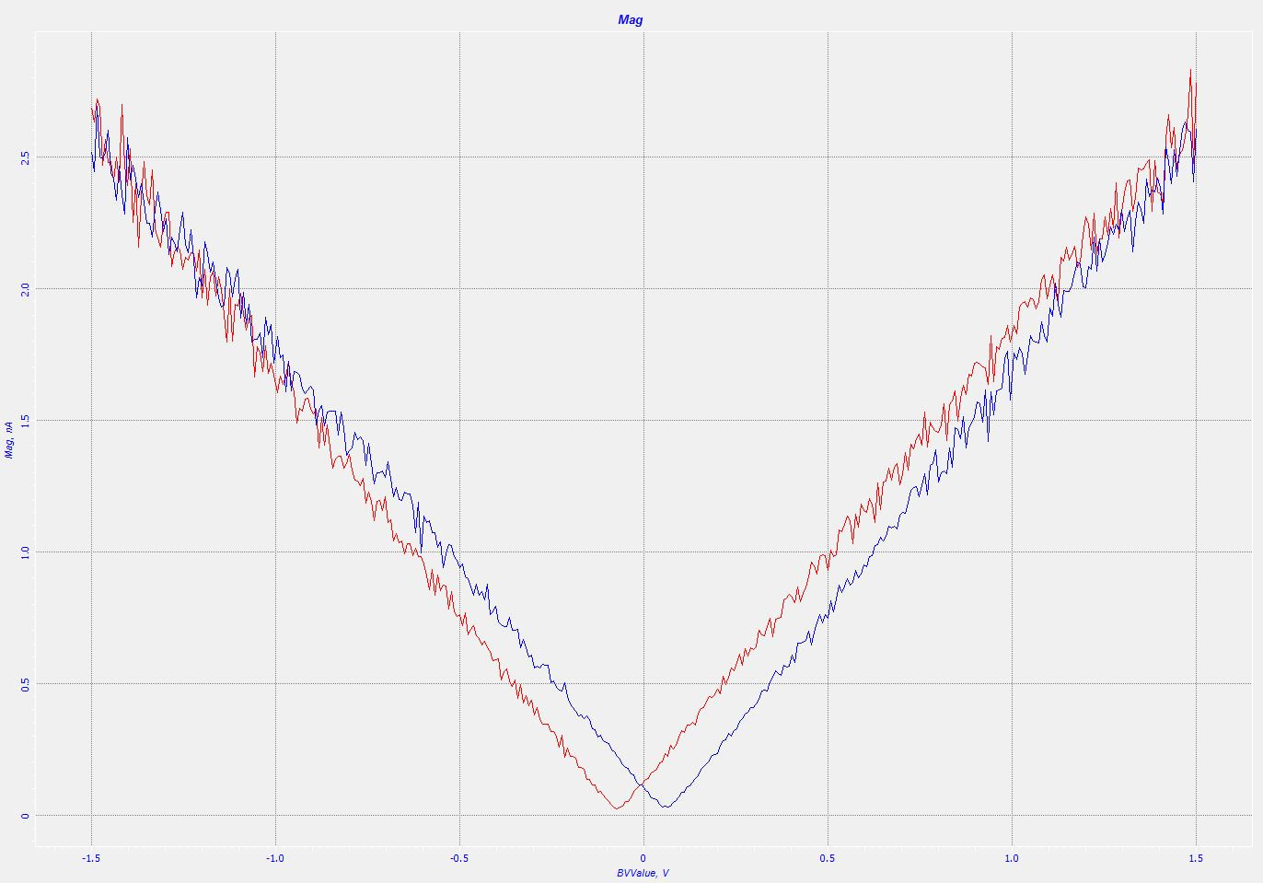
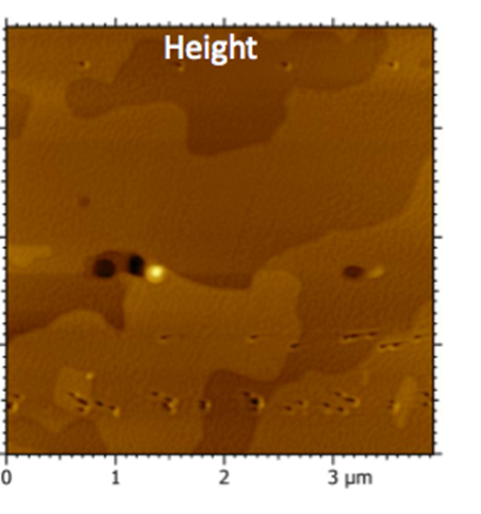
Piezo Force Microscopy PFM
DIPA-B Domains
Croconic Thin Film
Tip NOT scanning
Ferroelectric Lithography:
Very convincing evidence.
BaTiO3
Ferro response( Phase)
Piezo response (magnitude)
Applied field
PFM results can be misinterpreted: Sanwlani, Solid State Communications 2016

Slide 12
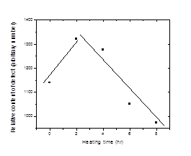
Positron Annihilation Lifetime Spectroscopy
Defect size as well as the relative defect content increases during the initial thermal treatment time, and both subsequently decrease with longer heating times. Croconic Acid.
(left) Positron lifetime and corresponding defect size vs. heating time; (right) Positron intensity vs. heating time during thermal treatment
Relative content of defects vs. heating time (The lines are eye-guides)
F. Guzman, … R. Zhang, Mat. Sci. Forum, 2016
Correlation between the spontaneous polarization and the relative defect content

Slide 13
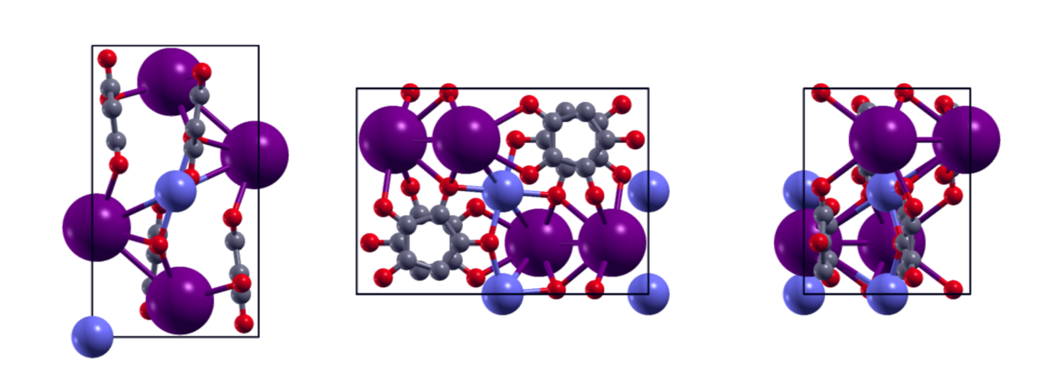
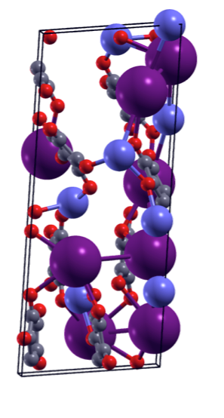
twinning models--theory
Cesium Sodium Croconate “Red” puzzle
predicted non ferro/piezo
confirmed non ferro but strong piezo-like response
violently breaks apart when heated
Red unit cell
Red unit cell aligned & appended to cell with 0.1.1 axis rotation
as seen in X-ray studies
introduces significant asymmetry
Energetically unfavorable twin boundary
Notes:
Red is centrosymmetric and therefore predicted to have no electroactivity
X-ray studies show significant twinning in most samples; the twin boundary is both asymmetric, as required for piezoelectric like behavior, and significantly destabilizing: the material with alternating twinning boundaries, which would be highly unlikely in nature has an energy 3.08 eV higher than the untwinned symmetric cell.

Slide 14


Welcome collaborations
Expand experimental techniques
SHG
Solve Red Puzzle
Acknowledgements
Axel Enders (STM), Xiaoshan Xu (CA films), Alexei Gruverman (PFM)
This work was supported by the National Science Foundation (NSF) through the Nebraska Materials Research Science and Engineering Center (MRSEC) (grant No. DMR-1420645).”
This work was also supported by the National Science Foundation (NSF) through the California State University San Bernardino Center for Research Centers of Research Excellence in Science and Technology (CREST) HRD - 1345163
http://materials.csusb.edu
tusher@csusb.edu

