Slide 1
Create a domestic expense report with Hotel expense

Slide 2
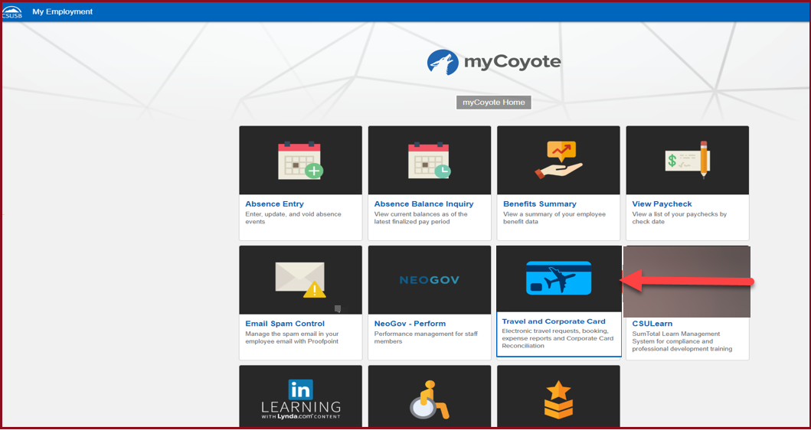
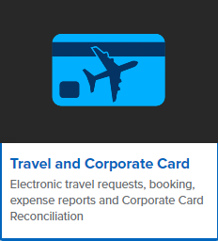
On the single sign on page, type in your mycoyote ID and password, hit enter and then either choose My Employment or, Administrative Systems and click on the Travel and Corporate card Icon as shown below:

Slide 3
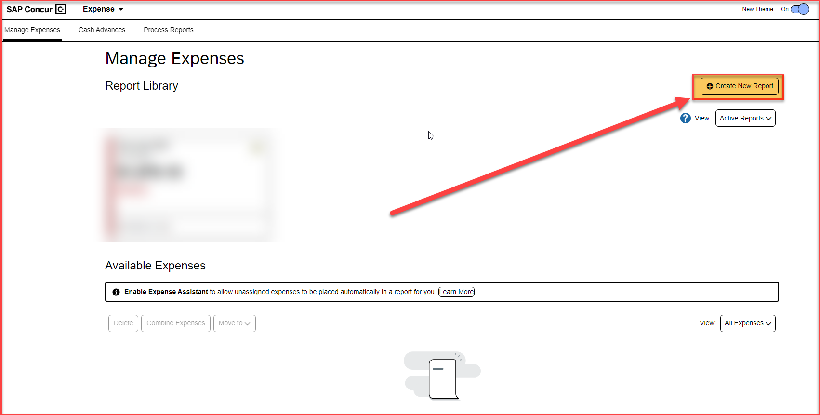
To begin the expense report, click on Create New Report

Slide 4
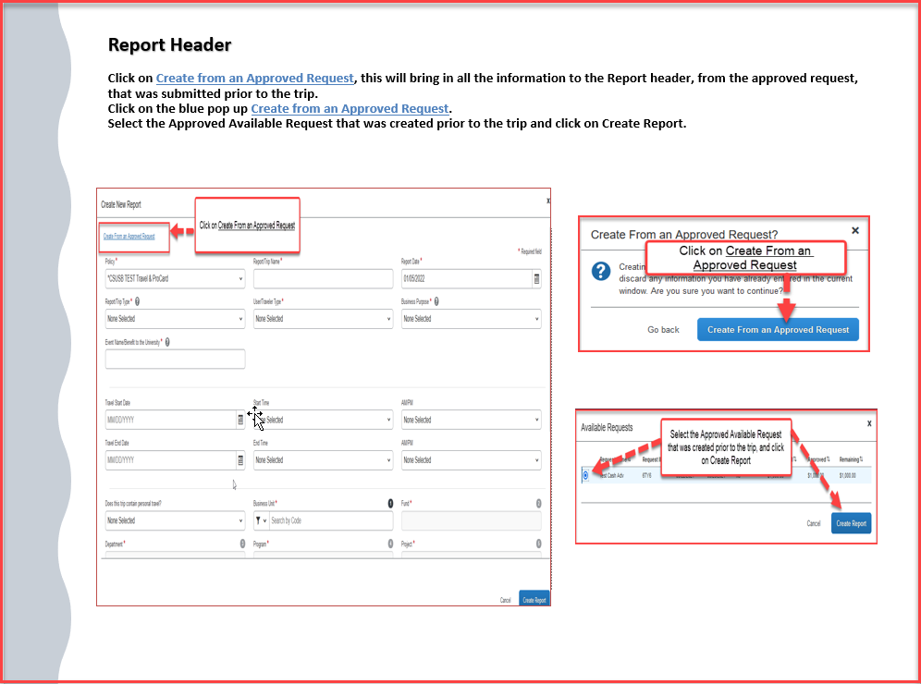

Slide 5
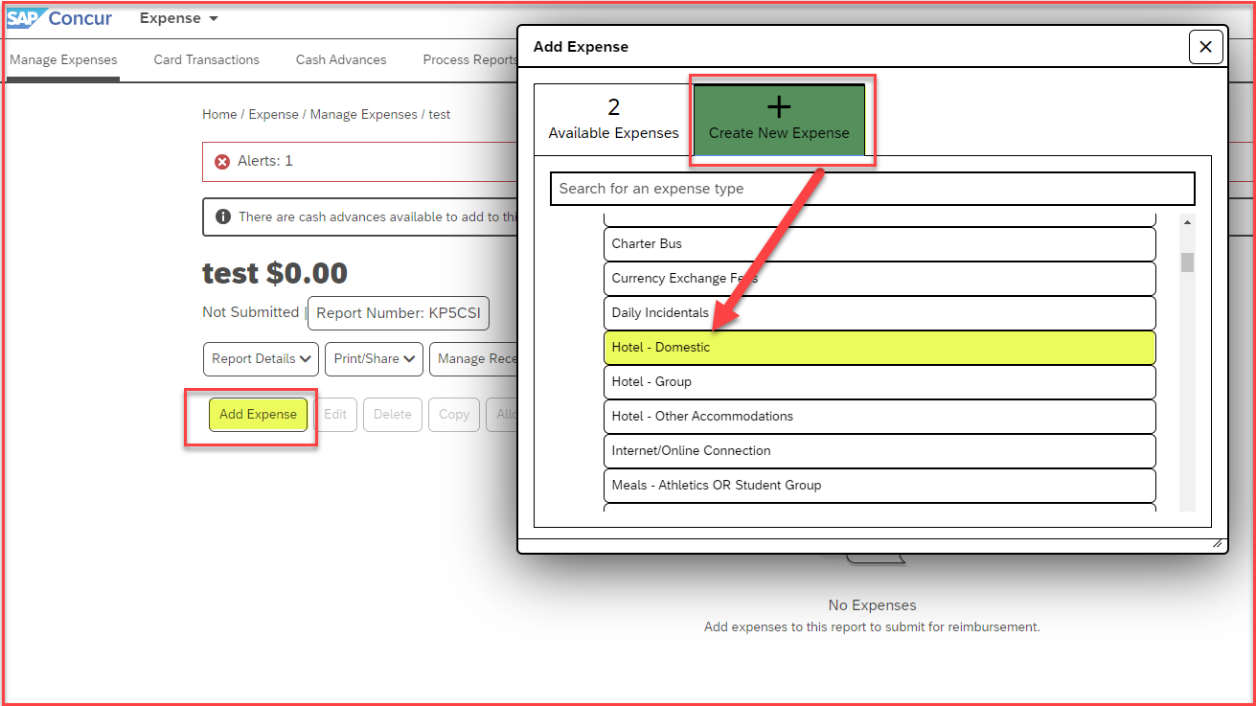
To add the Hotel expense, click on Create New Expense > Hotel-Domestic. For Hotel expenses, that involve a group of students, select Hotel – Group. For any other accommodation, like Airbnb, select Hotel - Other Accommodation.

Slide 6
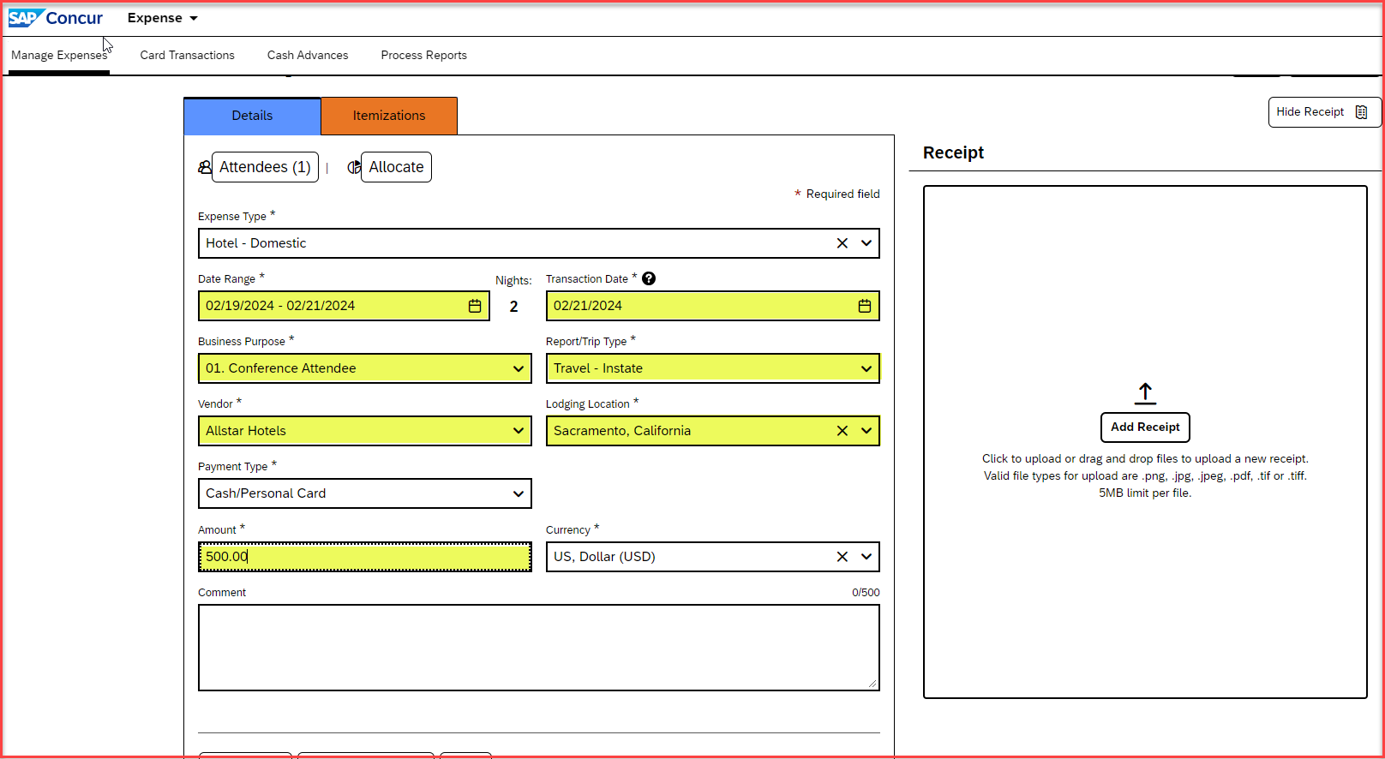
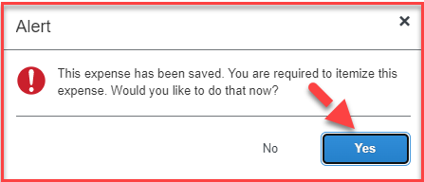
Add the Date Range(Check-in date and Check-out date), the Business Purpose, the Report/trip Type, Vendor, Lodging Location and the Amount. Once all that is entered, Save Expense.
Once the expense is saved, an alert will come up to itemize the expense
Click on “Yes”, to proceed

Slide 7
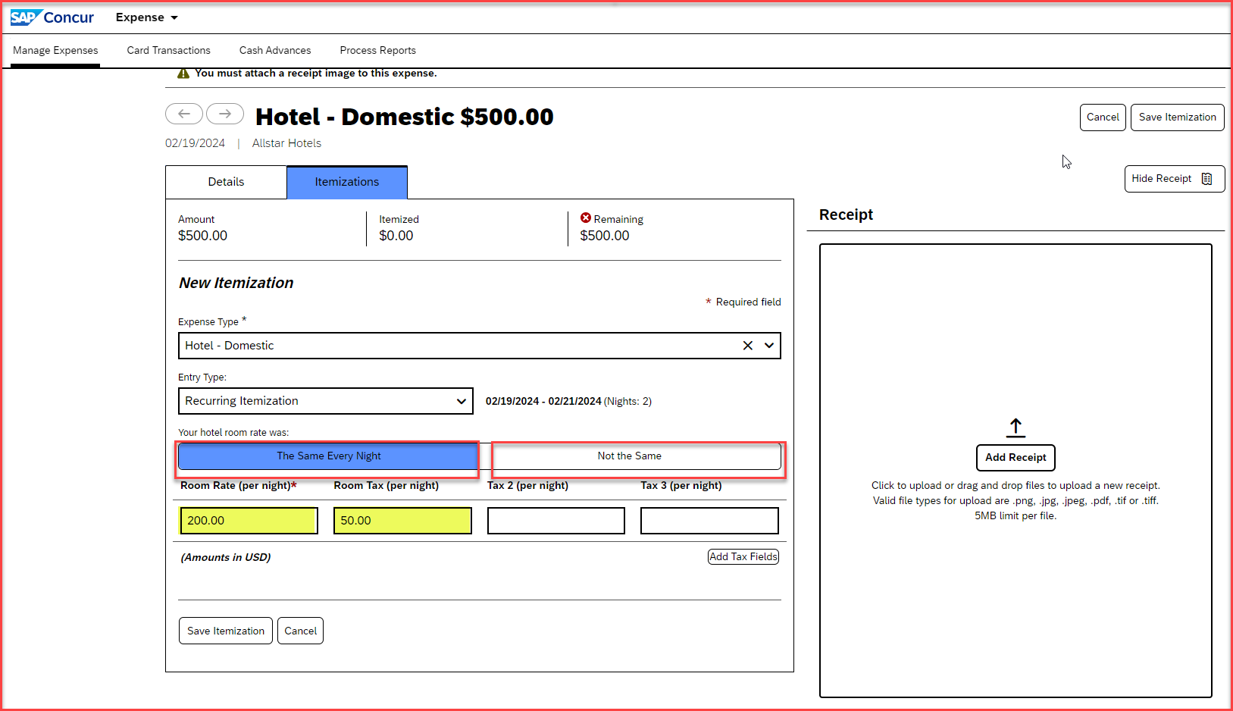
Adding Itemizations for hotel expense
Depending on whether the amounts are the same for every night, choose the box – The Same Every Night, or – Not the Same box, for different rates.
Enter the Room Rate(per night) and Room Tax(per night)
Save Itemization

Slide 8
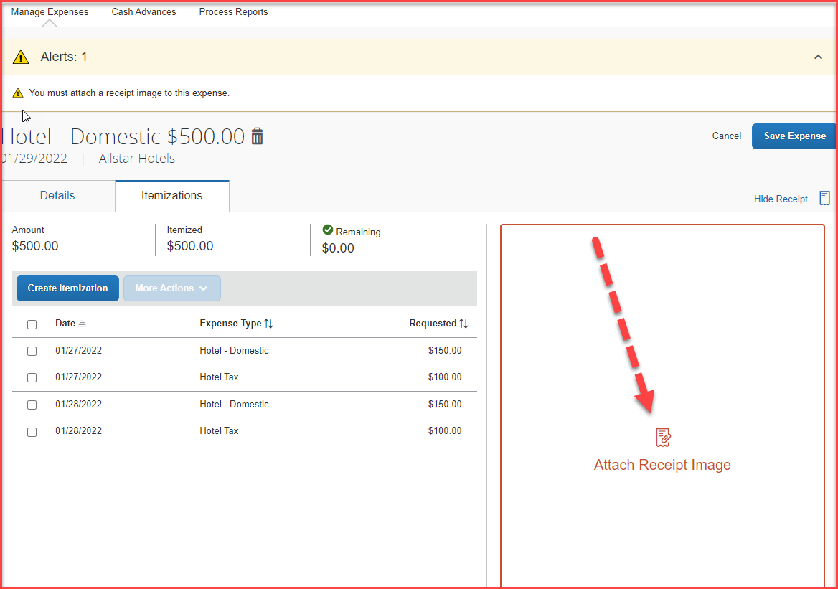
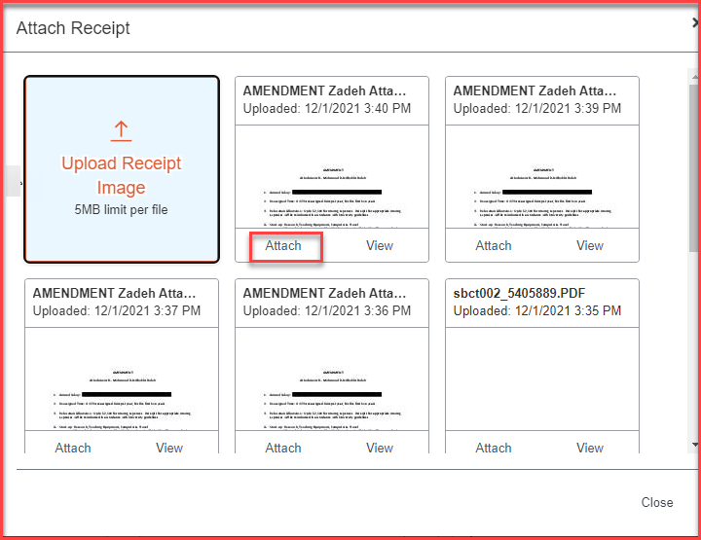
Attaching Receipts
Once the itemizations are saved, click on Attach Receipt Image
The receipt can be uploaded from the receipt library, or, from the folder where the receipt is saved
Click on Attach and save expense

Slide 9
THANK YOU!
If further information or assistance is needed, please do not hesitate to contact Accounts Payable/Travel at 909-537-3158
Notes:
Updated August, 2017 CL

