Slide 1
Cisco IP Phone & Agent Training
California State University
San Bernardino
Finesse
Agent Desktop Training

Slide 2
AGENT TRAINING OVERVIEW
Agent - Finesse
Agent Log-In & Agent Log-Out
Agent State Changes
Basic Call Features
Inbound/Outbound Calling
Hold/Resume
Transfer and Conference
_ Reports
My History
My Stats

Slide 3
Cisco Finesse
Version12
AGENT DESKTOP

Slide 4
AGENT LOG-IN
Log-in Procedure
Open your Internet Explorer and type in the following website address http://sbccxpub01.csusb.edu:8445/desktop
Bookmark the link
NOTE: Ignore references to Chat or Email in the desktop. They are not implemented at this time.

Slide 5
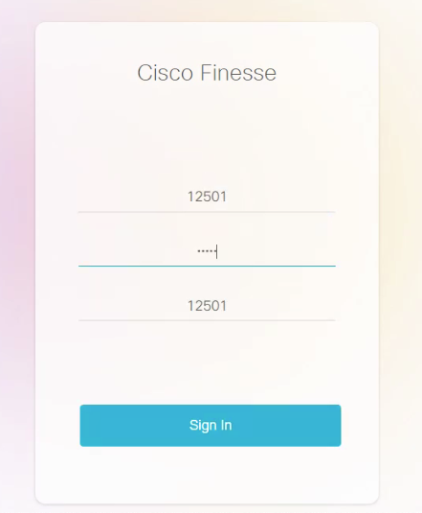
AGENT LOG-IN
Credentials
Use your computer network logonID and password.
Enter the extension of the agent phone.

Slide 6
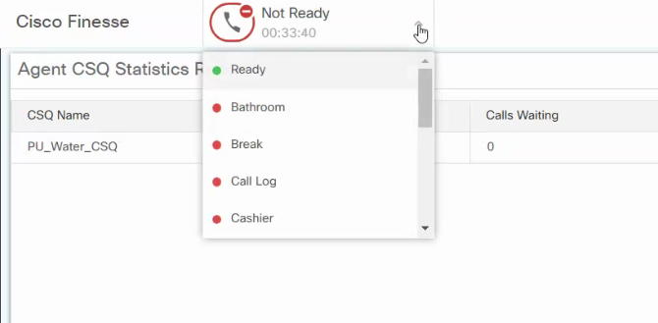
AGENT STATUS CHANGE
Go “Ready” Status
Click where it says, “Not Ready” and select “Ready”
You are now “Ready” to take calls

Slide 7
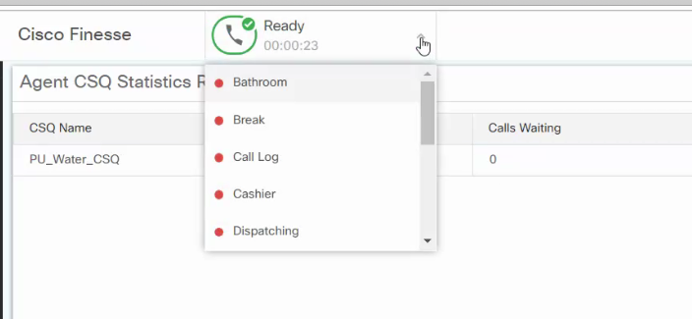
AGENT STATUS CHANGE
Go “Not Ready” Status
Click where it says “Ready” and select “Not Ready”
You are now “Not Ready”. Some Teams will have Reason Codes that you select. This will display as your status.

Slide 8
Finesse Buttons
NOTE: Finesse will not show all buttons on the desktop. It only shows those that apply to your current state.
Waiting for a call.
On a call, talking.

Slide 9
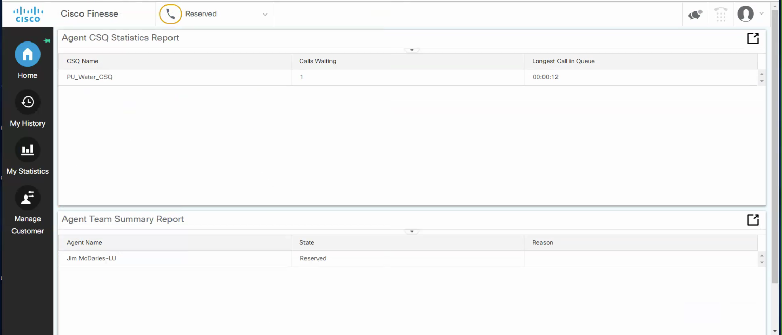
QUEUE CALL CONTROL
Answer Calls:
Before you are offered a call, you will go into a “Reserved” state for a brief period of time.

Slide 10
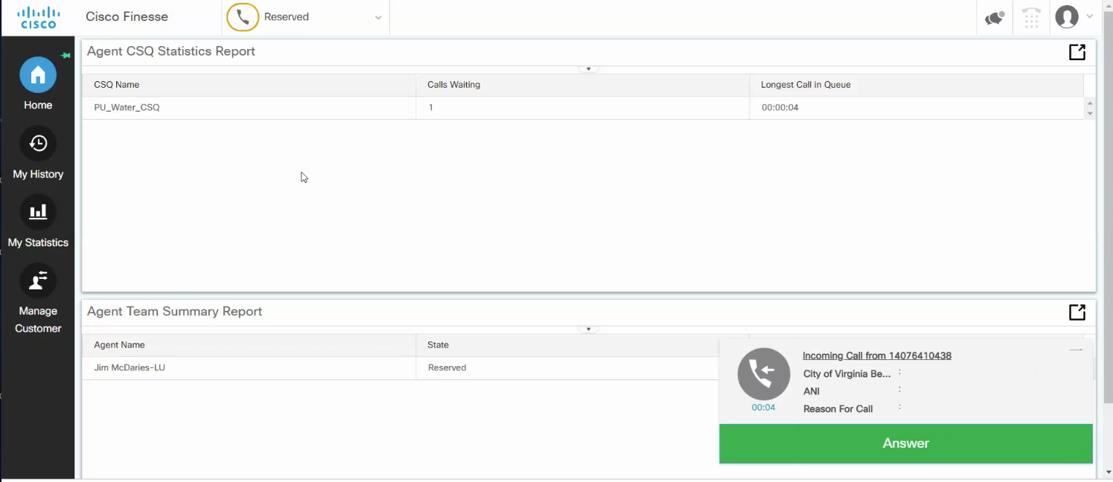
QUEUE CALL CONTROL
Answer Calls:
When you are offered a call a small window will pop in the lower right of your browser. Click “Answer” to be connected with the call.

Slide 11
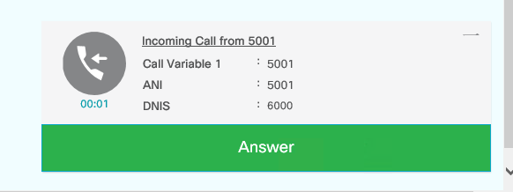
QUEUE CALL CONTROL
Answer Calls:
Clicking on the small bar in the upper right reduces the window size.
From this:
To this:

Slide 12
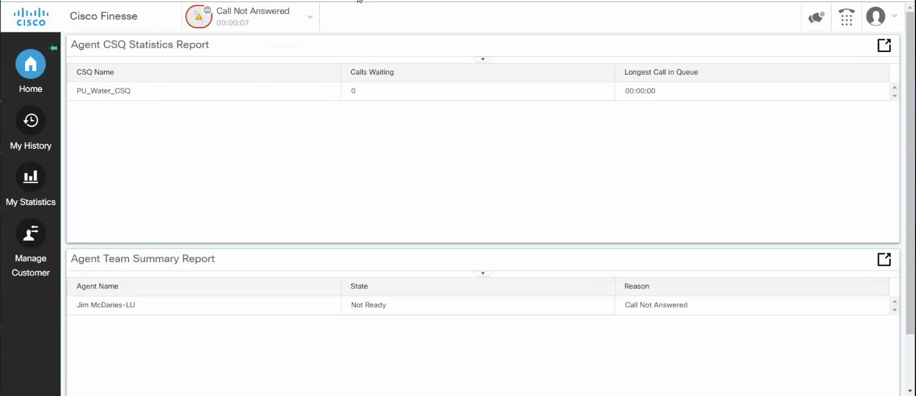
RONA
Unanswered call from Queue
If you miss a call from the Queue the system will note that you have an missed a call and make you “Not Ready”.
You will need to click on the drop down to go Ready and receive calls.

Slide 13
CALL CONTROL
Agent Call Hold/Resume- buttons appear when you are on a call.
On an active call, click on the “Hold” button to place the caller on hold. The caller will hear music on hold.
Click on the “Retrieve” button to resume the call.

Slide 14
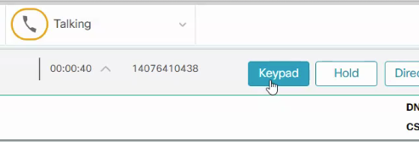
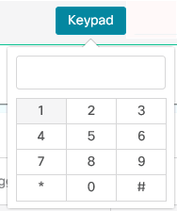
CALL CONTROL
Entering Digits When Prompted
When prompted to enter digits by an IVR, voicemail system, etc…
Enter the number into the keypad.

Slide 15
QUEUE CALL CONTROL
Agent Call Direct Transfer (Or Blind Transfer)
On an active call, click on the “Direct Transfer” button in order to transfer the call without consulting with the recipient.

Slide 16
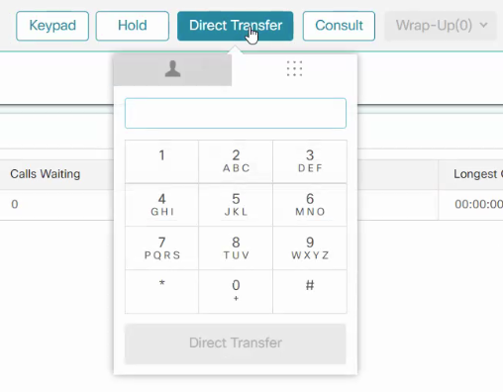
QUEUE CALL CONTROL
Agent Call Direct Transfer (Or Blind Transfer)
The dial pad for the direct transfer will open. Enter the number you wish to transfer the call to.
Enter the number you want to Direct Transfer to

Slide 17
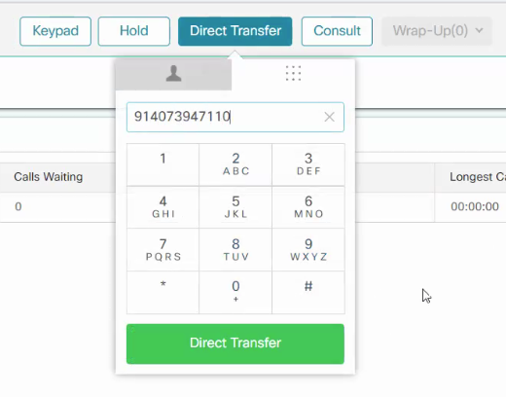
QUEUE CALL CONTROL
Agent Call Direct Transfer (Or Blind Transfer)
Press the green “Direct transfer” button to complete the direct transfer

Slide 18
QUEUE CALL CONTROL
Agent Call Consult Transfer/Conference
A ”Consult” will activate a Consult Transfer or a Consult Conference call depending on which one is needed
A “Consult Transfer” Is a Supervised/Warm Transfer.
A “Consult Conference” is when you bring multiple calls to the same call(A conference call).
.

Slide 19
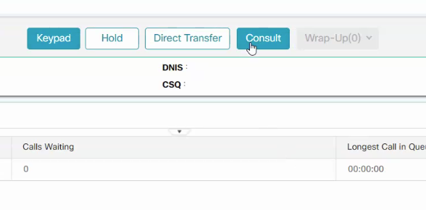
QUEUE CALL CONTROL
Agent Call Consult Transfer/Conference
On an active call, click on the “Consult” button

Slide 20
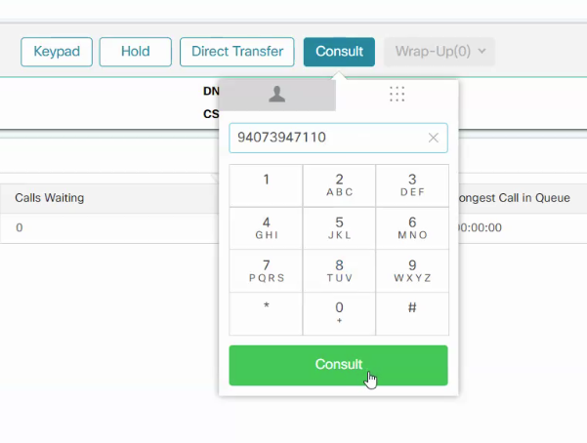
QUEUE CALL CONTROL
Agent Call Consult Transfer/Conference
The dial pad for the “Consult” will open. Enter the number you wish to transfer/conference the call to.
Press the green “Consult button to complete the consult transfer.
Enter the phone number
Click on the Consult button

Slide 21
QUEUE CALL CONTROL
Agent Call Consult Transfer/Conference Cont’d
Once you have connected you have 3 choices.
Retrieve- reconnect with your caller.
Transfer- send the caller to the person you consulted.
Conference- put all three calls into a conference call.

Slide 22
CALL CONTROL
Agent Call Consult Cont’d
When in Consult both call connections will show. The Original call will have“pause” symbol and the consult has the “phone” symbol The “pause” is on hold and the “phone” is the active call.
Original Call
Consult Call

Slide 23
QUEUE CALL CONTROL
Agent Call Consult Cont’d 2
If there is a need to “Bounce” back and forth between the original caller and the consult call, press the “Retrieve” button. This will bring the call that is on hold back and put the active call on hold.
Original Call
Consult Call
-------------------------------------------------------------------------------------------------------------
Original Call
Consult Call

Slide 24
QUEUE CALL CONTROL
Agent Call Consult Cont’d 3
When finished with the consult call make sure the original call is the active call and end the consult call.
Original Call
Consult Call

Slide 25
QUEUE CALL CONTROL
Agent Call Hang-up
Click on the “End” button to terminate your call or to drop out of a Conference call. The conference will continue for the other callers.

Slide 26
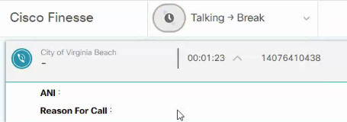
QUEUE CALL CONTROL
Post Call Pending Status
During an Active call, select “Ready” or “Not Ready”
State will show current state with an arrow to the pending state.
When the call ends you will go immediately into the state chosen.

Slide 27
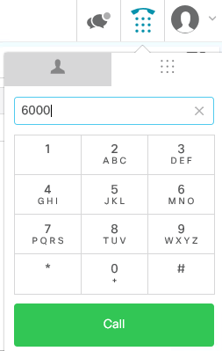
OUTBOUND CALLING
Make Outbound Calls
Click on the keyboard icon
Enter the number you wish to dial and press “Call”

Slide 28
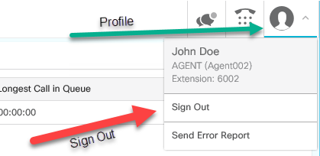
AGENT LOG-OUT
Agent End of Shift Procedure
Click on the “Ready” button and select “Not Ready”
Click on the “Profile” button and select “Sign Out”
Note: Logging out is only possible when the agent is in “Not Ready” status

Slide 29
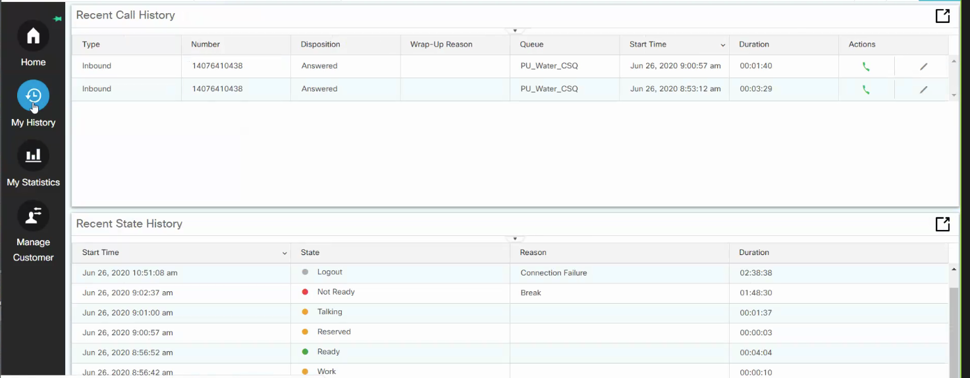
My History Report
Clicking on My History will show you your Calls and State changes for the day

Slide 30
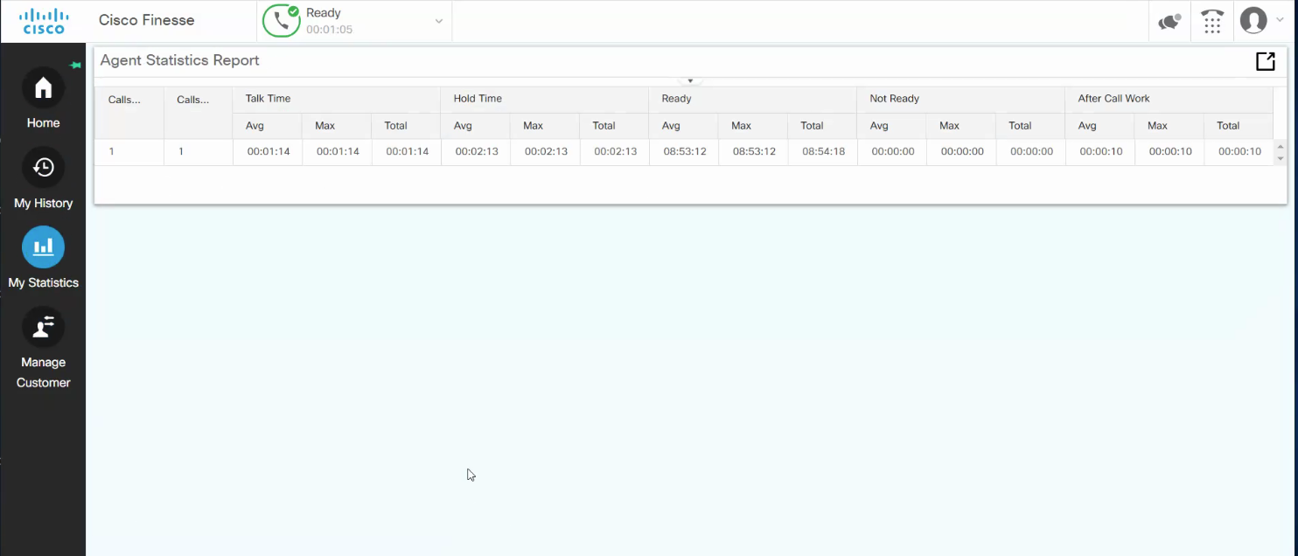
My Statistics
Clicking on My Statistics will show you the number of calls and stats for the day

Slide 31
END

